Slide 1
Conference of European Statistics Stakeholders 2018
Bamberg, 19 October 2018
Statistical literacy:
A key to comprehend a changing world
Patrizia Collesi - Istat
Statistical literacy – Directorate for development of statistical literacy information and literacy

Slide 2
Statistical literacy: a key to comprehend a changing world
At Istat the Directorate for development of statistical literacy information and literacy has the task to promote the capacity to use statistical information for several purposes, among which:
Making informed decisions
Making evaluations for work and everyday life
CESS 2018 - Bamberg, 19 October 2018

Slide 3
Statistical literacy: a key to comprehend a changing world
Istat as a provider:
should develop the demand: answers can be found in available statistics
needs to understand what lacks in the offer
has a potential to grow as a provider:
Adapting what is available
Bridging the gaps
CESS 2018 - Bamberg, 19 October 2018

Slide 4
Statistical literacy: a key to comprehend a changing world
Istat as a provider:
Is prepared for latend demand of new information
what is in,
what should be added
CESS 2018 - Bamberg, 19 October 2018

Slide 5
Statistical literacy: a key to comprehend a changing world
Statistics at school and out of school, as part of lifelong learning, starting from schools, a cross-section ability
A project to relaunch statistical literacy, in four main axes:
At national level (for general projects to be managed at central level)
At regional level (a network at territorial level to develop initiatives)
CESS 2018 - Bamberg, 19 October 2018

Slide 6
Statistical literacy: a key to comprehend a changing world
Statistics at school and out of school, as part of lifelong learning, starting from schools, a cross-section ability
A four-axes strategy:
1. Proposals for a pervasive and reasoned use of statistics in all curricular subjects/topics at school:
Humanities, social sciences, STEM disciplines, statistical and quantitative literacy
Underline the importance of the official statistics and not simply quoting figures without sources
CESS 2018 - Bamberg, 19 October 2018

Slide 7
Statistical literacy: a key to comprehend a changing world
Statistics at school and out of school, as part of lifelong learning, starting from schools, a cross-section ability
A four-axes strategy:
2. Statistical toolbox, intended as a contribution to critical reasoning
Recognition of regularity, capacity for statistical synthesis, interpretation of reality through models: numeracy
Re-engineering of existing materials on the website
CESS 2018 - Bamberg, 19 October 2018

Slide 8
Statistical literacy: a key to comprehend a changing world
Statistics at school and out of school, as part of lifelong learning, starting from schools, a cross-section ability
A four-axes strategy:
3. Statistics not limited to school channels, funny ways as well, gamification
CESS 2018 - Bamberg, 19 October 2018

Slide 9
Statistical literacy: a key to comprehend a changing world
Statistics at school and out of school, as part of lifelong learning, starting from schools, a cross-section ability
A four-axes strategy:
4. Development of interest and quantitative literacy of adults:
Lifelong learning and adult competencies.
Cooperation with the project of financial education
CESS 2018 - Bamberg, 19 October 2018

Slide 10
Statistical literacy: a key to comprehend a changing world
One of the main point of the project of statistical literacy is the standardization of initiatives.
All initiatives must be standardized/-able and uniform at territorial level for several reasons:
Time constraints
Reasources constraints
Budget constraints
Teachers training
CESS 2018 - Bamberg, 19 October 2018

Slide 11
Statistical literacy: a key to comprehend a changing world
Standardization
Istat should appear in a unique/sole/single manner, strong governance of the activity with different cases:
Top-down initiatives:
start from the DCSI and reach the territorial network as a standard and with a coordinated image. Improve Istat image on the supply side (as a producer of the kowledge service offered by statistics)
Bottom-up initiatives from the territory
Local projects are evaluated and sometimes modified to become “national” projects, and as standards are carried out on the territory.
It is a way to put int production a “new chain” of products activated by territorial demand
One-shot initiatives: start at territorial level and are not applicable for other regions
CESS 2018 - Bamberg, 19 October 2018

Slide 12
Statistical literacy: a key to comprehend a changing world
Nothing needs to be created but networks and sinergies need to be created and activated again
Istat as statistics leader should be partner in projects, not necessarily new projects, also existing projects and bring there the interdisciplinarity of statistics.
With this vision we are currently developing partnerships:
With an Open data project fo the monitoring of European funds at territorial level directed to students aged 14-18 (ASOC project)
With the Financial education project
In these cases Istat enters as a leader in statistics
CESS 2018 - Bamberg, 19 October 2018

Slide 13
Statistical literacy: a key to comprehend a changing world
The Asoc project
Aimed at secondary school students
With a strong link with the territory
Students monitor the use of European funded projects
They learn how to use data, simple indicators
How to expose concepts with data
CESS 2018 - Bamberg, 19 October 2018

Slide 14
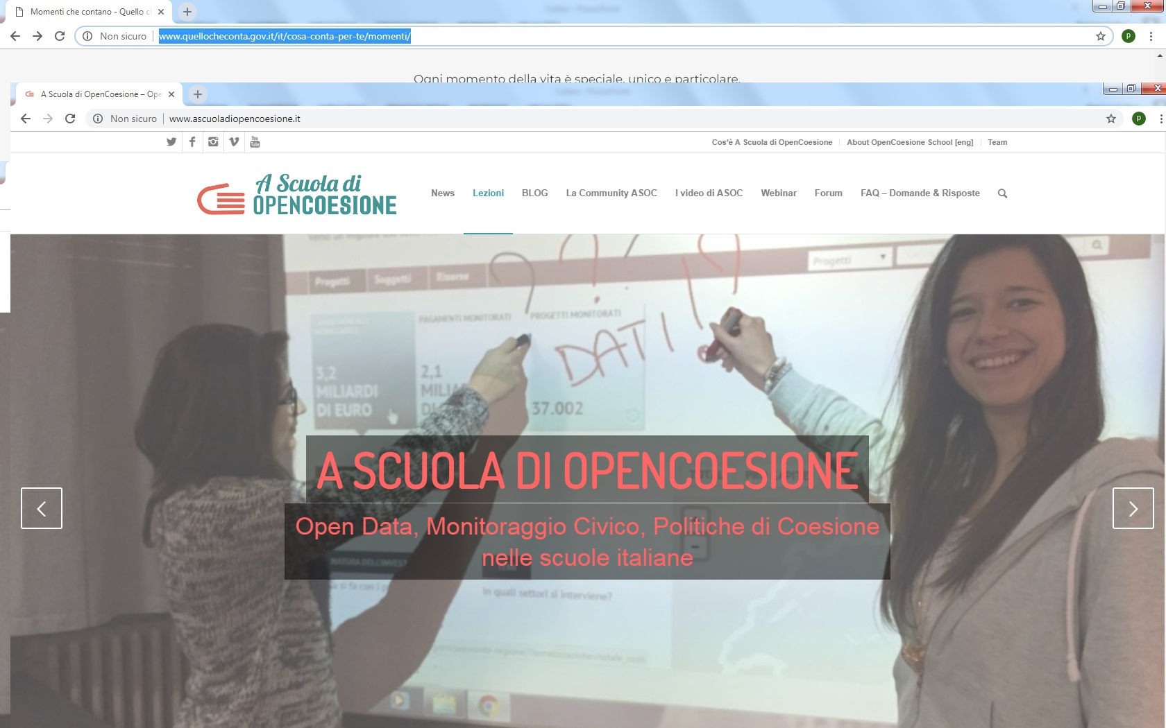
Statistical literacy: a key to comprehend a changing world
The ASOC project
CESS 2018 - Bamberg, 19 October 2018

Slide 15
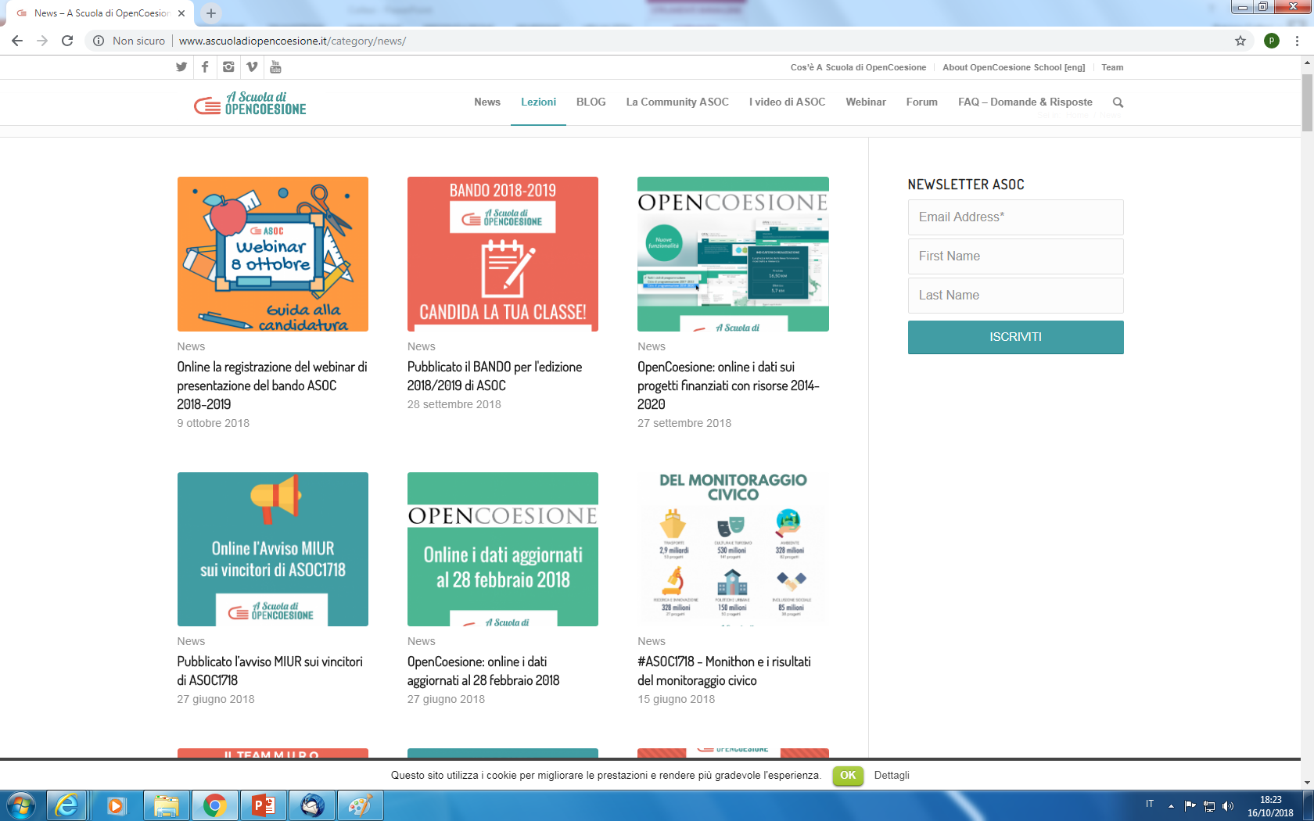
Statistical literacy: a key to comprehend a changing world
The ASOC project
CESS 2018 - Bamberg, 19 October 2018

Slide 16
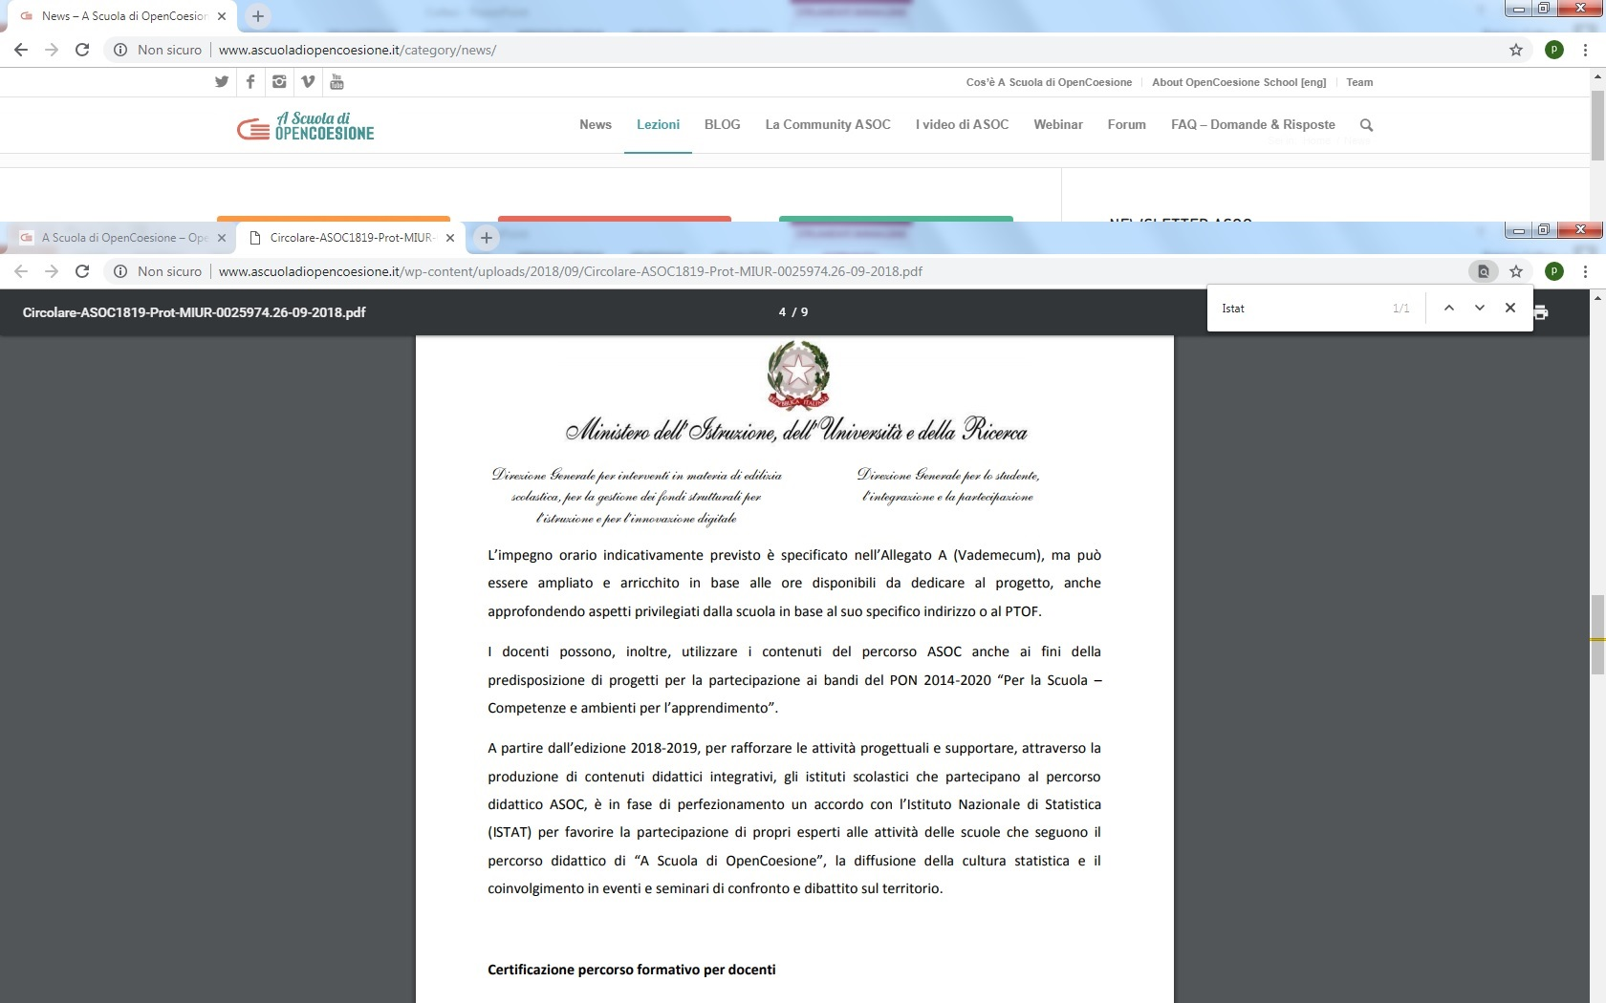
Statistical literacy: a key to comprehend a changing world
The ASOC porject
CESS 2018 - Bamberg, 19 October 2018

Slide 17
Statistical literacy: a key to comprehend a changing world
The financial education project
Istat participates to the interistitutional project of financial education with fact- sheets on topical moments in life
CESS 2018 - Bamberg, 19 October 2018

Slide 18
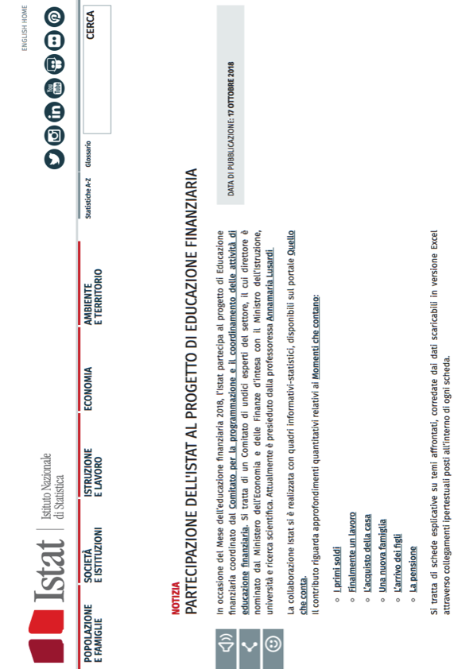
Statistical literacy: a key to comprehend a changing world
Titolo
Luogo, data

Slide 19
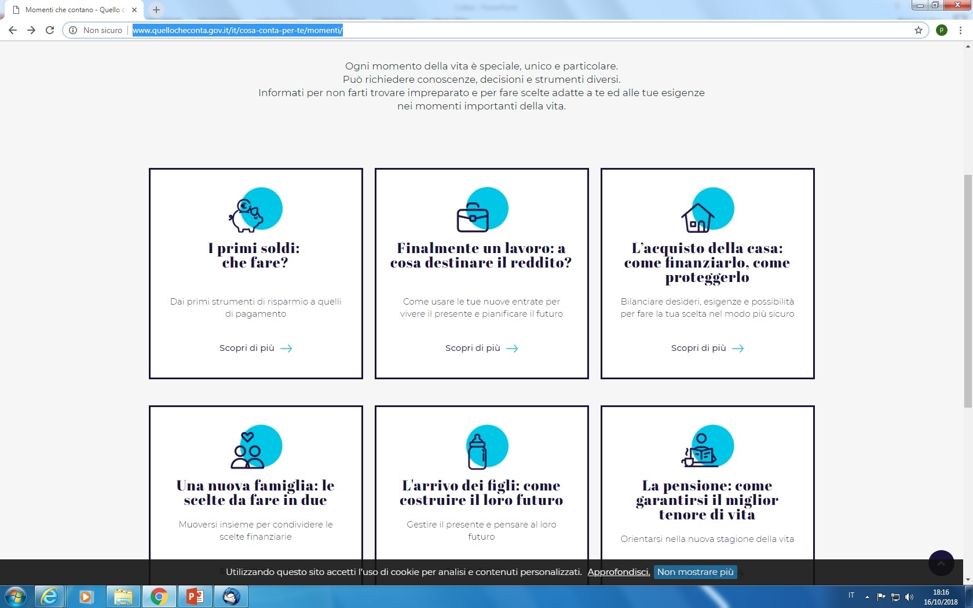
Statistical literacy: a key to comprehend a changing world
CESS 2018 - Bamberg, 19 October 2018

Slide 20
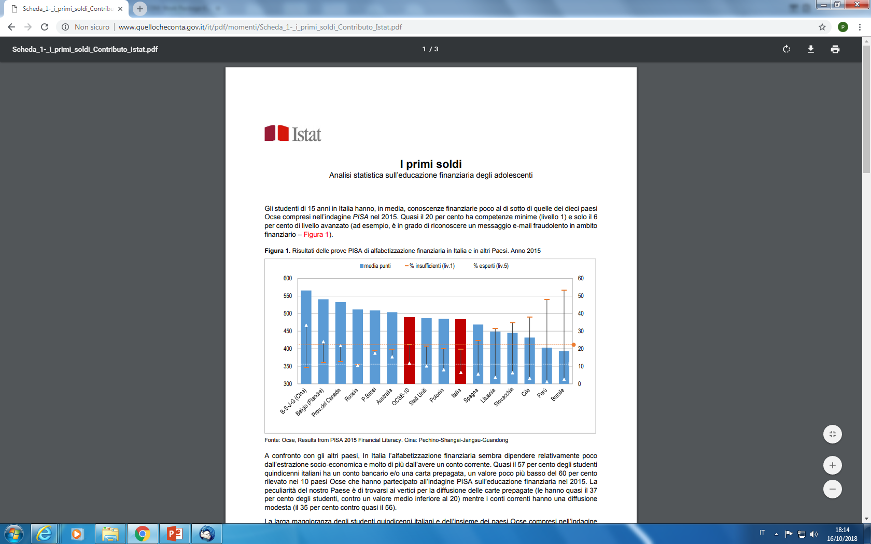
Statistical literacy: a key to comprehend a changing world
Testo testo testo
Titolo
Luogo, data

Slide 21
Statistical literacy: a key to comprehend a changing world
In short the ratio is:
Giving/adding statistical tools in existing projects
Enriching projects with basic data and data already interpreted according to standard statistical methodologies
Participating in national events with shared projects and shared contents
National statistics day,
Celebrations at territorial level European Researchers’ Night with a common catalogue and possibilities to make differences at the regional level
Participation in the project of financial literacy, with fact-sheets on the main topics
CESS 2018 - Bamberg, 19 October 2018

Slide 22
Statistical literacy: a key to comprehend a changing world
Thank you
pcollesi@istat.it
CESS 2018 - Bamberg, 19 October 2018

Slide 23
Statistical literacy: a key to comprehend a changing world
Testo testo testo
Titolo
Luogo, data

