Slide 1
Challenges and Opportunities
with Mobile Phone Data in Official Statistics
Tiziana Tuoto - Istat Italy
Conference of European Statistics Stakeholders
University of Bamberg, Germany, 18–19 October 2018
Joint work with:
Istat team: Fabrizio de Fausti WindTre team: Marcello Savarese Roberta Radini Francesco Fabbri Luca Valentino Maria Rita Spada

Slide 2
Outline
Statistical Outputs from mobile phone data
    Population estimates
    Mobility – Commuting patterns
Data
First results
Lesson learned and open issues

Slide 3
Mobile Phone Data and Population estimates
Recently in NSIs, several experiences of the usage of Mobile phone data (MPD) for population estimates
We experimented their use in the Census transformation program, to enhance the evaluation of undercoverage, we also investigated their use for statistics on mobility/commuting patterns.
Notes:
to validate population estimates
as complementary data source
as primary data source

Slide 4
MPD for Population estimates
MPD provide info on the presence/activity of MP users at a given date (with detailed time) and very small spatial scales.
We firstly investigate the correlation between MPD and population estimates both for residents and by day and daytime.
At first, a small experiment, just one province, PISA

Slide 5
MPD for Population estimates
Basic assumptions:
High level of MP penetration rate
In Italy, the percentage of MP connection per 100 citizen is about 140% in 2016
High level of MP coverage over the field
Known the MP operator market share

Slide 6
The data
We used the Call Detail Records (CDRs), that archive a passive localisation corresponding to the antenna/sector code to which the calling device and the call end antenna has been linked.
In the CDR data we have the localisation, the anonymous SIM (Subscriber Identity Module) who makes the calls, information related to the type (call-in or text mess) and time of the event.
We observed CDRs for 6 weeks

Slide 7
The data at a glance
Number calling SIM per day
Number Call&SMS per day
Holiday
Weekend
Number calling SIM per hours
Number Call&SMS per hours

Slide 8
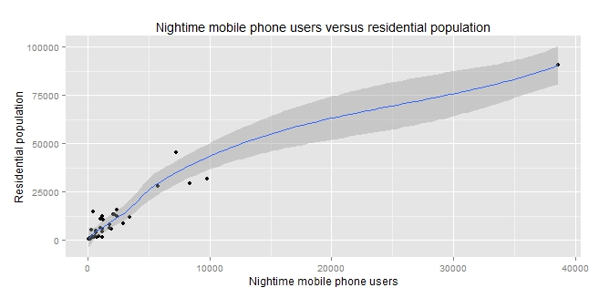
Population estimates: how MPD predict residential population
R² 0.88 including the largest city --- R² 0.77 excluding the largest city

Slide 9
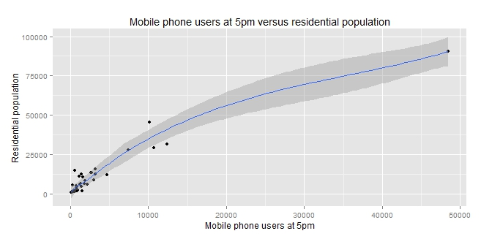
Population estimates: how MPD predict residential population
R² 0.89 including the largest city --- R² 0.79 excluding the largest city

Slide 10
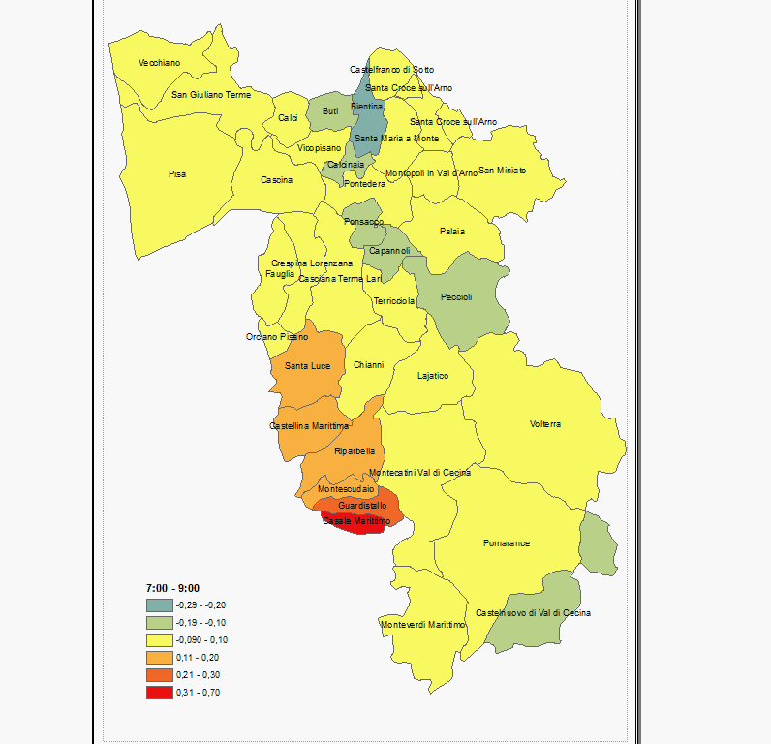
Population changes over the field and over the daytime

Slide 11
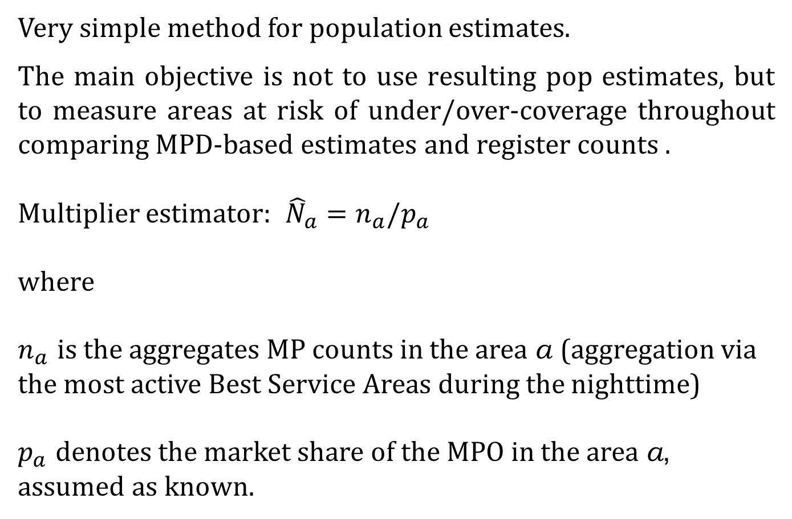
MPD and population estimates
Very simple method for population estimates.
The main objective is not to use resulting pop estimates, but to measure areas at risk of under/over-coverage throughout comparing MPD-based estimates and register counts .
Multiplier estimator: ${\hat{N}}_{a}=n_{a}/p_{a}$
where
$n_{a}$ is the aggregates MP counts in the area a (aggregation via the most active Best Service Areas during the nighttime)
$p_{a}$ denotes the market share of the MPO in the area a, assumed as known.

Slide 12
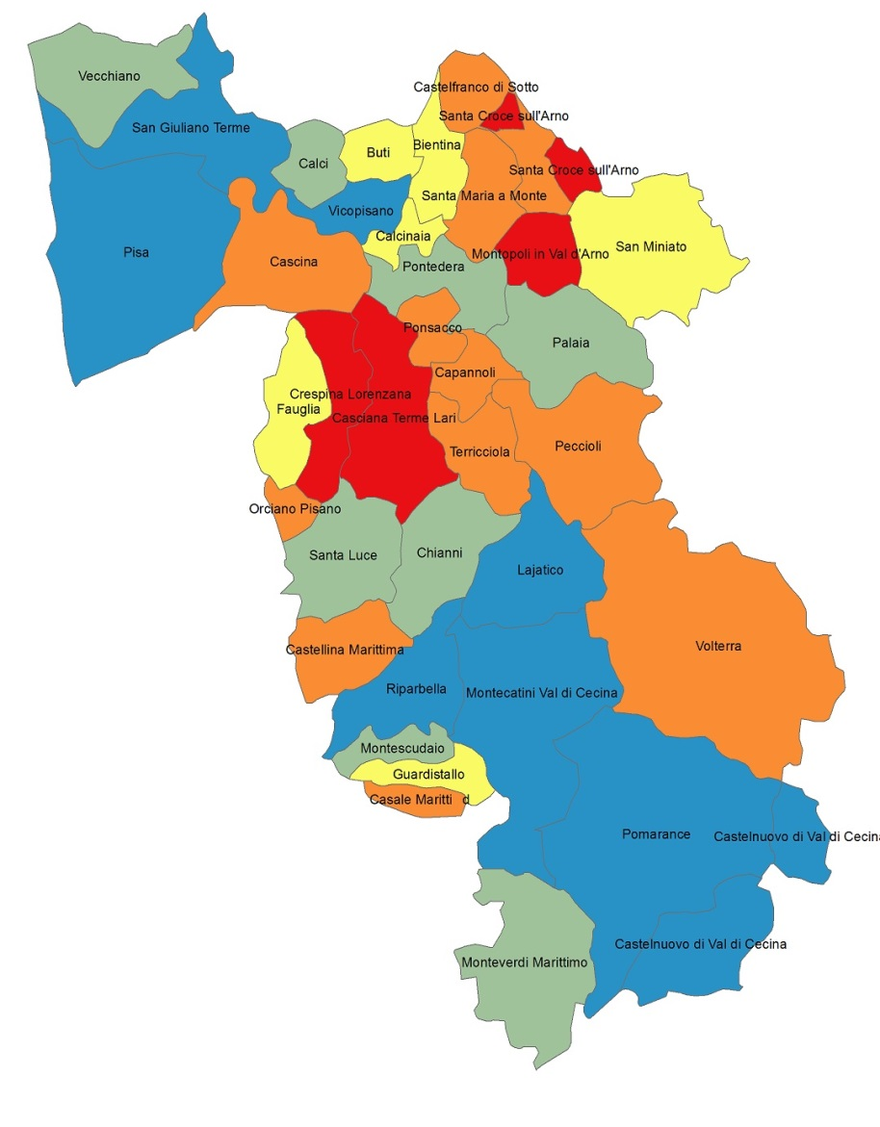
Areas at risk of under/over coverage
The MPD allow us to identify areas that might be problematic for census counts
Risk of coverage | Number of municipalities
High risk of under cov | 8
Moderate risk of under cov | 8
No risk | 6
Moderate risk of over cov | 11
High risk of over cov | 4
Moreover, the MPD provide auxiliary info at small area level

Slide 13
Mobility: OD Matrix
First analysis based on nighttime and daytime population
We are able to define the OD Matrix for the Pisa Province
First results: about 30% of the nighttime population moves within the province, while 70% remains at the nighttime municipality, that is in line with our knowledge form other sources.
Compared to other sources:
We cannot distinguish the reason of the mobility
We can assess the frequencies of the mobility

Slide 14
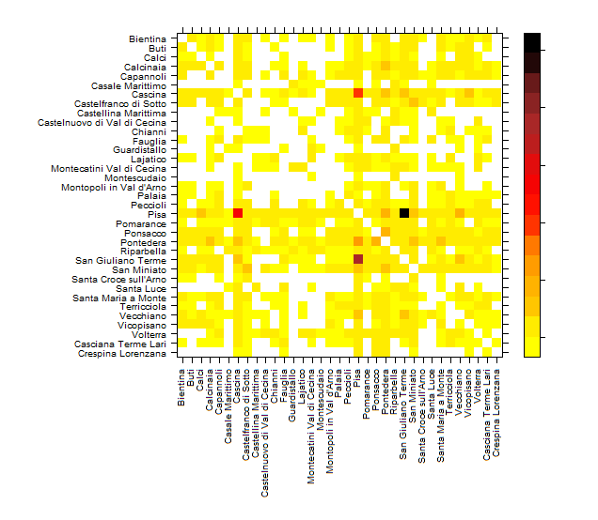



OD Matrix

Slide 15
Concluding remarks, next steps and open issues
Potentialities of MPD for official statistics in population estimates and mobility’s analyses
High correlations thanks to the small scale localization
Privacy issues is the main challenge
A great challenge is the small scale localization of a person from call cell location. Strong cooperation with MPO for achieving best localization
The analysis can be enriched considering the localizations of major transit routes as well as major retail centers …
Other classification methods for inferring resident/present from call habits
Further investigations: relations with other demographics like deprivation level of an area, tourism statistics, migration…

