Slide 1


National Statistician’s Data Ethics Advisory Committee
Providing assurance that the use of data for research and statistical purposes is ethical and for the public good
Simon Whitworth
Simon.whitworth@statistics. gov.uk

Slide 2

UK Statistics Authority
The Statistics and Registration Service Act 2007 established the UK Statistics Authority as an independent body at arm’s length from the Government.
The Act gives the Authority the statutory objective of promoting and safeguarding the production and publication of official statistics that ‘serve the public good’. This includes:
  informing the public about social and economic matters;
  assisting in the development and evaluation of public policy; and
  regulating quality and publicly challenging the misuse of statistics.

Slide 3

Strategy for UK Statistics
    Better Statistics, Better Decisions
    The Statistical System’s Strategy focuses on making better use of pre-existing administrative, real time and big data using innovative methods, to produce more frequent, timely and accurate statistics accounting for users needs

Slide 4
NSDEC Aims
The National Statistician’s Data Ethics Advisory Committee (NSDEC) has been established to provide independent advice to the National Statistician that the access, use and sharing of data, for research and statistical purposes, is ethical and for the public good.
provide ethical consideration of proposals to access, share and use data;
advise on individual policies and projects against NSDEC’s ethical principles; and
develop a consistent ethical framework for relevant projects related to official statistics

Slide 5
The Benefits of NSDEC
Majority independent membership ensuring impartial and credible advice
External perspectives & challenge to uses of data
Supports consistency in decision making across GSS
Independent justification in the face of challenge
Greater transparency around how data is shared, linked, and used

Slide 6
Ethical Principles
The use of data has clear benefits for users and
serves the public good.
Public Good
Confidentiality, data security
The data subject’s identity (whether person or organisation) is protected, information is kept confidential and secure.
Methods and Quality
The risks and limits of new technologies are considered and
there is sufficient human oversight so that methods employed
are consistent with recognised standards of integrity and quality.
Legal Compliance
Data used and methods employed are consistent with legal requirements such as the DPA, the Human Rights Act, the SRSA and the common law duty of confidence.
Public views & engagement
The views of the public are considered in light of the data used and the perceived benefits of the research.
Transparency
The access, use and sharing of data is transparent, and is communicated clearly and accessibly to the public.
6
HS
6

Slide 7


Benefits and the Public Good
Clear benefits for users and serves the public good.
Public good central to our use of data as it is set out in
  the Statistics and Registration Service Act; and
  the Digital Economy Act.
Goes beyond the statistics produced to clearly communicate the better decisions that the statistics will inform.

Slide 8

Protecting privacy and confidentiality
The data subject’s identity (whether person or organisation) is protected, information is kept confidential and secure
Security accredited environments with strict access controls
Secure transfer of data
Statistical disclosure control

Slide 9



Data
Integrity/Quality
Person VS Machine
Legal Gateways
Quality of sources fit for the research purpose
Technological risks
Machines/software making decisions
Legal gateways exist to access the data

Slide 10

Public Perception and Acceptability
The views of the public are considered in light of the data used and the perceived benefits of the research
Joint UKSA/ESRC research published 2014
  understand public views on data linkage for statistical and research
Joint funded public acceptability research with Cabinet Office
  understand public views on use of data science in government
Open Policy Making process and Public consultation around the research and statistics strands of the Digital Economy Act

Slide 11

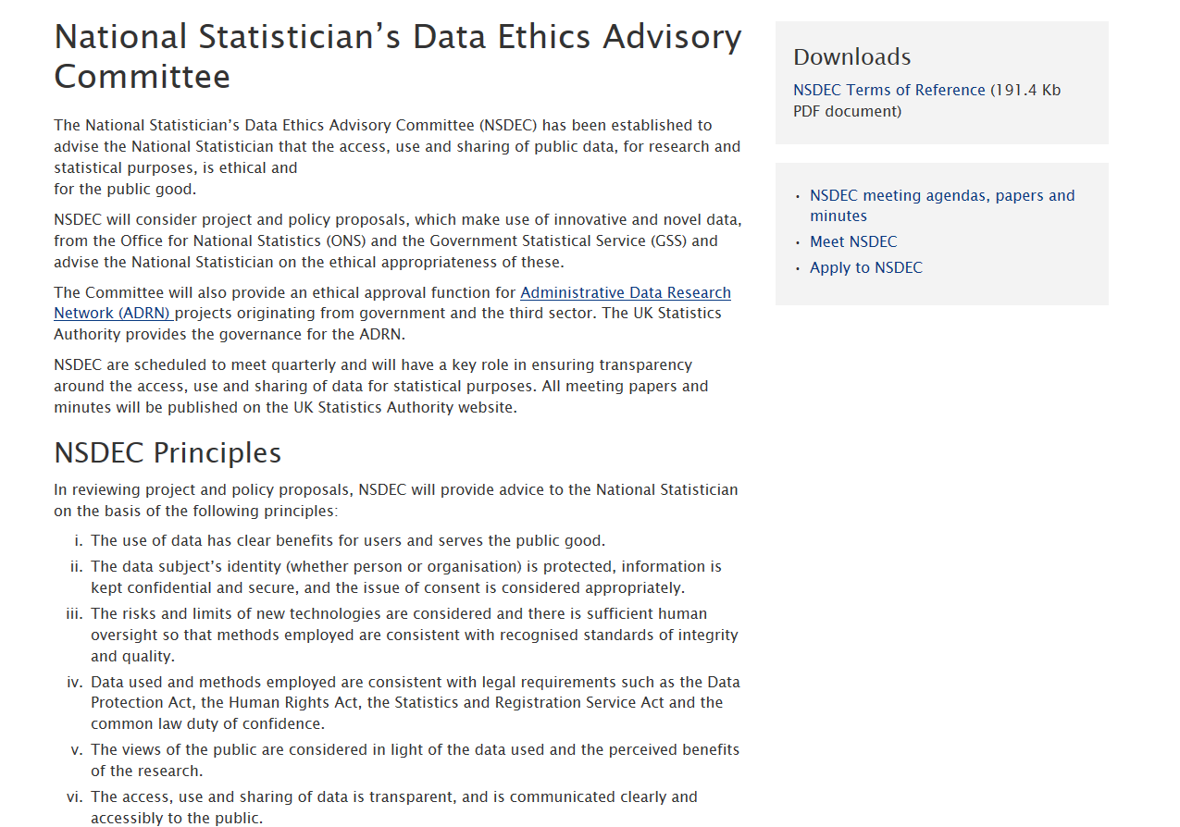
Transparency

Slide 12


Main Methods of considering research applications against NSDEC’s ethical principles
Self-assessment of projects
Review of projects via precedent
NSDEC meetings

Slide 13
Self-assessment framework
1
A consistent framework for self-assessment based on the NSDEC principles
UKSA provide support and training to help researchers complete the self-assessment
3
Robust and efficient governance enabling timely ethical research
4
2
Oversight by NSDEC (all projects that go through the self-assessment are reported to NSDEC)

Slide 14







Projects
NHS
Public Bodies
Other Central Government Departments
European Commission
Academia
Who?
ONS
Devolved
Administrations
Commercial Sector

Slide 15
Example Research Projects
Linking suicide deaths data to Higher Education student registry data to provide evidence to assist in measures to prevent student suicides..
Student suicide data
Estimating income from admin sources
Linking administrative sources to produce income estimates at lower levels of geography to meet a user need to enable policy makers to plan and provide public services
Using the Annual Pop Survey and Annual Business survey to provide an evidence base of aggregate outputs about the effects of migrant workers on London’s economy to inform government poilcy on migration.
Migrant workers and London’s economy
Investigating Mental Health Analysis
Linking death records, census data and data on those who have accessed mental health services to identify physical and mental health conditions that commonly co-occur so that the health service can provide a better service.
Ethical review of the crime survey
The inclusion of questions on abuse during childhood on the Crime Survey for England and Wales to meet a demand for better statistics on child abuse.
15
HS
15

Slide 16
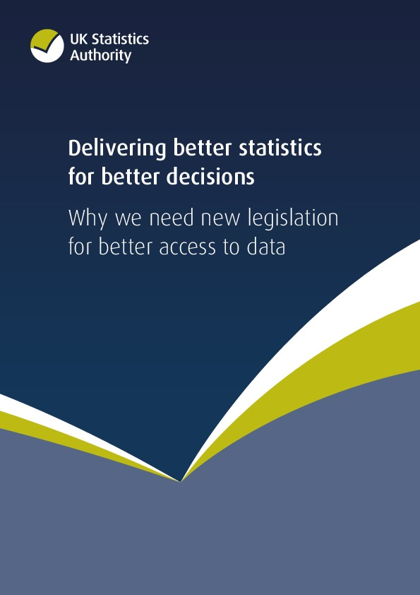
The DEA: Statistics Strand
A statutory right of access for UKSA/ONS to information required to support any of UKSA’s functions held by:
  Government Departments,
  other public authorities, and
  large/medium-sized undertakings (businesses and charities) where the information is
Public authorities and undertakings who provide data to UKSA must consult UKSA when it is considering making changes to its systems and processes in order to avoid compromising the integrity of statistics or statistical research drawing on that data.

Slide 17

The DEA: Research Strand
A statutory framework to support the UK research community that permits public authorities to share de-identified information with accredited researchers for the purposes of public good research.
The UK Statistics Authority is the statutory body that will oversee the accreditation of researchers, projects, processors and secure access environments.

Slide 18
Importance of NSDEC: Information Commissioner’s Office
“(the draft statistics code for the DEA powers) makes reference to the National Statistician’s Data Ethics Advisory Committee and requires practitioners to have regard to ethical standards. The Commissioner welcomes these additional considerations.”

Slide 19
Importance of NSDEC: UK Privacy Group
“(NSDEC) operates in a transparent fashion, to UKSA standards - we expect this to continue … There must be standardised paperwork available to review should there become a question which it seeks to address.”

Slide 20
Common Themes
Showing the public and data suppliers that ONS don’t just consider what we can do but also take independent advice on what we should do.
This independent advice has reinforced the importance of:
  Clearly communicating the public good of the research.
  Carrying out appropriate engagement to assess the public acceptability of research.
  Publishing results so that the public can see how data is being used and what decisions it is informing.
  Being aware of the wider societal consequences of research.

