Slide 1
The harmonised Labour Market Areas – the European value added
Dario Buono, Eurostat B1,
Teodora Brandmueller, Valeriya Angelova, Eurostat E4
October 2018, Bamberg

Slide 2
1. Introduction – the need of functional geographies
2. The method for definition of harmonised Labour Market Areas
3. Examples from the European LMAs' network

Slide 3
The need of functional geographies Limitations of the NUTS
Regional administrative boundaries often the result of historical circumstances
They do not necessarily mirror the present day's social and economic reality
Commuting distorts important data on the administrative regions such as employment, GDP, consumption and waste generation especially in regions with asymmetric commuting patterns (e.g. Luxembourg, Inner London, Brussels, Zürich)
Notes:
Hierarchical structure: 3 levels; each level of NUTS is a subdivision of the higher level. It can be amended after at least 3 years have passed on the previous version to ensure a minimum of stability. It prefers the use of territorial units which are administrative in the Member States and should correspond to population thresholds.

Slide 4
Cross-border commuter, by NUTS 2 regions, 2015
Source: Regional
Yearbook 2016

Slide 5
The concept of European harmonised Labour Market Areas
A LMA is an agglomeration of municipalities where the majority of people live and work
Independent from the administrative upper level
Assist in the design of employment, labour mobility and urban planning policies
Bring to light the effects of commuting on the labour market

Slide 6
The method for delineation of harmonised LMAs
The aim of the method is to aggregate neighbouring LAUs to LMAs, satisfying a particular validity condition
Just two input datasets: number of persons employed and number of commuters
Four parameters set the constraints to define the LMAs in an open R package:
minimum self-containment
target self-containment
minimum number of persons employed
target number of persons employed

Slide 7
Main principles of the algorithm
The target self-containment is always greater than the minimum self-containment
The recommended target self-containment is between 0.75 (1 out of 4 residents is commuting outside the LMA) and 0.8 (only 1 out 5 residents is commuting outside the LMA)
The recommended minimum self-containment is between 0.6 (3 out of 5 is commuting outside the LMA) and 0.6667 (1 out of 3)

Slide 8
Main principles of the algorithm
The parameters could be adapted to better reflect on the national peculiarities and regional diversity
The method considers a cluster of municipalities to be an LMA if the validity condition is fulfilled:
$$\frac{minSC}{tarSC}≤\left(1−\left(1−\frac{minSC}{tarSC}\right)∙MAX\left(\frac{tarSZ − SZ}{tarSZ − minSZ},0\right)\right)∙\left(\frac{MIN(SC, tarSC)}{tarSC}\right)$$
Some fine tuning is applied at the end to ensure continuity of the LMAs

Slide 9
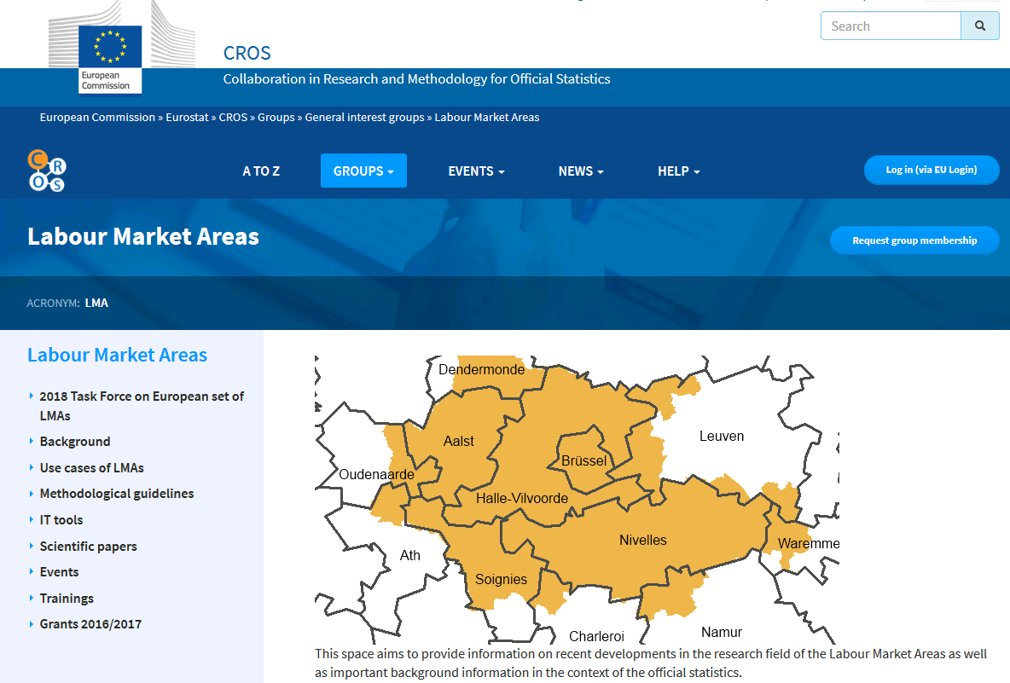
Examples for the achievements of the European LMAs' network
All results publicly available
https://ec.europa.eu/eurostat/cros/content/labour-market-areas_en
The R package for delineation of LMAs available
https://ec.europa.eu/eurostat/cros/content/it-tools_en

Slide 10
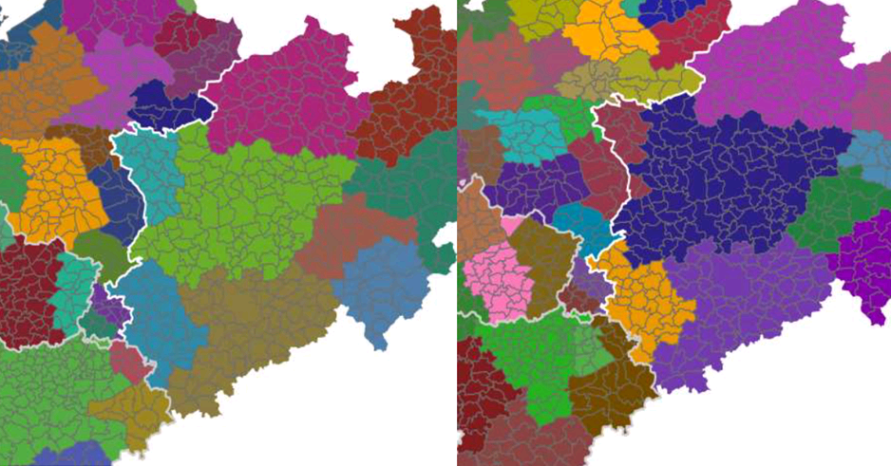
LMAs in the Dutch-German border region produced without and with cross-border commuting data

Slide 11
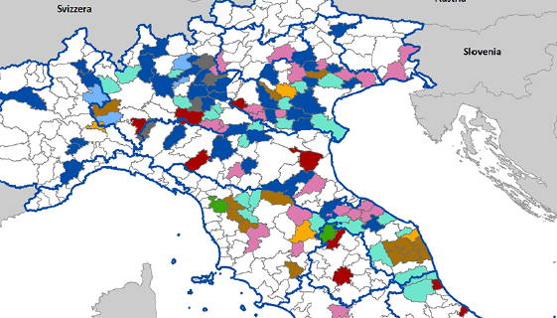
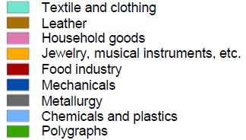
Industrial districts based on LMAs in Italy

Slide 12
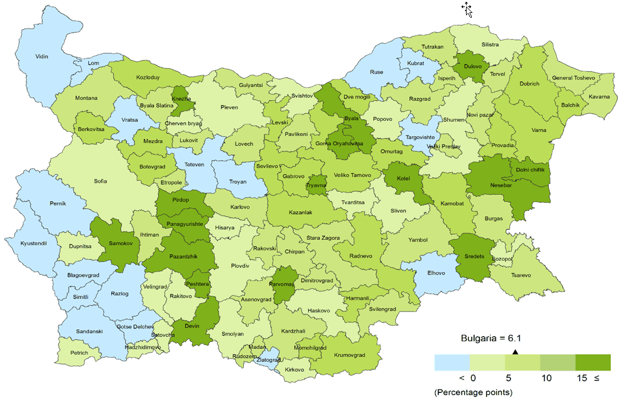
Gender gap for the employment rate (15-64) by LMAs in Bulgaria

Slide 13
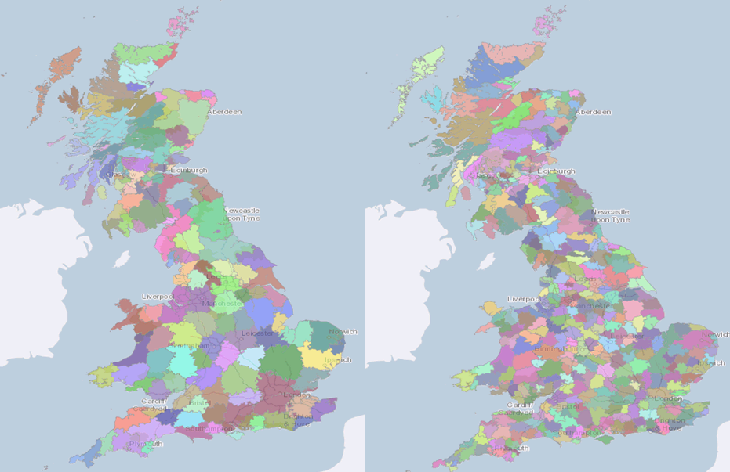
Alternative LMAs by high and low qualifications of the employed persons in UK

Slide 14
Do you have any questions?
To send us feedback regarding stakeholder needs
We kindly invite you:
To become members of the LMAs group of interest on the cros portal
To join the LMAs community

Slide 15
Thank you for the attention!

