Slide 1
microdata.no
Instant Access to Microdata
CESS 2018 / Conference of European Statistics Stakeholders
Bamberg 18-19 October 2018

Slide 2
Thank you for inviting us
Dr. Johan Heldal
Senior Adviser | Division for Methods
Department for Digitalisation and shared business services | Statistics Norway
johan.heldal@ssb.no
Svein Johansen
Senior Adviser | Division for Access to Microdata
Department of Social Statistics | Statistics Norway
svein.johansen@ssb.no
Ørnulf Risnes
Head of Digital Development
Norwegian Centre for Research Data (NSD)
ornulf.risnes@nsd.no

Slide 3
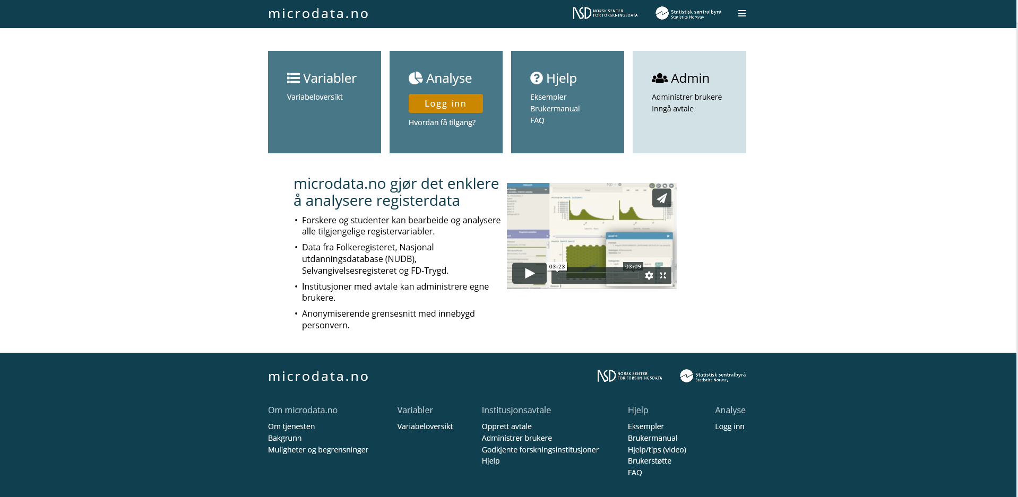
For researchers, PhD and master students in approved institutions
- Fast access
- No application for data
- Self service
- Negligible bill
Notes:
Microdata.no is a new (March 2018) scientific service where researchers get access to a defined database with sharp register microdata without any form for application. They work online with instant access to whichever populations and variables they need, presently costless, in the future at a substantial lower cost than today.
Microdata.no was launched in March this year. By now some 20 institutions (among them the main universities and research institutes) with some 150 users are connected to the system.
Present content: 124 variables on population, education, labour market, income, and welfare benefits.
Developed 2012-2018 in co-operation with NSD – Norwegian Centre for Research data, and funded by The Research Council of Norway with some 4 mill Euro

Slide 4
microdata.no
Launched in March 2018.
20 institutions with some 150 users are connected to the system.
Present content: 124 register variables on population, education, labour market, income, and welfare benefits.
Event history data on 10,2 million individuals.
Developed 2012–2018 in co-operation with NSD – Norwegian Centre for Research data, and funded by The Research Council of Norway.

Slide 5

Research is about results, not records
New and different approach: Metadata driven
Metadata open for anybody.
Sharp data
  Individual records are invisible
Data base stored in Statistics Norway
Safe login
GSIM (General Statistical Information Model)
Results: confidentially safe on the fly
Notes:
Data base stored at Statistics Norway. Data hidden from the user. Only anonymous results downloadable
The clue: Anonymous = no need for applications and allowances.
The egg that WON’T stand: anonymous data. Expensive, reducing value for researchers
More realistic: make the output, the results anonymous.
But then the individual records must be invisible. Solution: Metadata driven. Sharp data stored at Statistics Norway. No information hidden.

Slide 6
Notes:
This is the front page. It is only in Norwegian so far. By clicking the square «Variabler» we come to the metadata page.

Slide 7
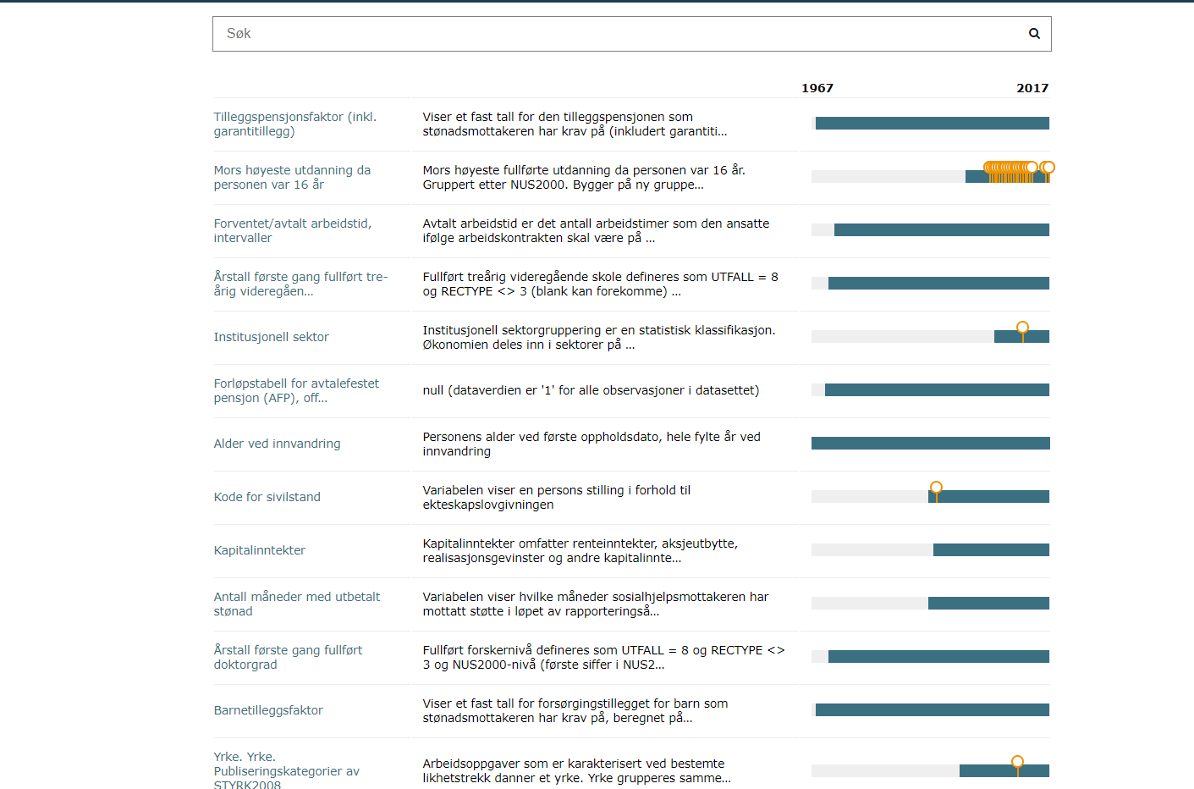
Notes:
Focus:
Rich metadata
Integration of data & metadata
General structures for data GSIM
Metadata are open for anybody
But so far only in Norwegian

Slide 8



Infrastructure layout – metadatadriven, remote access
Metadata
DataStore
Statistics
User Workspace
Notes:
Data are stored in microdata.no DataStore.
The Data are stored in Statistics Norway.
Users import interesting variables to User workspace and give them

Slide 9
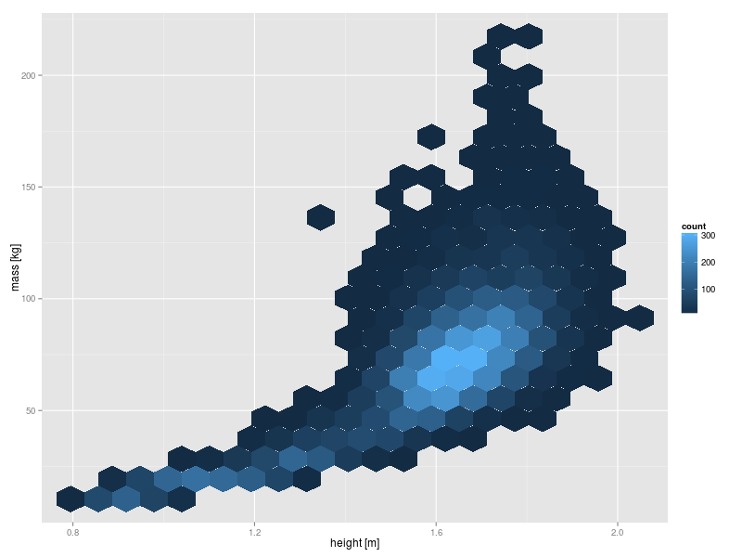
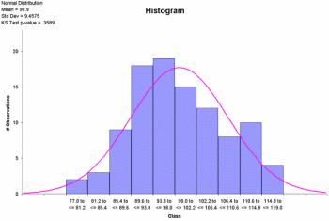
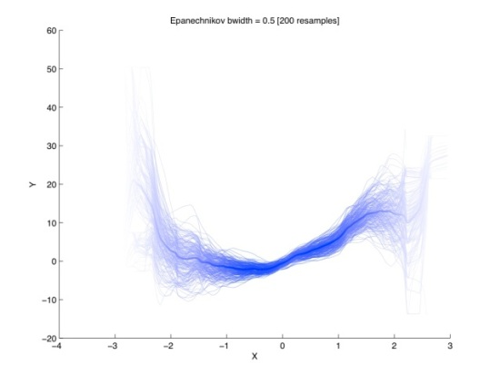
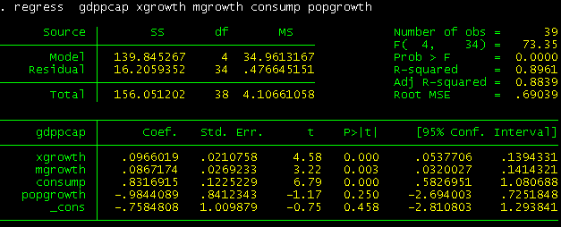

Confidentially safe output
Statistics
User Workspace
Notes:
Based on the variables imported to the User Workspace, users can subset populations, recode variables, create new variables and do analyses.
The user defines the names of the variables in his or her workspace.

Slide 10
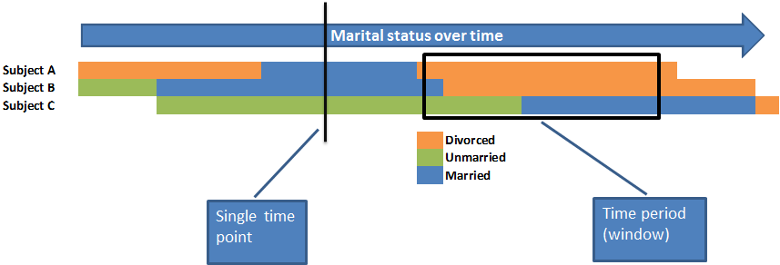
Temporality structure, an example.
Notes:
4 classes of Temporality: Event (start-stop), Single Time Point, Unchangeable, Accumulated

Slide 11
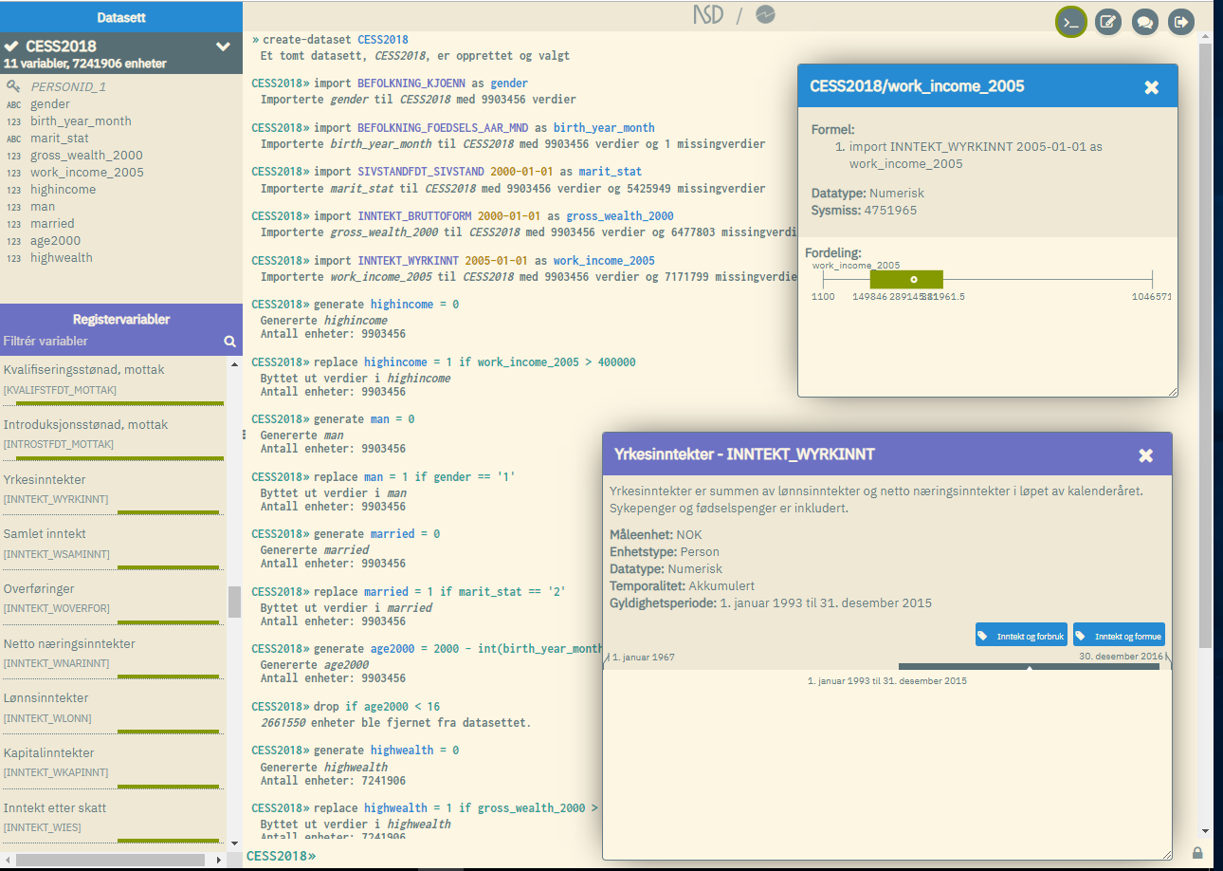
Command interface
Work space variable window
Click for metadata
Data store variable window
Click for metadata
Notes:
Command interface. This shows the meaning of metadata driven approach.
When importing variables from Data Store the user defines his or her own names in the work space.

Slide 12
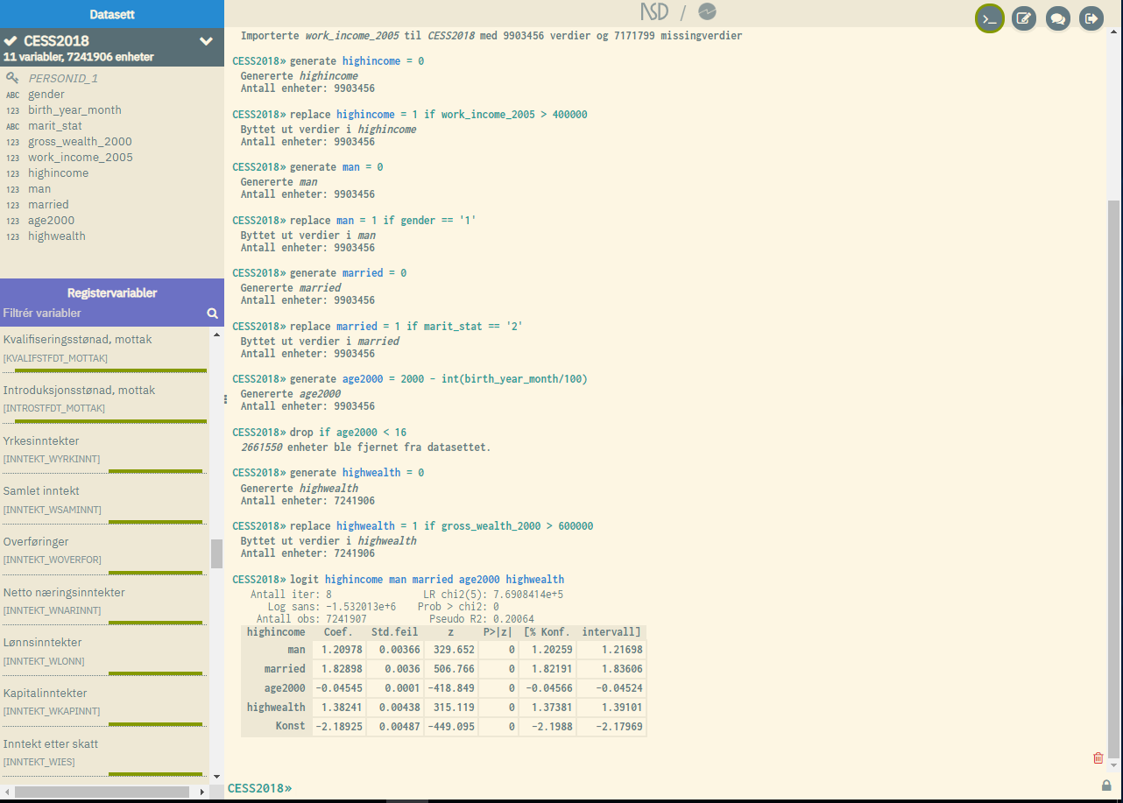
Command interface
Change to Script mode
Chat for assistance
Results of analysis
Notes:
Command mode

Slide 13
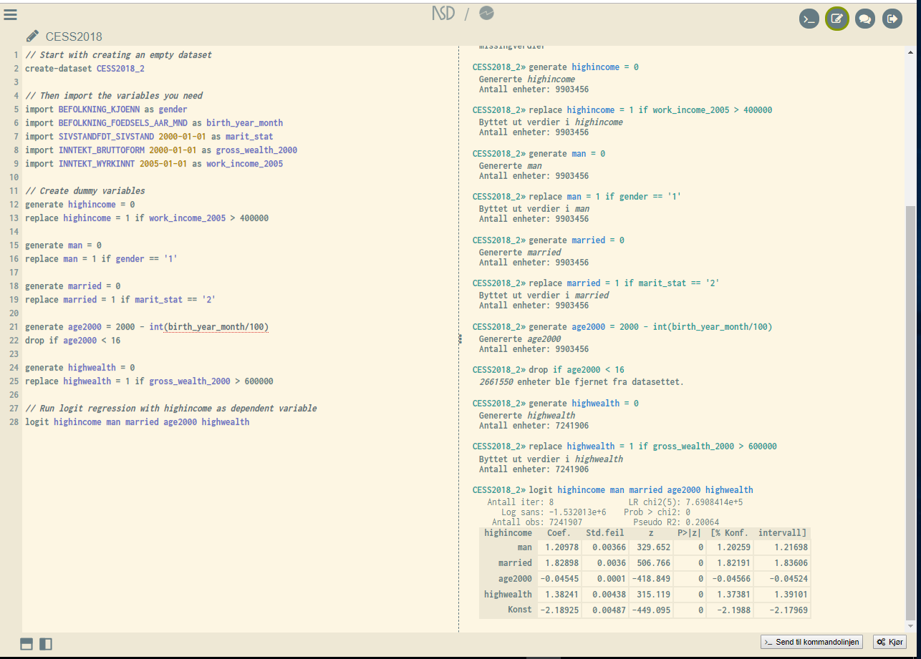
Command
mode
Script mode interface.
You can run all commands an ensemble
Script in the left pane
Results in the right pane
Run
Notes:
Script mode interface

Slide 14
Metadata play several roles
Informative: Open access at microdata.no
  definitions, data types, temporality, code lists
Tech function. Data access only through metadata.
Supportive function. Interactive assistance in User Interface.

Slide 15
Statistical Disclosure Control (SDC)
Minimum size of populations to be analysed: At least 1000
Constant unbiased restricted maximum entropy noise addition on counts (max ±5)
  Inspired by the «Australian Bureau of Statistics method».
  No perturbations to negative counts and no counts 1-4.
  Magnitude totals adjusted proportionally to pertubed counts
Automatic winsorization of all magnitude variables when subsetting
  hides extreme values
All activity on microdata.no is logged
Aims at preventing realistic disclosure scenarios

Slide 16
Next on the Agenda
Include variables from new sources
  E.g health registers
More statistical methods available
Give access to new groups, e.g. public administration.
International access to researchers.
Strengthened SDC methods.
Applications for new grants from the Norwegian Research Council are in (a week ago).
Notes:
We consider the metadata driven approach to be very useful, and have a strong wish to use it widely, both externally and internally in Statistics Norway.

Slide 17
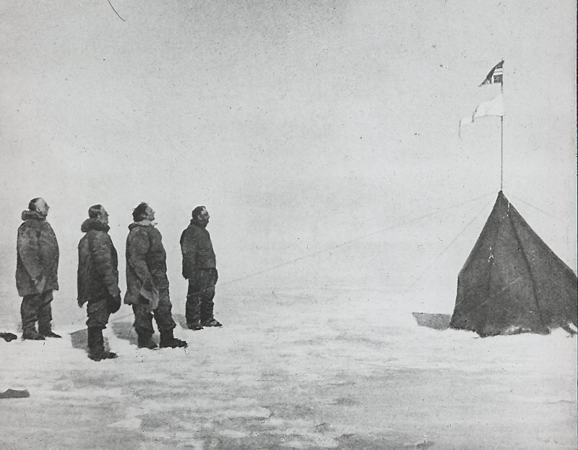
Appreciating the value of register data for research and the value of research, we want to create the best possible solution for register based research data
Thank You

