Slide 1
From Report to
Card-stack
A new way to disseminate research findings
Ineke Stoop
Anouk de Wit
i.stoop@scp.nl

Slide 2
Contents
The Netherlands Institute for Social Research│SCP
What we publish
How we published
From reports to card-stacks

Slide 3
About SCP
A government agency which conducts research into the social aspects of all areas of government policy.
The main fields studied are health, welfare, social security, the labour market and education, with a particular focus on the interfaces between these fields.
The reports published by SCP are widely used by government, civil servants, local authorities and academics.
SCP is independent, and all publications are publicly available at www.scp.nl
The independence of SCP and its partner agencies CPB and PBL is safeguarded in the Protocol for the Policy Assessment Agencies (Aanwijzingen voor de Planbureaus), Staatscourant (government gazette) 3200, 21 February 2012.

Slide 4
Dutch governmental advisory structure
SCP
CPB
The Netherlands Bureau for Economic Policy Analysis (CPB) was founded in 1945. Research at CPB is carried out on CPB’s own initiative, or at the request of the government, parliament, individual members of parliament, national trade unions or employers' federations.
CPB works at the crossroads of the economic sciences and public policy.
PBL
The Netherlands Environmental Assessment Agency is the national institute for strategic policy analysis in the fields of the environment, nature and spatial planning.
We contribute to improving the quality of political and administrative decision-making by conducting outlook studies, analyses and evaluations in which an integrated approach is considered paramount. Policy relevance is the prime concern in all of our studies. We conduct solicited and unsolicited research that is independent and scientifically sound.

Slide 5
SCP and Statistics Netherlands
Cooperation
Data collection
Sampling
Fieldwork
Joint publications
Joint innovation projects
Shared topics
Emphasis on empirical data
Independent
Differences (SCP)
More problem oriented
More analytical
Closer to policy making and evaluation
Multiple sources
Quantative and qualitative data

Slide 6
Publications SCP
Publicly available (PDF and/or paper)
Wide media attention
Policy makers
Practicioners
Media
Citizens
Science (background info)
Other institutes
In education
By international organisations (OECD)
Types
Reports (specific)
Monitors (repeated)
Fact sheets
Others

Slide 10
Publications in 2015 (# of pages excl. Appendices)

Slide 11
Publications SCP
Complete
In-depth
Great detail (+/-)
Long press releases (appreciated by media)
Social media (increasingly)
Timely?
Multiple users?
Monitoring (statistics)
Analytical perspectives and policy recommendations
Authority based on thorough studies
Thorough studies not always read

Slide 12
Internal task force publication policy (2015)
Chaired by Cok Vrooman
Types of users
Types of publication
Types of dissemination
Diversification
Not everything is simple
But we can try to make it as simple as possible
Card-stack
https://www.vox.com/cards/crime-rate-drop

Slide 15
SCP card stacks: characteristics
Dynamic e-pubs presenting core information
Directed at broad audience: citizens, media, policy makers
To be updated when new data are available
Cards with a core message
Every card a landing page
Simple texts
Links to other cards, additional information, definitions
Interactive dynamic graphs
Cards easily shared on social media
Tweet card related to current debates

Slide 16
Examples (in Dutch)
Time use in the Netherlands
A week at a glance
Personal care
Employment
Household and care
Leisure
Background of the Time Use Survey
https://digitaal.scp.nl/timeuse1/
(Un)healthy lifestyles: education as a dividing line
Health-related behaviour in NL
Education as a dividing line
Health-related behaviour and the education gap
The Netherlands in Europe
Family and lifestyle habits
Partner and health-related behaviour
The neighbourhood and health-related behaviour
Accumulation of risk factors
Sex and the discrepancy in health behaviour
Health-related behaviour by age
Alternative medicine
The education gap and policy relevance
Acknowledgements and sources
Editors: Stéfanie André, Gerbert Kraaykamp & Roza Meuleman (Radboud University)
Data from European Social Survey
https://digitaal.scp.nl/leefstijl/

Slide 20
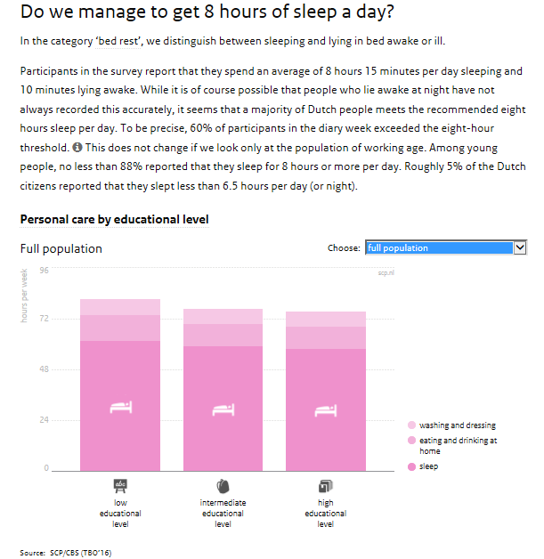

Slide 22
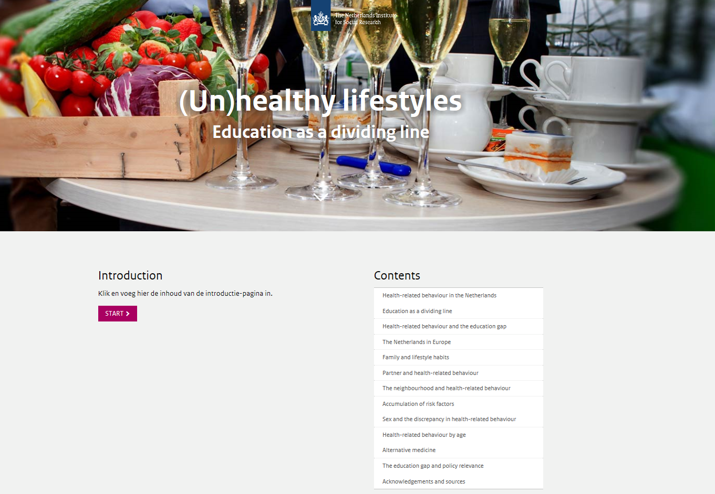

Slide 27
Where are we now?
Promising type of publication
Increasing number of card stacks
Two in English
How are they used?
Card or chapter?
Lots of work
Update cards?

Slide 28
The exciting world of the card stacks
Anouk de Wit
@SCPonderzoek

