Slide 1
INEXDA
CESS 2018, Bamberg
Christian Hirsch, Forschungsdaten- und Servicezentrum, Deutsche Bundesbank
The views expressed here do not necessarily reflect the opinion of the Deutsche Bundesbank, the INEXDA network, or the Eurosystem.

Slide 2
Outline
Background
INEXDA - the granular data network
Work programme for the first two years
Chronology of INEXDA meetings
Conclusion
References

Slide 3
Background
IFC report on data-sharing: issues and good practices between statistical and supervisory authorities (2015).
IFC Report on the sharing of micro data – a central bank perspective (2016).
Recommendation # II.20 of the G20 Data Gaps Initiative (2016).
The IAG and G-20 economies to promote and encourage the exchange of data and metadata among and within G-20 economies, and with international agencies, to improve the quality (e.g., consistency) of data, and availability for policy use. The G-20 economies are also encouraged to increase the sharing and accessibility of granular data, if needed by revisiting existing confidentiality constraints.
(Source: G-20 DGI-2 First Progress Report (2016)
Workshop on data sharing in Frankfurt am Main (2017).
The workshop benefited from the contributions of almost 90 participants, from G20 economies, international organizations, non-G20 FSB member economies and other non-G20 jurisdictions.
Recommendations concluded at the workshop were subsequently endorsed by the FMCBG and G20 leaders in the Hamburg Action Plan.

Slide 4
On 6th January 2017,
have launched the International Network of Exchanging Experiences on Statistical Handling of Granular Data (INEXDA), an international cooperative project to declare their willingness to further strengthen their cooperation.
Since its foundation, the following institutions have joined INEXDA as members:

Slide 5
INEXDA`s objective
INEXDA aims at
investigating possibilities to harmonise access procedures and metadata structures,
developing comparable structures of existing data and,
further fostering efficiency of statistical work with granular data.
The ultimate aim of INEXDA is to facilitate the use of granular data for analytical, research and comparative purposes by users outside the participating institutions, within the limits set by the applicable confidentiality regimes.

Slide 6
Work programme for the first two years
Comprehensive inventory of data in all member institutions.
Agreement on unified metadata schema.
Setup of a platform to collect and exchange metadata.
Start harmonising metadata across INEXDA member countries.
Inventory of existing data access procedures and registration processes for researchers.
ECB pilot collection of information on access for researchers.
ADRF for INEXDA proposed by Prof. Julia Lane (NYU).
Setup of a working group.
Dissemination of INEXDA results.
IV Meeting of the Financial Information Forum of Center for Latin American Monetary Studies (CEMLA) in 2018.
9th biennial IFC Conference in 2018.
2018 Conference of European Statistics Stakeholders (CESS).
62nd ISI World Statistical Congress in Kuala Lumpur in 2019.
Website in preparation.

Slide 7
INEXDA’s Metadata Schema
1 | Resource Type
2 | Resource Identifier
3 | Name of Dataset
4 | Creator
5 | DOI Proposal
6 | URL
7 | Language of Resource
8 | Publication Date
9 | Availability
10 | Sampled Universe
11 | Sampling
12 | Temporal Coverage
13 | Time Dimension
14 | Collection Mode
15 | Unit Descriptions
16 | Descriptions
17 | Geographical Coverage
18 | Keywords
19 | Alternative Identifiers
20 | Relations
21 | Publications
Based on the GESIS DOI registration service da|ra (GESIS is cooperating with DataCite). https://www.da-ra.de/en/home
Purpose is to foster harmonisation between INEXDA members and broaden metadata sharing within INEXDA and possibly outside.
Name of metadata items closely follows da|ra conventions to enable seamless DOI registration, if desired later in the project.
Is basis for INEXDA metadata database that was established to store and view metadata from INEXDA members.

Slide 8
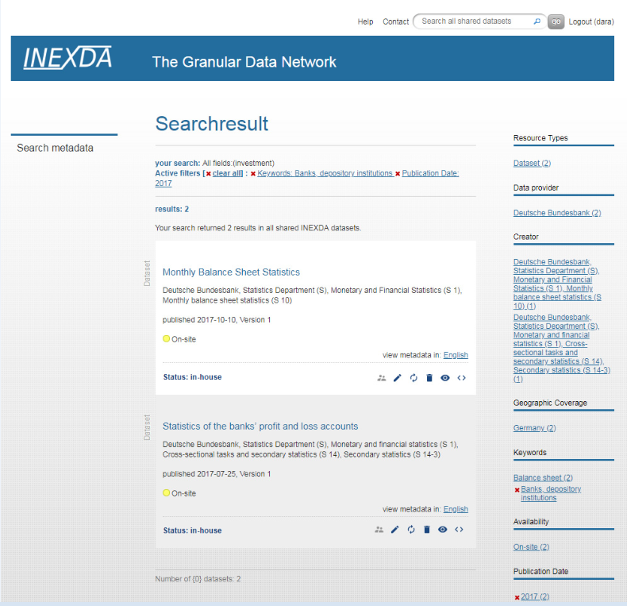
INEXDA Metadata Database
The database serves
as an information tool for INEXDA members, researchers and analysts.
as the basis for the harmonisation activities of INEXDA (e.g. item relation)
Current the 42 contributions to the database come from
Banca d‘Italia | 6
Banco de Espana | 13
Banco de Portugal | 2
Bundesbank | 15
ECB | 6

Slide 9
Work programme for the first two years
Comprehensive inventory of data in all member institutions.
Agreement on unified metadata schema.
Setup of a platform to collect and exchange metadata.
Start harmonising metadata across INEXDA member countries.
Inventory of existing data access procedures and registration processes for researchers.
ECB pilot collection of information on access for researchers.
ADRF for INEXDA proposed by Prof. Julia Lane (NYU).
Setup of a working group.
Dissemination of INEXDA results.
IV Meeting of the Financial Information Forum of Center for Latin American Monetary Studies (CEMLA) in 2018.
9th biennial IFC Conference in 2018.
2018 Conference of European Statistics Stakeholders (CESS).
62nd ISI World Statistical Congress in Kuala Lumpur in 2019.
Website in preparation.

Slide 10
INEXDA webpage
INEXDA’s internet platform will be implemented by Banque de France (Renaud Lacroix and team).
Planned content
Access to (part of) metadata database.
Results of inventory of existing data access procedures.

Slide 11
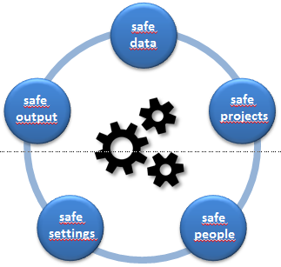
Chronology of INEXDA meetings
1st INEXDA meeting in Lisbon
2nd INEXDA meeting in London
3rd INEXDA meeting in Paris
4th INEXDA meeting in Basel
INEXDA members
(+CL, ECB, ES, TR)
Guests: AT, CH, BIS, DE (NSI), Eurostat, MX, RU, UK (NSI)
INEXDA members
(DE, FR, IT, PT, UK)
Guests: BIS
INEXDA members
(DE, FR, IT, PT, UK)
Guests: BIS, ECB, ES
INEXDA members
(+ECB, ES)
Guests: AT, BIS, CL, MX, TR, UK (NSI)
Jan 2017
Jul 2017
Jan 2018
Aug 2018
Memorandum of Understanding
Signing and publication
INEXDA Metadata Tool
by GESIS
Working groups
Dissemination
Metadata
ADRF
Modes of accreditation
Contracts for research projects/bodies
Modes of data provision
Output control
Risk management for published results
Data Access

Slide 12
Conclusion
INEXDA provides a platform for exchanging experiences on statistical handling of granular data for central banks, national statistical institutes and international organisations.
Supports the G20 process, especially the Data Gaps Initiative 2 recommendation aiming to promote the exchange of (granular) data as well as metadata.
So far, focus has been on taking stock which granular data is available in member institutions using a unified metadata schema.
Focus is gradually shifting towards harmonising metadata and exchanging experiences about data access procedures.

Slide 13
References
INEXDA is governed by an MoU, that every member has to sign
https://www.ecb.europa.eu/stats/ecb_statistics/co-operation_and_standards/inexda/html/INEXDA_Memorandum_of_Understanding_extension_201802.en.pdf
IFC report on data-sharing: issues and good practices between statistical and supervisory authorities
https://www.bis.org/ifc/events/7ifc-tf-report-datasharing.pdf
IFC report on the sharing of micro data
https://www.bis.org/ifc/publications.htm?m=3%7C46%7C94
Recommendation # II.20 of the G20 Data Gaps Initiative
http://www.fsb.org/wp-content/uploads/Second-phase-of-the-G20-Data-Gaps-Initiative-DGI-2-First-Progress-Report.pdf
(page 40)
G20 Hamburg Action Plan
https://www.g20germany.de/Content/DE/_Anlagen/G7_G20/2017-g20-hamburg-action-plan-en.pdf;jsessionid=EE9E8591E82BFADADD2942FED67878B7.s6t2?__blob=publicationFile&v=4
(page 15: “Promoting Data Sharing“)
Communiqué of the G20 FMCBG Meeting, Baden-Baden, Germany, March 17–18, 2017
http://www.bundesfinanzministerium.de/Content/EN/Standardartikel/Topics/Featured/G20/g20-communique.pdf;jsessionid=CF74A1983810F30E7D6EECA63397797E?__blob=publicationFile&v=3
(page 5, bullet point 15)
Proceedings of the G20 Workshop on Data Sharing (January 31-February 1, 2017) and related IAG report http://www.principalglobalindicators.org/?sk=E30FAADE-77D0-4F8E-953C-C48DD9D14735&sId=1433357451568

