Slide 1
Exchange Rate Effects in the IIP
Methods, Tools and Applications for Germany
Ulf von Kalckreuth, Principal Economist-Statistician, DG Statistics, Deutsche Bundesbank*
Conference of European Statistics Stakeholders 2018
Session on Institutional Sector Accounts and Balance of Payment Statistics
Bamberg, October 18, 2018
*The paper is joint work with Stephanus Arz and Stefan Hopp. It represents the authors' personal opinion and does not necessarily reflect the views of the Deutsche Bundesbank or the Eurosystem..

Slide 2
Outline
Introduction: The significance of exchange rate fluctuations on the IIP for wealth and financial stability
Basic concepts: the matrix of currency compositions
An index of IIP weighted exchange-rate effects
Sensitivity analysis
Outlook: taking hedging into account

Slide 3
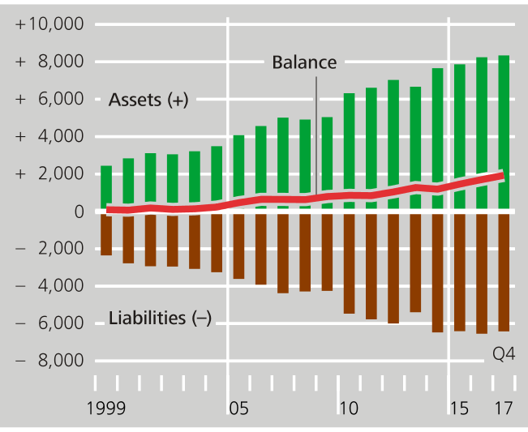
Introduction
German IIP, all sectors, 1999 to end of 2017
The net external position of Germany has increased from almost 20% to around 60% of GDP in the years between 2007 and 2017. At the end of 2017, external assets have reached a volume of € 8,346 bn € and external liabilities amount to € 6,417 bn €.

Slide 4
Introduction
German IIP, all sectors, 1999 to end of 2017
A large share of IIP is denominated in foreign currencies: 34% of all assets and 20% of all liabilities – net exposure is equivalent to € 1.5 trillion, around 50% of GDP. For such a portfolio, even small exchange rate changes may have a high impact.

Slide 5
Introduction
National wealth is sum of real capital plus net foreign position
For wealth effects of exchange rate changes, IIP is the point of departure.
Wealth effects on countries, sectors and individuals depend on the currency composition of their portfolio
For investors holding unhedged net positions in a foreign currency, exchange rate changes will directly affect net wealth.
BPM6 asks for breakdown of changes of IIP positions into transactions, revaluations – exchange rate changes among them – and other changes.
To identify effects of exchange rate changes, a system of bookkeeping for currency denominations is needed -- for each position, each instrument of each entity!
Matrix of currency compositions needed!

Slide 6
Basic concepts
Euro value of N currency positions in
IIP stock k, the first being €
Exchange rate change for home currency, identically = 0
Vector of K different IIP stocks, in €
Matrix of currency compositions of stocks in a_{t}
Vector of exchange rate changes w.r. to €, for currencies 1 to N

Slide 7
Basic concepts
The vector of exchange rate effects is given by:
Consider the matrix of weights
and accordingly a vector of IIP weighted exchange rate changes:
Share of currency N in the Euro value of item 1

Slide 8
Basic concepts
Formally, η_{t} is a vector of growth rates. One can look at it in two ways:
By weighting the exchange rate changes on the basis of IIP positions, η_{t} "translates" these changes into effects on wealth stocks.
Regarding the stocks, the elements of η_{t} denote the relative changes of IIP positions induced by exchange rate variations.
Absolute value of exchange rate effects can be recovered by simply multiplying the weighted changes back into the stocks.

Slide 9
An index of IIP weighted exchange rate effects
Chain-linking the growth factors associated with asset k while setting some base period equal to 100 yields an index for the capital gains and losses due to exchange rate changes in the respective IIP positions.
For any asset or liability position k, we obtain the Index of IIP-weighted Exchange rate effects:
See Lane and Shambough (2010), Bénétrix, Lane and Shambough (2015) and Kearns and Patel (2016) for similarly constructed aggregate indices!
At the Bundesbank, as a service to analysts, the IIE are being computed and stored for the baseline combinations of sectors, instruments and currency denominations, as well as for many meaningful aggregates!

Slide 10
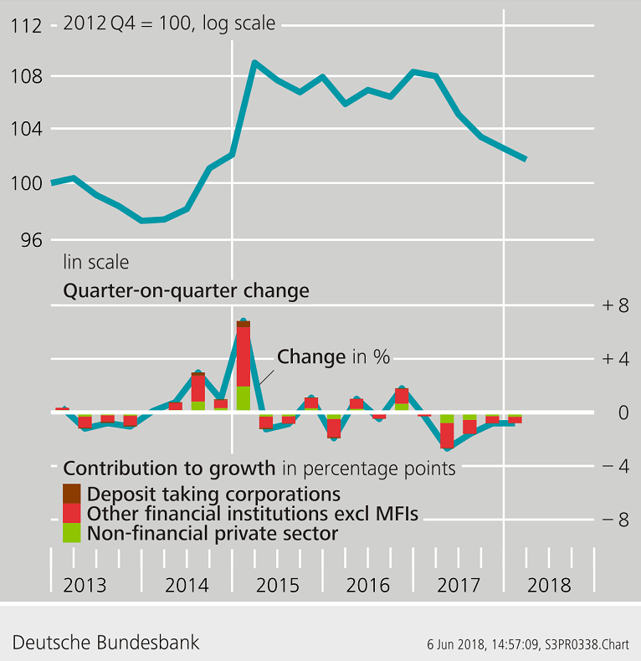
An index of IIP weighted exchange rate effects
IIE for shares in portfolio investment (asset side)

Slide 11
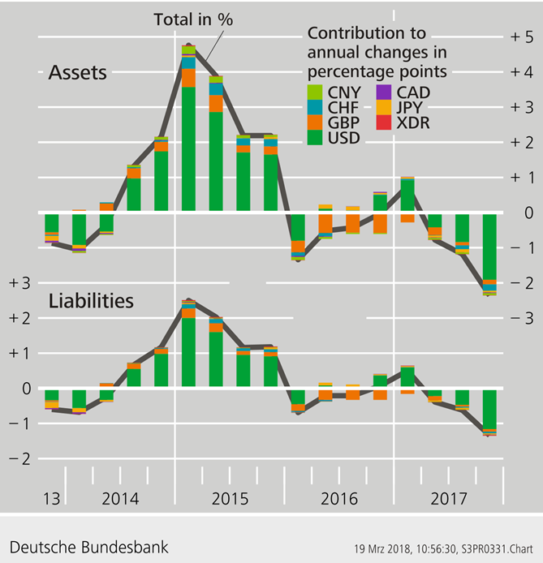
An index of IIP weighted exchange rate effects
Currency decomposition of IIE changes in percentage points
Total assets and liabilities

Slide 12
Sensitivity: ex post analysis
We may start by looking at time series variability of IIP weighted exchange rate changes, for certain asset positions or an aggregate portfolio, using historic currency compositions and ER-changes.
Std dev of portfolio inv. assets: q-on-q changes of IIE
However, the currency compositions of asset or liability positions evolve over time, as does the covariance structure of exchange rate volatility.
 | All sectors | Banks | MM funds | Fin. corp. w/o MFIs | Gov | Others*
All instruments | 0.6 | 0.9 | 0.1 | 0.8 | 1.7 | 0.4
Long term debt securities | 0.6 | 0.3 | 0.0 | 0.6 | 1.5 | 0.3
Short term debt securities | 0.8 | 1.2 | 3.3 | 0.8 | 0.0 | 0.6
Shares | 2.0 | 1.5 | 0.0 | 2.0 | 0.0 | 2.4
Investment fund shares | 0.6 | 0.9 | 0.1 | 0.8 | 1.7 | 0.4

Slide 13
Sensitivity: the effect of a 1 pp exchange-rate change
It is informative to study current IIP and currency composition.
The effect of an isolated 1 percentage point change in currency n…
… is given by the respective column of the currency composition matrix

Slide 14
Sensitivity: considering correlation
However, exchange rate changes do not happen in isolation.
Covariance matrix of exchange-rate fluctuations:
We obtain
as the effect of a one standard deviations shock to currency n on the asset positions in absolute values, taking into account the correlation structure.
Exchange rate change for home currency identically 0

Slide 15
Sensitivity: standard deviation for rates of change
Total volatility given current currency composition and current covariance structure of exchange rate changes
Std. dev. of asset or liability position k resulting from FX volatility:
Exchange-rate induced r.o.c. in IIP position k
Currency weights for IIP position k

Slide 16
Sensitivity: standard deviation for rates of change
Growing exchange rate sensitivity of total assets…

Slide 17
Sensitivity: standard deviation for rates of change
… due to rising share of US Dollar

Slide 18
Sensitivity: standard deviation for absolute changes
Looking at absolute values
The absolute value of position k may be changing quite strongly over time. → look at the scaled standard deviation:
This is a measure for potential currency risk in position k
Absolute value of change in IIP position k
Currency weights for IIP position k

Slide 19
Sensitivity: standard deviation for absolute changes
Strongly increasing volatility of total assets

Slide 20
Outlook: taking hedging into account
Taking hedging into account – a way towards useful macro-statistical risk measures?
Part of IIP positions are hedged (forward contracts, derivatives or holding counter positions within the group). No direct information in IIP!
Wealth risk from FX volatility: If there is exogenous information on hedging, we may construct modified weights g* to be used instead of g:
Std dev of exchange rate induced changes in unhedged part of IIP position k
Currency weights of unhedged assets or liabilities in IIP position k

Slide 21
Outlook: taking hedging into account
This may delineate the path towards operational macro-statistical risk measures of foreign currency exposure associated with IIP.
But:
Empirical values for g* are not to be had without estimates and approximations.
Derivative contracts between agents that are both domestic residents will not reduce the aggregate exposure of the country – although it can still reduce systemic risk if currency risk in different positions is annihilated or ultimately rests with agents that are able to deal with it.
Trading in derivatives with non-residents may increase or reduce aggregate open positions, thereby affecting aggregate exposure outside the IIP.
A better understanding of sectoral hedging activities is needed.

Slide 22
This is the end…
Thank you!

