Slide 1
Effects of attrition on longitudinal EU-LFS estimates
CESS 2018 Bamberg – 18 October 2018
IPS01: Improving statistical data collections: methods, tools and sources
hannah.kiiver@ec.europa.eu

Slide 2
Motivation
Improving statistical data collections: exploit longitudinal dimension of EU-LFS
Derive information on the transitions between labour market status over time
This talk: impact of attrition on estimates

Slide 3
EU-Labour Force Survey
Quarterly cross-sectional household survey on the labour market
(average sample per quarter: ca. 1.5 million )
Output-harmonized; ILO labour market status (unemployment, employment, inactivity) are most important indicators
Source for most policy indicators concerning the labour market and education; about 25% of Eurostat data offer

Slide 4
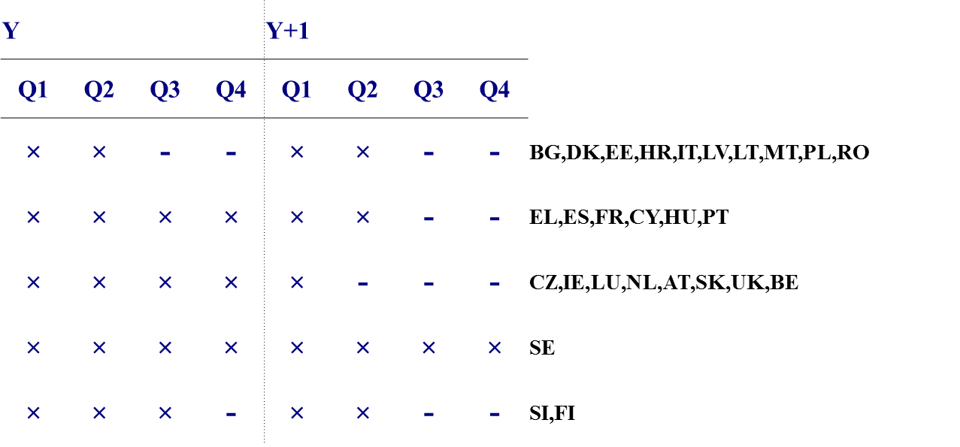
The longitudinal component of the LFS – rotational patterns

Slide 5
Non-response
YEAR Y
Q1
Q1
Q2
Q2
Q3
Q4
Movers
YEAR Y+1
Q1
Q2
Q3
Q4
Deaths
Quarterly overlap – currently derived and published
Annual overlap – work in progress

Slide 6
Initial period
Sample initial period
ATTRITION
Overlapping sample
(50%)
Actual overlapping sample
Deaths
Sample target period
Internal and international movers
No contact/
refusals

Slide 7
Extent of attrition, in %, 2015 to 2016

Slide 8
Determinants and type of attrition
Overall extent influenced by mode of data collection, compulsory survey participation; no effect of rotational pattern
Simple regression models indicate differential attrition: young urban unemployed most likely to drop out
Possible overestimation of "stayers", underestimation of "movers"

Slide 9
Deal with effects of attrition
Transition matrix without correction for attrition, target quarter weights
Transition matrix with recalibrated longitudinal weights using target year margins (sex, age, ILO-status, urbanisation, education)
Transition matrix using "employment" assumption: highly educated below age of 45 are assumed to move into employment; all others stay in initial status

Slide 10
Transitions between ILO labour market status, in % of initial status Estonia, 2015-2016 No correction for attrition

Slide 11
Recalibration of weights
"Employment assumption"

Slide 12
Conclusions
Assumptions matter! – but even extreme assumptions have similar impacts over time/between countries
Investigating longitudinal data from the LFS is a worthwhile experiment - estimates for annual flows and metadata in 2019

