Slide 1
Item Sum: A New Technique for Asking Quantitative Sensitive Questions
CESS 2018, Bamberg
Mark Trappmann (IAB / Universität Bamberg)
Ivar Krumpal (Universität of Leipzig)
Antje Kirchner (University of Nebraska at Lincoln)
Ben Jann (Universität Bern)

Slide 2
Asking Sensitive Questions in Surveys
“A question is sensitive when it asks for a socially undesirable answer, when it asks in effect, that the respondent admits he or she has violated a social norm.” (Tourangeau and Yan, 2007: 860)
Non-random responses distort estimates due to (Tourangeau and Smith, 1996: 276)
  partial nonresponse (break-offs),
  (item-)nonresponse (refusal),
  misreporting (here: systematic underreporting)

Slide 3
Techniques for Asking Sensitive Questions
Wording
  load questions
  ask about long periods/distant past
  paraphrase
Mode
  self administration
Indirect Questioning Techniques
  Randomized Response Technique (Warner 1965)
  Item Count Technique (Smith et al. 1975, Droitcour et al. 1991)
  Crosswise Model (Yu et al. 2008, Jann et al. 2012)
Notes:
From session abstract: “ … researcher is able to estimate parameters of interest, while at the same time they cannot infer whether a specific respondent has the stigmatizing or sensitive characteristic”

Slide 4
The Item Count Technique
Randomize respondents to two subsamples
  Group 1: Short list (SL) of n innocuous questions
  Group 2: Long list (LL): Same as SL plus sensitive item
Ask for number of items in the list that apply
Mean difference between group between groups provides prevalence estimate of sensitive item
Expectation of higher estimates confirmed in several experimental studies (overview Holbrook and Krosnick 2010a)
Moderate cognitive burden
Recently shown to outperforms RRT (Holbrook and Krosnick 2010a, b)
Until recently never generalized to quantitative items

Slide 5
The Item Sum Technique: Basic Idea
Generalization of the IST
Same randomization to SL and LL
Ask for the sum of values of a list instead of the number of items that apply

Slide 6
The Item Sum Technique: Estimators
Let S be the sensitive item of interest and C be the non-sensitive control item. Observed is:
Estimates of the unbiased population mean of S are calculated as the difference in the expected values of the two lists (assuming the two samples are unbiased):
The sampling variance of the mean estimate of S is given as:

Slide 7
Application: Measurement of Undeclared Work
Obviously sensitive topic: norm violation punishable by law
  socially undesirable
  fear of disclosure
In spite of this: No nationwide studies in Germany using dejeopardizing techniques (Boockmann et al. 2010)
Wide range of prevalence estimates from existing studies

Slide 8
Our Study (Design)
Nationwide telephone survey conducted in 2010
  3,211 interviews
  Sample 1: People aged 18-70 who were employed in December 2009 (RR1: 16.3%) drawn from registers at FEA
  Sample 2: UB II recipients in June 2010 (RR1: 18.8%) drawn from regsiters at FEA
Randomization to DQ and IST
  Randomization within both subsamples
  one third DQ (n=1,145) , two thirds IST (n=2,066)
  Within IST: 50% LL and 50% SL
  About 15% noncompliance related to previous RRT experiment: Responded in DQ mode, but unrelated to randomization within IST

Slide 9
Implementation of the IST
Group LL (Long List) | Group SL (Short List)
C1: How many hours did you watch TV last week? S1: How many hours per week do you usually engage in undeclared work? | C1: How many hours did you watch TV last week?
Please sum up the answer to both questions, please, do not report individual answers.
Group LL (Long List) | Group SL (Short List)
C2: How much do you pay per month for your apartment or house? S2: How high are your usual earnings per month engaging in undeclared work? | C2: How much do you pay per month for your apartment or house?
Please sum up the answer to both questions, please, do not report individual answers

Slide 10
Item Sum: Mean Estimates
(isreg: Jann 2013)
 | Hours of undeclared work (per week)
 | Employees | Benefit recipients
Direct questioning (DQ) | 0.07 (0.03) | 0.14 (0.06)
Assigned to DQ | 0.07 (0.04) | 0.19 (0.08)
Opted for DQ | 0.05 (0.05) | 0.00 (-)
Item sum technique (IST) | 0.85 (0.70) | -0.17 (1.06)
24 of 29

Slide 11
Item Sum: Mean Estimates
(isreg: Jann 2013)
 | Hours of undeclared work (per week)
 | Employees | Benefit recipients
Direct questioning (DQ) | 0.07 (0.03) | 0.14 (0.06)
Assigned to DQ | 0.07 (0.04) | 0.19 (0.08)
Opted for DQ | 0.05 (0.05) | 0.00 (-)
Item sum technique (IST) | 0.85 (0.70) | -0.17 (1.06)
24 of 29

Slide 12
Item Sum: Mean Estimates
(isreg: Jann 2013)
 | Hours of undeclared work (per week) |  | Earnings from undeclared work (per month)
 | Employees | Benefit recipients | Employees | Benefit recipients
Direct questioning (DQ) | 0.07 (0.03) | 0.14 (0.06) | 1.8 (0.7) | 3.4 (1.2)
Assigned to DQ | 0.07 (0.04) | 0.19 (0.08) | 1.9 (0.8) | 4.4 (1.5)
Opted for DQ | 0.05 (0.05) | 0.00 (-) | 1.1 (1.1) | 0.0 (-)
Item sum technique (IST) | 0.85 (0.70) | -0.17 (1.06) | 113.8 (40.1) | 83.4 (27.4)
24 of 29

Slide 13
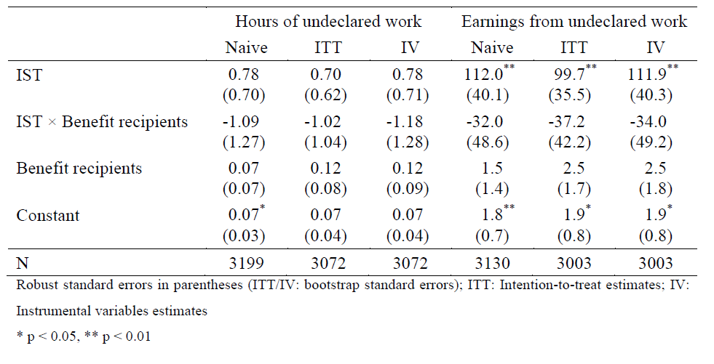
An extension: Item Sum Regression Models
(isreg: Jann 2013)
Notes:
DQ = S
SL = C
LL = S(DQ) + S(LL) + C (= observed)
Beobachtet:
DQ = S
LL = S(DQ) + S(LL) (+ C not reportet)
(SL = C not reported)

Slide 14
Some issues around privacy: panel consent
| version
panel consent | direct sl ll | Total
----------------------+---------------------------------+----------
yes| 251 229 218 | 698
| 84.51 84.19 81.04 | 83.29
----------------------+---------------------------------+----------
no | 46 43 51 | 140
| 15.49 15.81 18.96 | 16.71
----------------------+---------------------------------+----------
Total | 297 272 269 | 838
| 100.00 100.00 100.00 | 100.00
Pearson chi2(2) = 1.4552 Pr = 0.483
-> no significant difference between techniques and versions

Slide 15


Variance vs. privacy
$$\hat{V}\left[\hat{μ}\right]=\hat{V}\left[\overline{Y_{LL}}\right]+\hat{V}\left[\overline{Y_{SL}}\right]$$
Sampling Variance
Large standard errors of point estimates and regression coefficients
Obviously: standard error can be reduced by reducing the variance of the mean of the short list
  Trade-off with privacy protection
Find innocuous items …
  … where variance is underestimated by respondents
  … that are negatively correlated to the sensitive item
  … that can be explained well by other variables in the survey (for more efficient regression estimation)
$$=\hat{V}\left[S_{i}\right]+2\hat{V}\left[\overline{Y_{SL}}\right]+2 Cov \left[S_{i}, \overline{Y_{SL}}\right]$$

Slide 16
Summary
IST is a new privacy preserving technique for quantitative sensitive items and applied it in a study on undeclared work
  no randomizing device
  low cognitive effort
  implementation easily possible (interviewer and self administered)
We derived point and regression estimators for IST variables
Results indicate that the item sum technique (IST) can be effective in eliciting a higher extent of the socially undesirable behaviour compared to direct questioning (`more-is-better` assumption)
Unknown why IST produced higher estimates for earnings but not for hours: Further research needed:
  not a power issue
  choice of innocuous item
  Test “no design effect” assumption (Blair and Imai 2012) with two innocuous items

Slide 17
Thank You
mark.trappmann@iab.de
This work has been published as:
Trappmann, M., Krumpal, I., Kirchner, A. and B. Jann (2014). Item Sum: A New Technique for Asking Quantitative Sensitive Questions. In: Journal of Survey Statistics and Methodology 2(1), 58-77.

Slide 18
References
Blair, G., and K. Imai (2012), “Statistical Analysis of List Experiments,” Political Analysis, 20, 47–77.
Boockmann, B.; Döhrn, R.; Groneck, M. & Verbeek, H. (2010): Abschätzung des Ausmaßes der Schwarzarbeit. Report. Institut für Angewandte Wirtschaftsforschung e.V. (IAW) und Rheinisch-Westfälisches Institut für Wirtschaftsforschung e.V. (RWI).
Droitcour, J.; Caspar, R.A.; Hubbard, M.L.; Parsley, T.L.; Visscher, W. & Ezzati, T.M. (1991): “The item count technique as a method of indirect questioning: A review of its development and a case study application” In Measurement errors in surveys, eds. P.P. Biemer, R.M. Groves, L.E. Lyberg, N.A. Mathiowetz & S. Sudman, p. 185-210. Wiley.
Holbrook, A. L., and J. A. Krosnick (2010a), “Social Desirability Bias in Voter Turnout Reports: Tests Using the Item Count Technique,” Public Opinion Quarterly, 74, 37–67.
——— (2010b), “Measuring Voter Turnout by Using the Randomized Response Technique: Evidence Calling into Question the Method’s Validity,” Public Opinion Quarterly, 74, 328–343.
Jann, B. (2013): “isreg: Stata module to estimate a regression for item sum data”. Unpublished.
Jann, B., Jerke, J., & Krumpal, I. (2012). “Asking Sensitive Questions Using the Crosswise Model: An Experimental Survey Measuring Plagiarism.” Public Opinion Quarterly, 76, 32-49.

Slide 19
References
Smith, L. L., W. T. Federer, and D. Raghavarao (1975), “A Comparison of Three Techniques for Eliciting Truthful Answers to Sensitive Questions,” in Proceedings of the Social Statistics Section 1974, pp. 447–452,Washington, DC: American Statistical Association.
Tourangeau, R., & Smith, T. W. (1996): „Asking sensitive questions the impact of data collection mode, question format, and question context.“ Public Opinion Quarterly, 60, 275-304.
Tourangeau, R. & Yan, T. (2007): “Sensitive questions in surveys.” Psychological Bulletin 133:859-883.
Warner, S. L. (1965), “Randomized-Response: A Survey Technique for Eliminating Evasive Answer Bias,” Journal of the American Statistical Association, 60, 63–69.
Yu, J. W., Tian, G. L., & Tang, M. L. (2008). “Two new models for survey sampling with sensitive characteristic: design and analysis.” Metrika, 67, 251-263.

Slide 20
Appendix: Estimators

Slide 21
Estimators: IST

Slide 22
Estimators: IST cont.

Slide 23
Estimators: IST cont.
Notes:
Instead of measuring the effect of actually receiving the treatment, the effect of being assigned to the treatment is estimated. The ITT is a conservative estimate for the causal treatment effect. That is, because only a fraction of the assigned treatment group is actually treated, the ITT is a weighted average of the true treatment effect and zero. However, other than the naive approach, the ITT protects from possible overestimation of the treatment effect
The least-squares estimate of $\left(β−β^{∗}\right)$ is a consistent estimate of the intention-to-treat effect of the IST, but note that standard errors are biased because the additional uncertainty introduced by the variance of $\hat{γ}$ is not taken into account. We therefore apply the non-parametric bootstrap procedure across the two steps to compute the standard errors (Davison and Hinkley 1997).
The ITT is a conservative estimate of the causal treatment effect. We can improve on the ITT by fitting

Slide 24
Estimators: IST cont.
Notes:
Estimation follows the two-step procedure outlined above, where in a first step gamma is estimated using the shortlist group and, using this estimate, the observations from the longlist group are residualized. In the second step,
A necessary assumption for the ITT estimate to be consistent is that the respondents opting out of the short-list sample (who are completely discarded in our ITT estimation procedure) are not systematically different from the respondents opting out of the long-list group. This assumption appears plausible in our case because respondents did not know to which of the two IST groups they were assigned to when deciding to opt for direct questioning (we also tested the assumption by comparing the outcomes for the two subgroups; no significant differences were found).

