Slide 1
Official statistics as clickbait – the new threat in the post-truth society?
Lyubomira Dimitrova
Sofia University
Conference of European Statistics Stakeholders 2018
18-19 October 2018, Bamberg

Slide 2
Outline
Threats in the post-truth society
The dataset
The models
Main results
Conclusion

Slide 3
The threat in the post-truth society
How does official data co-exist with fake news in the media?
The media as the main tool for dissemination
The “Chinese whispers” effect
Challenges for the producers of official data
    Dramatization of data
    Pinpointing only the data, which yields at negative economic and social picture
    General mistrust towards official data

Slide 4
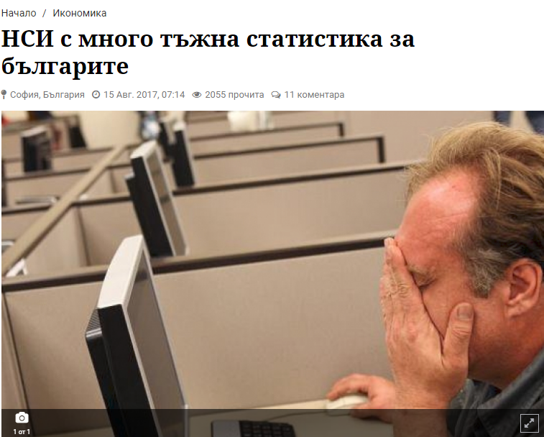
The Dataset
Headline: “NSI with very sad statistics about the Bulgarians”
Actually: The body text presents the data from the labor survey and it is rather promising (unemployment is decreasing with 1.7%)
Number of reads: 2055

Slide 5
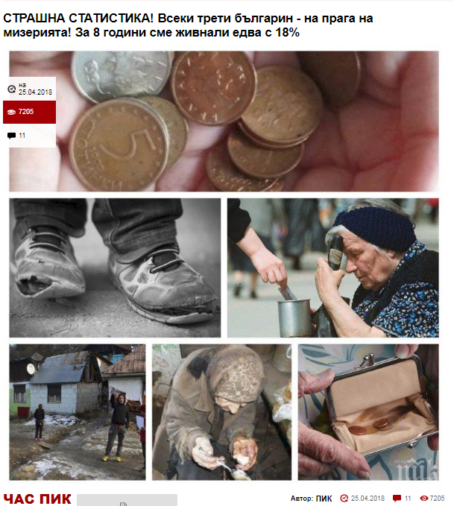
The Dataset
Headline: “SCARY STATISTICS! Every third Bulgarian – on the edge to misery! We have been boosted only by 18% for the last 8 years”
Actually: The body text presents data from the statistics on Social Inclusion and Living Conditions and the share of people living in poverty has dropped by 16% for 6 years
Number of reads: 7205

Slide 6
The Dataset
1175 headlines from 21 news websites from 2017
945 non-clickbaits
230 clickbaits

Slide 7
The models
Developing two bag-of-words models with words as features and with parts of speech as features
Handling the unbalanced dataset
Using SVM classifier in R

Slide 8
Main results – words as features
 | Precision | Recall | F1 | AUC
Clickbait | 0.33 | 0.63 | 0.43 | 0.66
Non- clickbait | 0.88 | 0.68 | 0.77 | 0.66

Slide 9
Main results – parts of speech as features
 | Precision | Recall | F1 | AUC
Clickbait | 0.96 | 0.52 | 0.68 | 0.76
Non- clickbait | 0.89 | 0.99 | 0.94 | 0.76

Slide 10
Conclusion
The threat is not in the use of fake news but in shaping official data as such
Emotions tend to grab the attention more than raw data
Tackling the problem requires involvement in the data dissemination process
If a machine can distinguish the clickbait headline so should the consumers

Slide 11
Thank you for your attention!
Questions?

