Slide 1
An integrated data collection system for farm structure statistics
Conference on New Techniques and Technologies for Statistics (NTTS)
J. Domingo Martínez Solano
Eurostat E1 – Agriculture and fisheries
Notes:
Welcome to this spotlight session…

Slide 2
IFS: Integrated Farm Statistics
Eight data collections
More than 10 million records
Around 400 collected and 700 derived variables

Slide 3
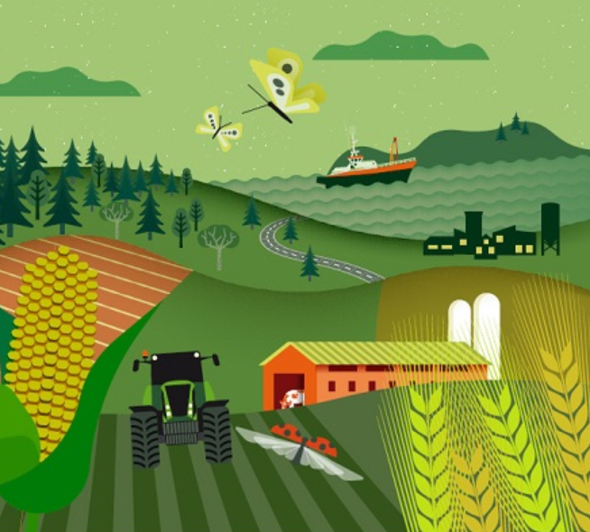
IFS: Eight integrated data collections
Farm structure microdata (2022)
Payments (2022)
ADM (2019)
Integrated Farm Statistics
Coverage thresholds
(2022)
NSNE (2019)
SO coefficients (2020)
RSEs (2022)
AWU factors (2022)

Slide 4
Goals of the project Eurofarm 2020
Create a semi-automated system to process, validate and disseminate farm structure statistics
Integrate the various data collections
Reduce burden to farmers and cost to taxpayers

Slide 5
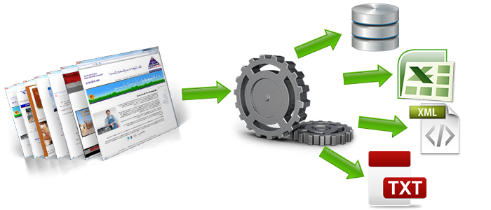
1) Collect data
New information data sources:
Administrative data
Modelling
Big data

Slide 6
2) Process – validate: Validation levels

Slide 7
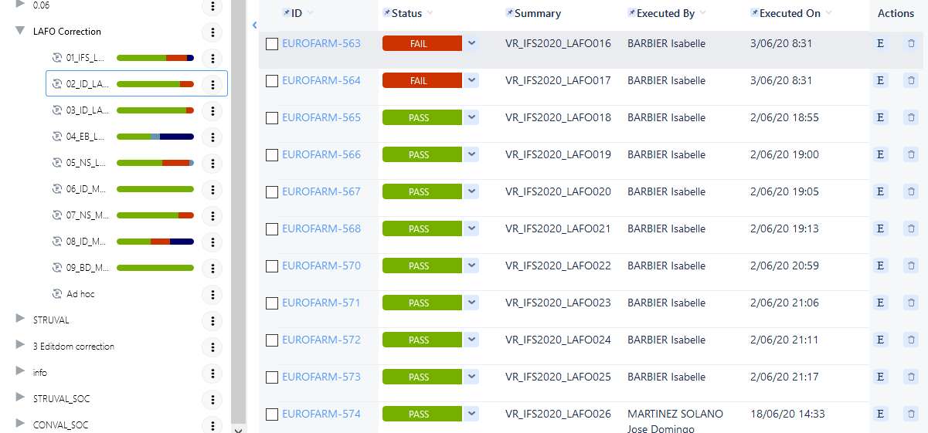
2) Process – validate: Project execution
Planning
Clear requests
Exhaustive but not redundant testing
Tracking progress
Traceability

Slide 8
3) Disseminate: meeting user needs
More combinations of variables
Scientific use files
Longer time series

Slide 9
Results: Less costs…and better quality
Reduce burden to farmers and cost to taxpayers
Higher quality
Accuracy: Sistematically assess data
Timeliness: Earlier publication of data as compared to previous periods
Relevance: Meet more user needs
Cost - effectiveness: Automated data processing and validation

