Slide 1
Estimation of monthly labour force figures during the COVID-19 pandemic
${\text{Jan} \text{van} \text{den} \text{Brakel}}^{†‡}$, ${\text{Martijn} \text{Souren}}^{†}$, ${\text{Sabine} \text{Krieg}}^{†}$
†: Statistics Netherlands
‡: Maastricht University
NTTS, Brussels, 09-11 March 2021
Corresponding author: jbrl@cbs.nl

Slide 2
Introduction
Labour Force Survey (LFS)
Rotating panel design: monthly samples observed 5 times at quarterly intervals
Data collection based on
First wave: web interviewing (WI), telephone interviewing (CATI), face-to-face interviewing (CAPI)
Follow-up waves: CATI only
Due to the lockdown:
CAPI stopped: systematic effects on the outcomes
Strong effects on real period-to-period change LFS figures
Problem:
How to separate changes in mode effects from real period-to-period changes?

Slide 3
Estimation approach for official monthly LFS figures
Structural time series model:
Small area estimation (borrowing strength from the past)
Account for rotation group bias
Rotating panel: sample observed five times at quarterly intervals
${\hat{y}}_{t}^{(j)}$: direct estimate month t, based on the panel that is observed for the j-th time
$$\left(\begin{matrix}{\hat{y}}_{t}^{(1)} \\ {\hat{y}}_{t}^{(2)} \\ \begin{matrix}{\hat{y}}_{t}^{(3)} \\ \begin{matrix}{\hat{y}}_{t}^{(4)} \\ {\hat{y}}_{t}^{(5)}\end{matrix}\end{matrix}\end{matrix}\right)=\left(\begin{matrix}1 \\ 1 \\ \begin{matrix}1 \\ \begin{matrix}1 \\ 1\end{matrix}\end{matrix}\end{matrix}\right)θ_{t}^{y}+\left(\begin{matrix}0 \\ λ_{t}^{(2)} \\ \begin{matrix}λ_{t}^{(3)} \\ \begin{matrix}λ_{t}^{(4)} \\ λ_{t}^{(5)}\end{matrix}\end{matrix}\end{matrix}\right)+\left(\begin{matrix}e_{t}^{(1)} \\ e_{t}^{(2)} \\ \begin{matrix}e_{t}^{(3)} \\ \begin{matrix}e_{t}^{(4)} \\ e_{t}^{(5)}\end{matrix}\end{matrix}\end{matrix}\right)$$
population parameter: $θ_{t}^{}=L_{t}+S_{t}+I_{t}^{}$ (= trend/cycle + seasonal + white noise).

Slide 4
Problems due to COVID-19
No CAPI data collection in the first wave (April until August)
Shock in ${\hat{y}}_{t}^{(1)}$ due to sudden change in mode effects
Strong effect on the real period-to-period changes
Lockdown marks a sharp turning point in the monthly LFS figures
How to account in the time series model for the increased dynamics in the LFS figures

Slide 5
Problem 1: changing mode effects due to loss of CAPI
$$\left(\begin{matrix}{\hat{y}}_{t}^{(1)} \\ {\hat{y}}_{t}^{(2)} \\ \begin{matrix}{\hat{y}}_{t}^{(3)} \\ \begin{matrix}{\hat{y}}_{t}^{(4)} \\ {\hat{y}}_{t}^{(5)}\end{matrix}\end{matrix}\end{matrix}\right)=\left(\begin{matrix}1 \\ 1 \\ \begin{matrix}1 \\ \begin{matrix}1 \\ 1\end{matrix}\end{matrix}\end{matrix}\right)θ_{t}^{y}+\left(\begin{matrix}0 \\ λ_{t}^{(2)} \\ \begin{matrix}λ_{t}^{(3)} \\ \begin{matrix}λ_{t}^{(4)} \\ λ_{t}^{(5)}\end{matrix}\end{matrix}\end{matrix}\right)+\left(\begin{matrix}δ_{t}^{(1)}β^{COV} \\ 0 \\ \begin{matrix}0 \\ \begin{matrix}0 \\ 0\end{matrix}\end{matrix}\end{matrix}\right)+\left(\begin{matrix}e_{t}^{(1)} \\ e_{t}^{(2)} \\ \begin{matrix}e_{t}^{(3)} \\ \begin{matrix}e_{t}^{(4)} \\ e_{t}^{(5)}\end{matrix}\end{matrix}\end{matrix}\right)$$
with $θ_{t}^{}=L_{t}+S_{t}+I_{t}^{}$
${\hat{y}}_{t}^{(1)}$: based on WI and CATI starting from April until August 2020
$δ_{t}^{(1)}=\left\{\begin{matrix}\begin{matrix}1 & \text{from} \text{April} \text{until} \text{August}\end{matrix} \\ \begin{matrix}0 & \text{otherwise} \end{matrix}\end{matrix}\right.$.
$β^{COV}$: discontinuity for the difference between ${\hat{y}}_{t}^{(1)}$ with and without CAPI
estimated with a separate model: next page

Slide 6
Problem 1: changing mode effects due to loss of CAPI
Estimation $β^{COV}$: difference first wave with and without CAPI
Used series first wave observed in the past under the sequential mixed mode design implemented in April 2012
${\hat{y}}_{t}^{\left(1\right)}$: series direct estimates first wave based on WI, CATI and CAPI from April 2012 – March 2020
${\hat{y}}_{t}^{\left(∗1\right)}$: series direct estimates first wave based on WI and CATI only from April 2012 – March 2020
$x_{t}^{}$: series of claimant counts

Slide 7
Problem 1: changing mode effects due to loss of CAPI
Estimation $β^{COV}$: based on $Δ_{t}^{Ly}$ in the following model
$\left(\begin{matrix}{\hat{y}}_{t}^{\left(1\right)} \\ {\hat{y}}_{t}^{\left(∗1\right)} \\ x_{t}^{}\end{matrix}\right)=\left(\begin{matrix}L_{t}^{y} \\ L_{t}^{y} \\ L_{t}^{x}\end{matrix}\right)+\left(\begin{matrix}Δ_{t}^{Ly} \\ 0 \\ 0\end{matrix}\right)+\left(\begin{matrix}S_{t}^{y} \\ S_{t}^{y} \\ S_{t}^{x}\end{matrix}\right)+\left(\begin{matrix}e_{t}^{y1} \\ e_{t}^{y1∗} \\ e_{t}^{x}\end{matrix}\right)$
$$\begin{matrix}\begin{matrix}L_{t}^{p}=L_{t−1}^{p}+R_{t−1}^{p} \\ Δ_{t}^{Ly}=Δ_{t−1}^{Ly}+ξ_{t}^{}\end{matrix} & \begin{matrix}R_{t}^{p}=R_{t−1}^{p}+η_{t}^{p} \\ {}_{}^{}\end{matrix} & \begin{matrix}\begin{matrix}η_{t}^{p}\sim N\left(0,σ_{η,p}^{2}\right) \\ ξ_{t}^{}\sim N\left(0,σ_{η,p}^{2}\right)\end{matrix} & \begin{matrix}p=x or y \\ {}_{}^{}\end{matrix}\end{matrix}\end{matrix}$$
$$cov\left(e_{t}^{y1},e_{t}^{y1∗}\right)=\frac{n_{1∗}}{\sqrt{n_{1}}\sqrt{n_{1∗}}}\sqrt{var\left({\hat{y}}_{t}^{\left(1\right)}\right)}\sqrt{var\left({\hat{y}}_{t}^{\left(∗1\right)}\right)}$$

Slide 8
Results $β^{COV}$: Differences first wave with and without CAPI after Lagrange
Unempl LF Empl LF Total LF
National -20848 (2555) 35052 (4206) 14203 (4125)
Men 15-24 -8494 (3023) -9903 (2052) -18396 (2128)
Women 15-24 -7097 (3469) -8140 (1950) -15236 (2051)
Men 25-44 -11539 (1059) 29000 (1851) 17461 (4097)
Women 25-44 -5268 (884) 36243 (2711) 30976 (8651)
Men 45-74 5739 (1083) -3325 (6413) 2415 (6543)
Women 45-74 5809 (2182) -8824 (11774) -3015 (10273)
Standard errors in brackets

Slide 9
Problem 1: changing mode effects due to loss of CAPI
$$\left(\begin{matrix}{\hat{y}}_{t}^{(1)} \\ {\hat{y}}_{t}^{(2)} \\ \begin{matrix}{\hat{y}}_{t}^{(3)} \\ \begin{matrix}{\hat{y}}_{t}^{(4)} \\ {\hat{y}}_{t}^{(5)}\end{matrix}\end{matrix}\end{matrix}\right)=\left(\begin{matrix}1 \\ 1 \\ \begin{matrix}1 \\ \begin{matrix}1 \\ 1\end{matrix}\end{matrix}\end{matrix}\right)θ_{t}^{y}+\left(\begin{matrix}0 \\ λ_{t}^{(2)} \\ \begin{matrix}λ_{t}^{(3)} \\ \begin{matrix}λ_{t}^{(4)} \\ λ_{t}^{(5)}\end{matrix}\end{matrix}\end{matrix}\right)+\left(\begin{matrix}δ_{t}^{(1)}β^{COV} \\ 0 \\ \begin{matrix}0 \\ \begin{matrix}0 \\ 0\end{matrix}\end{matrix}\end{matrix}\right)+\left(\begin{matrix}e_{t}^{(1)} \\ e_{t}^{(2)} \\ \begin{matrix}e_{t}^{(3)} \\ \begin{matrix}e_{t}^{(4)} \\ e_{t}^{(5)}\end{matrix}\end{matrix}\end{matrix}\right)$$
with $θ_{t}^{}=L_{t}+S_{t}+I_{t}^{}$
${\hat{y}}_{t}^{(1)}$: based on WI and CATI starting from April until August 2020
$δ_{t}^{(1)}=\left\{\begin{matrix}\begin{matrix}1 & \text{from} \text{April} \text{until} \text{August}\end{matrix} \\ \begin{matrix}0 & \text{otherwise} \end{matrix}\end{matrix}\right.$.
$β^{COV}$: discontinuity for the difference between ${\hat{y}}_{t}^{(1)}$ with and without CAPI
estimated with a separate model: next page

Slide 10
Problem 2: increased dynamics in the LFS figures
Time series component for the population parameter:
$$θ_{t}^{y}=L_{t}+S_{t}+I_{t}^{}$$
Trend/cycle model:
$$\begin{matrix}L_{t}^{}=L_{t−1}^{}+R_{t−1}^{} \\ R_{t}^{}=R_{t−1}^{}+η_{t}^{} \\ η_{t}^{}\sim N\left(0,σ_{η}^{2}\right)\end{matrix}$$
Model miss-specification: extreme outlier in the standardized innovations for April 2020 (absolute values >4)

Slide 11
Problem 2: increased dynamics in the LFS figures
Adaption of the time series model:
Temporarily increasing the variance for the slope disturbance terms:
$$η_{t}^{}\sim N\left(0,{k_{t}σ}_{η}^{2}\right)$$
Increased variance such that the standardized innovations for April, etc. : 2.0 – 2.2 (in absolute values)
Also: likelihood and external information (claimant counts)
Interpretation:
By increasing the model variance, the time series model gives more weight to the direct estimates in April and less weight to the model predictions based on the past

Slide 12
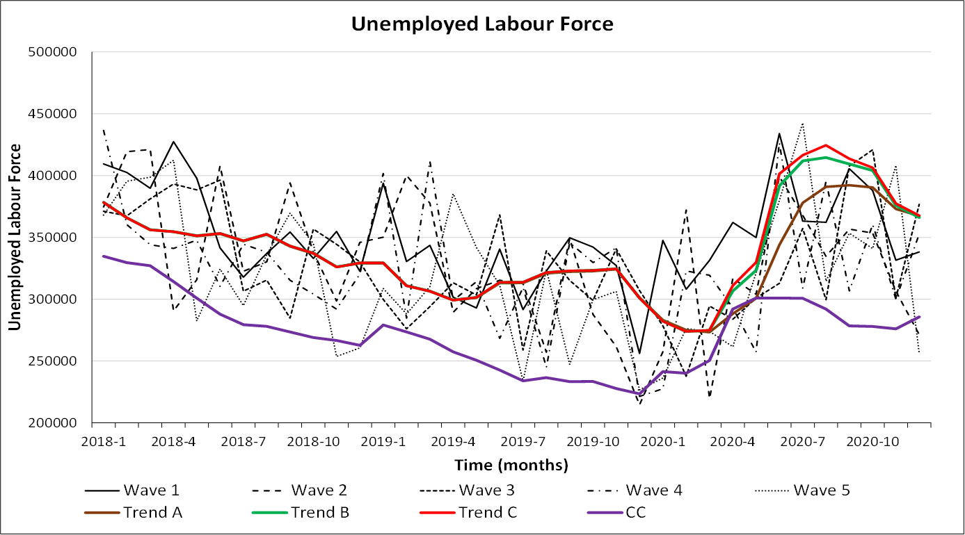
Trend 1: production model CC: claimant counts
Trend 2: time varying trend variance
Trend 3: time varying trend variance + correction missing CAPI

Slide 13
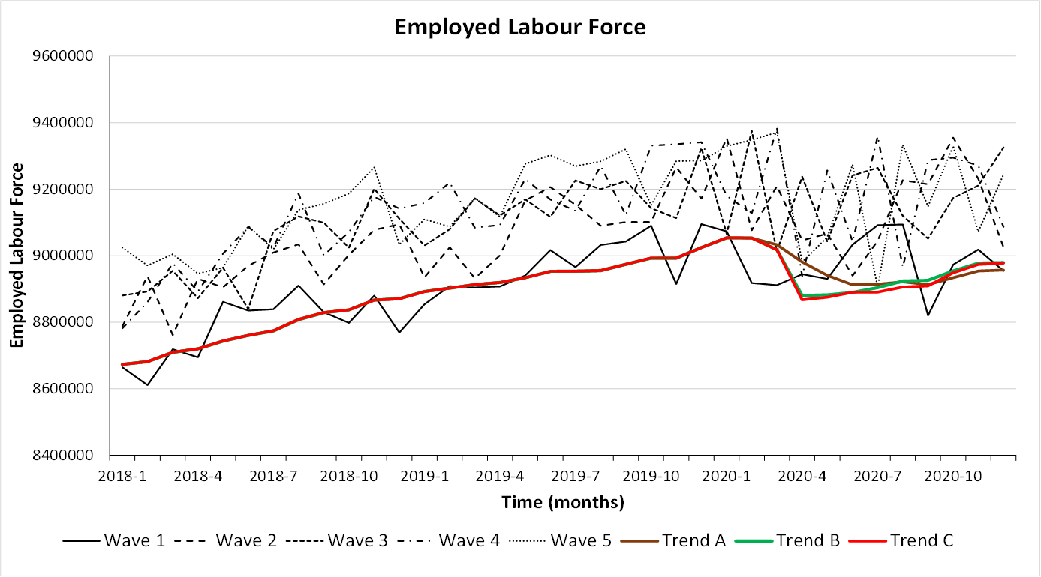
Trend 1: production model
Trend 2: time varying trend variance
Trend 3: time varying trend variance+correction missing CAPI

Slide 14
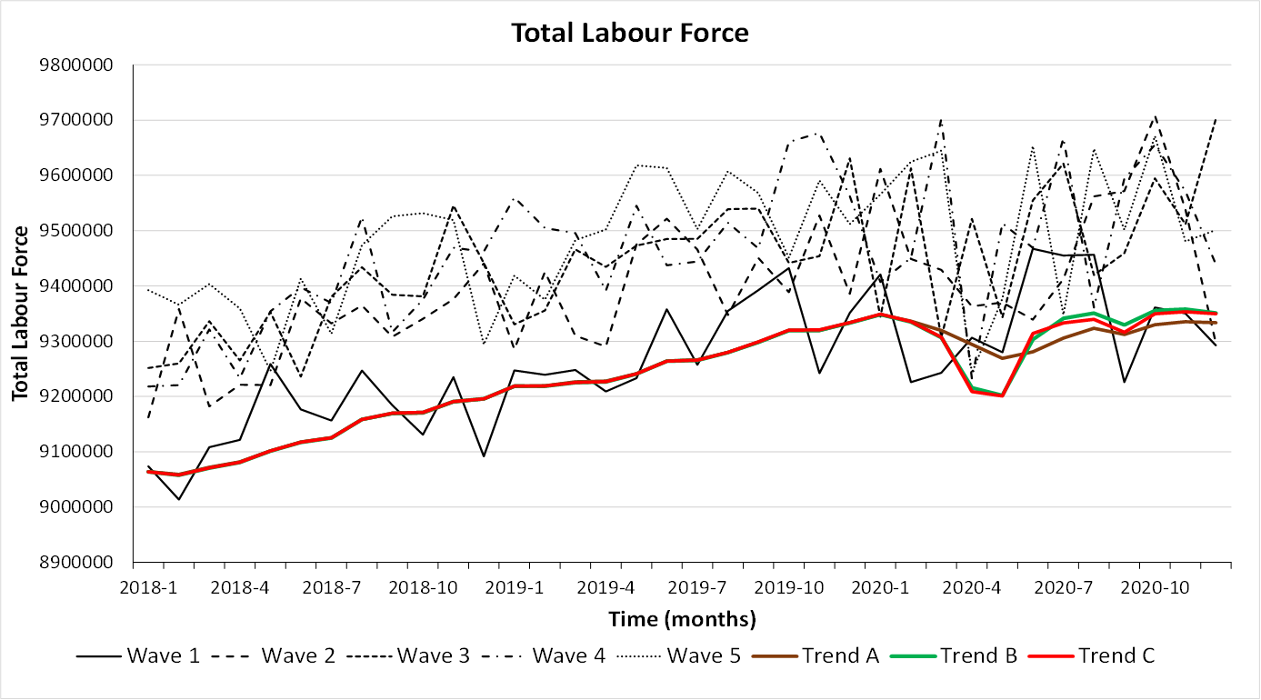
Trend 1: production model
Trend 2: time varying trend variance
Trend 3: time varying trend variance+correction missing CAPI

Slide 15
Discussion
COVID-19 has 2 effects:
Change in mode effects
Modelled via a level intervention (estimated with a separate model)
Effect is relative small
Change in the dynamics of the series
Model of the trend component is adjusted by making the variance of the trend disturbance terms time varying
Effect is relative large
Alternative options for both problems are discussed in the paper:
Estimating monthly Labour Force Figures during the COVID-19 pandemic in the Netherlands, Discussion paper, February 2021, Statistics Netherlands

Slide 16
Assumptions
Difference between first wave with and without CAPI is not affected by the lockdown (option 1 and 2)
WI and CATI response before and after the lockdown is comparable (all options)

Slide 17
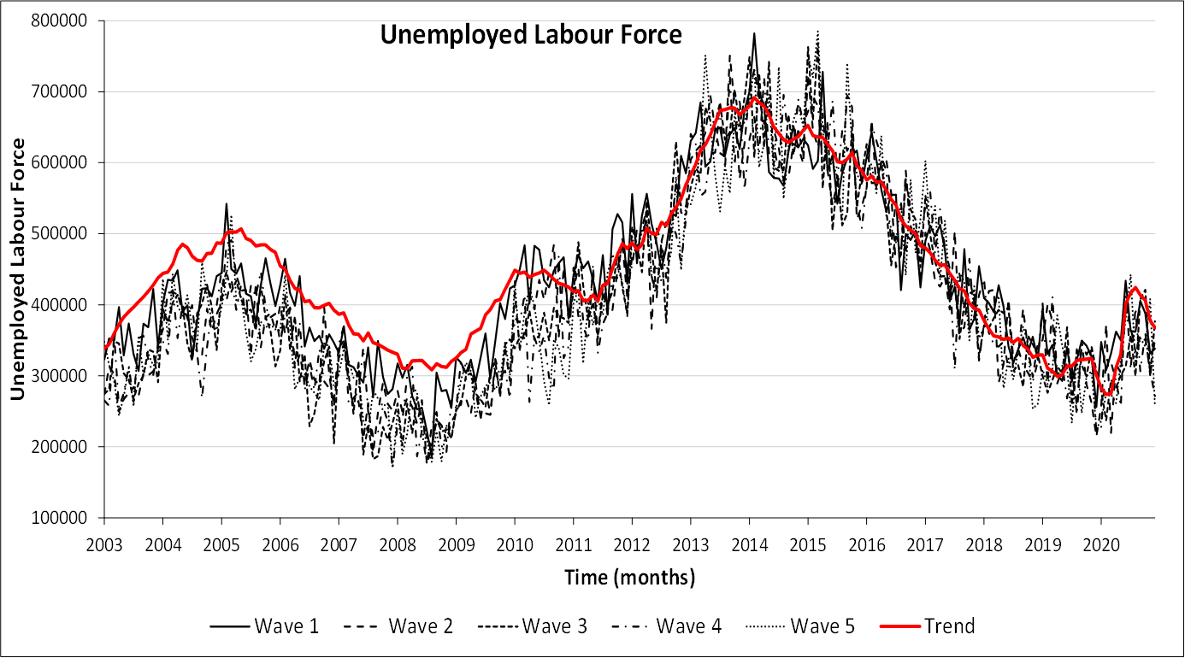
Trend: time varying trend variance+correction missing CAPI

Slide 18
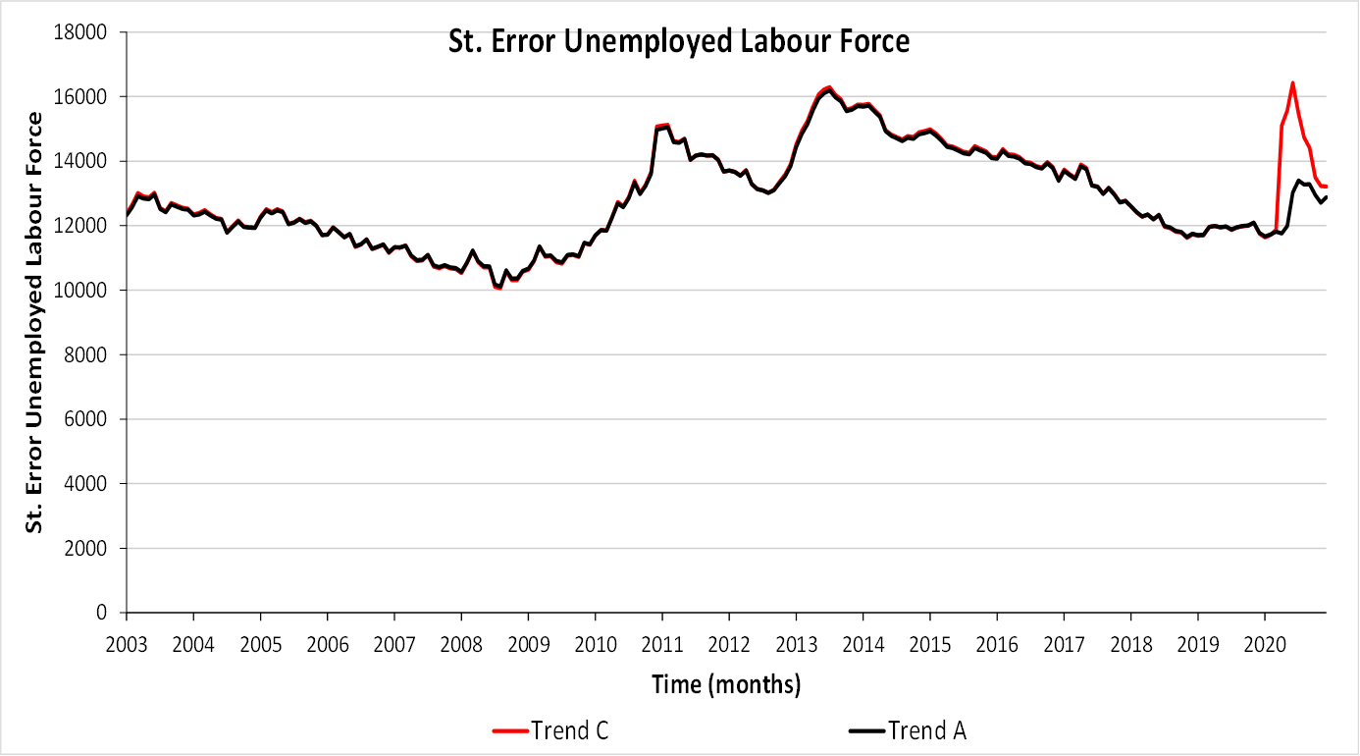
Trend A: original production model
Trend C: time varying trend variance+correction missing CAPI

Slide 19
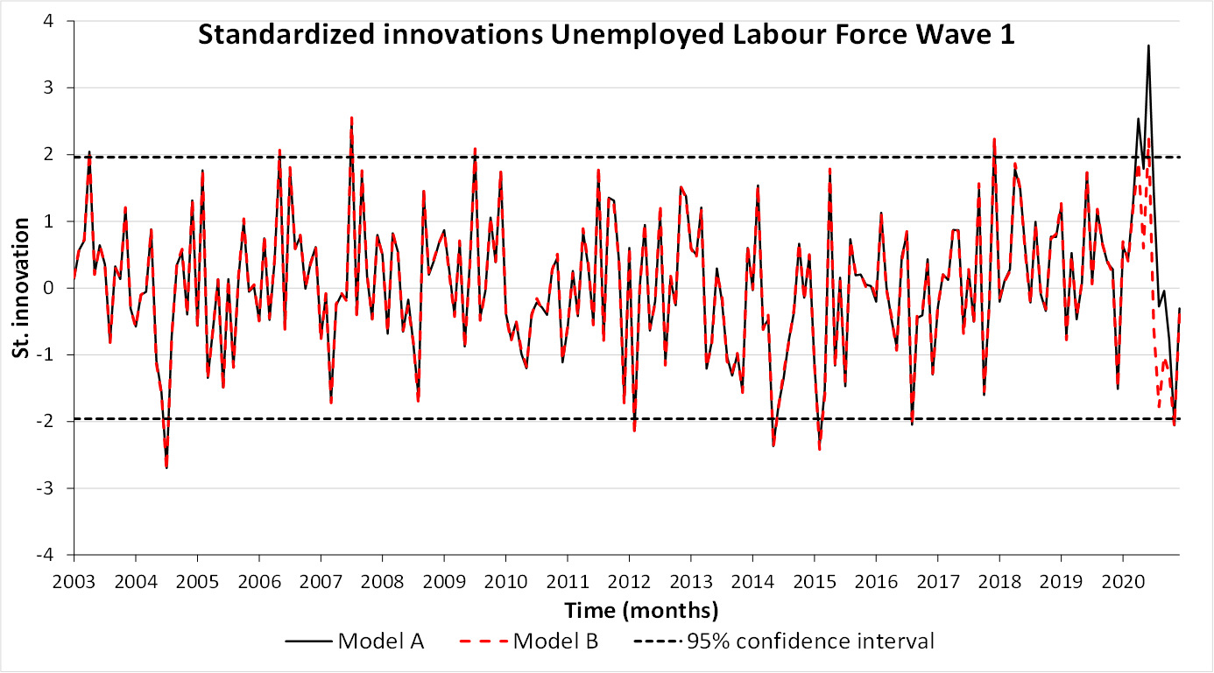
Trend A: original production model
Trend B: time varying trend variance

