Slide 1

Building consistent and efficient validation models
Nikolaos Iliopoulos
co-authors:
Maria Kotronia/Sigrid Dannbauer
NTTS 2021
9 - 11 March 2021
Disclaimer: This contribution does not represent the views of the European Central Bank (ECB). ​
The views expressed are those of the authors and do not necessarily reflect those of the ECB.​

Slide 2

1. Centralised Submission platform
Overview and validation engine

Slide 3
Centralised submission platform
Collect
Validate & Process
Analyse
NCA/NCB
Data
☑ Data collection
Analytical systems
Feedback
☑ Data validation
Data
☑ Data storage
e.g. MFI
☑ Data transfer
Data
Internet
Feedback
CSV
Other
Legend
Manual
NCAs: national competent authorities
NCBs: national central banks
MFIs: monetary and financial institutions
Automatic - push
Automatic - pull
Supported file formats

Slide 4
Centralised submission platform
Business validation engine
Define Validity Checks
Validate Data
Results
ISDATE(date_received) = TRUE
ISDATE(date_received) = TRUE
COUNT(UNIQUE(product_id)) = COUNT(product_id)
txt
COUNT(UNIQUE(product_id)) = COUNT(product_id)
Validation Engine
…..
csv
Validation Results
SUM(PD_Q1,PD_Q2,PD_Q3,PD_Q4) = 1
xlsx
SUM(PD_Q1,PD_Q2,PD_Q3,PD_Q4) = 1
...
Validation checks are applied to the received file
Validation results are displayed in the user-interface

Slide 5
2. Implementation
Description of the problem and solution

Slide 6
Scope
Problem description
01
Test the validity of the defined validation rules
Challenge
Absence of realistic sample files.
02
Solution
03
Generation of synthetic data based on the validation rules and inconsistency detection

Slide 7

Generation of data based on rules
SUM (assets) = SUM (liabilities)
txt
COUNT(product_id_A) = COUNT(product_id_B)
Parse formulas
Save generated data
csv
Identification of variables & data types
…..
...
xlsx
The custom solver finds the optimal combination of values that satisfy the constraints
A new file is generated with
the synthetic data
Set of validation rules
Simulate Data

Slide 8

Inconsistency detection
Sometimes the validation rules may have logical errors and are contradictory
Solution: Proposal of different data models
Rules 1 & 2 used
for simulated data
1) Data_Point_1 < 0
Rules 1 & 3 used
for simulated data
2) Data_Point_2 < 0
3)SUM(Data_Point_1 , Data_Point_2) > 0
Rules 2 & 3 used for
simulated data
The set of rules is inconsistent
Only consistent rule sets are selected for the simulation
Different data models are proposed

Slide 9

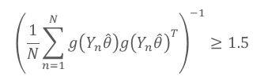
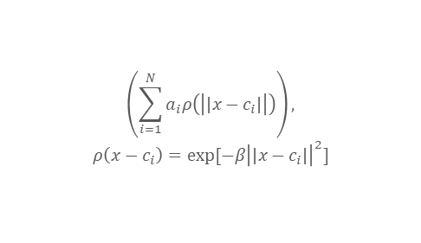

Evolution of smart data quality management & data simulation
Generalized Approach: Any set of equations can be used with this efficient validation program
→ Test data that satisfy complex conditions can be generated effectively
$${\left(\sum_{i=1}^{N}{x_{i}y_{i}+c }\right)}^{2}=0.05$$
$$\left(\sum_{i=1}^{N}{a_{i}ρ\left(\left|\left|x−c_{i}\right|\right|\right)}\right),$$
$$ρ\left(x−c_{i}\right)=exp⁡[−β{\left|\left|x−c_{i}\right|\right|}^{2}]$$
txt
Import equations
Generate Data
csv
…..
xlsx
$${\left(\frac{1}{N}\sum_{n=1}^{N}{g\left(Y_{n}\hat{θ}\right)g{\left(Y_{n}\hat{θ}\right)}^{T}}\right)}^{−1}≥1.5$$
The application can analyse any set of equation and generate optimal (sub)sets of constraints
…

Slide 10
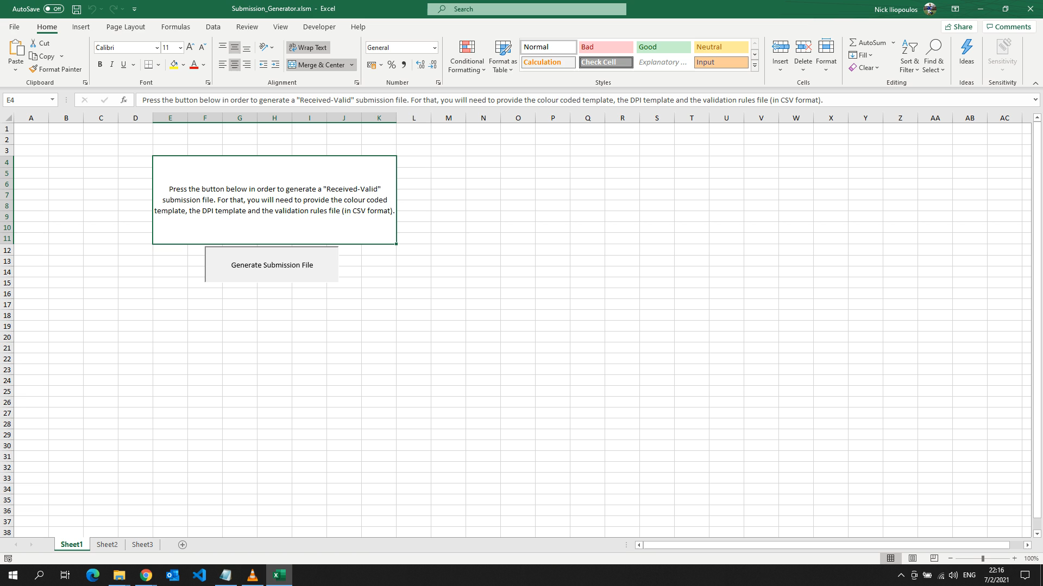

Slide 11


Technical implementation
Programming languages used:
  Python (along with C++ in the future)
  Python Libraries
      GEKKO https://gekko.readthedocs.io/en/latest/
      PYOMO http://www.pyomo.org/
  VBA

