Slide 1



Inequality and well-being in Europe: from a transnational to a place-based analysis
Conference on New Techniques
& Technologies for Official Statistics
(NTTS 2021 – 9-11 March)
Rosário Mauritti (rosario.mauritti@iscte-iul.pt)
Maria do Carmo Botelho
Nuno Nunes
Sara Franco da Silva
Luis Cabrita
Daniela Craveiro

Slide 2
Introduction
TIWELL – Territories of Inequality and Well-Being
Objective:
To operationalise a set of inequality and well-being monitoring indicators, with the adoption of a multi-scaling perspective – transnationally, nationally and place-based – that reveals how social inequalities have consequences on well-being of citizens.
Three Major outputs:
Multivariate statistical analysis, visualizations for associations and global indexes, substantive analysis in social sciences context.

Slide 3
Methods
Transnational & International analysis
Data: micro-data from the European Social Survey - 22 countries
(ESS8-2016+ESS6-2014 for Denmark)
Inequalities
Statistical Analysis
Gender
Social Class - ACM typology
(Costa et al., 2002)
Equivalent income
Education
(Basic, Upper secondary, Higher)
Supervision (None, 1-5, 6-10, >10)
Autonomy (Low, Medium, High)
Transnational scale:
Multiple component Analysis (MCA)
Cluster analysis
(hierarquical and non-hierarchiqual – K-means)
National scale:
Categorical Principal Components Analysis (CatPCA)
Weights: Post-stratification and new weight

Slide 4
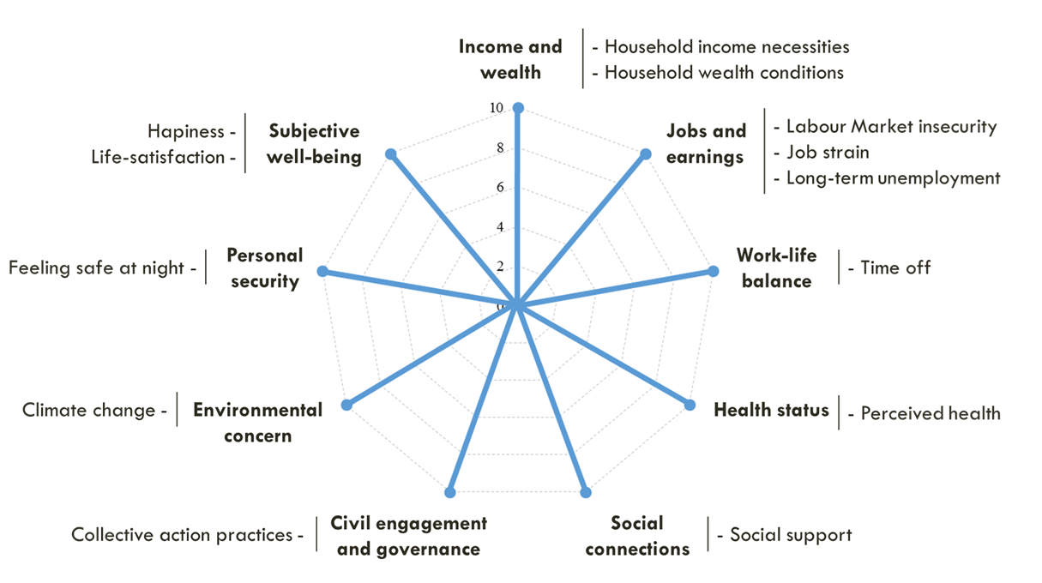
Methods
Transnational analysis
Well-being
Statistical Analysis
1-Selection of variables from ESS
2-Exploratory data analysis
3-Transformation and normalization (min-max) of indicators
4-Mean of well-being dimensions
by country
5-Cluster analysis
(hierarquical and
non-hierarchiqual – K-means)
Weights: Post-stratification and new weight

Slide 5
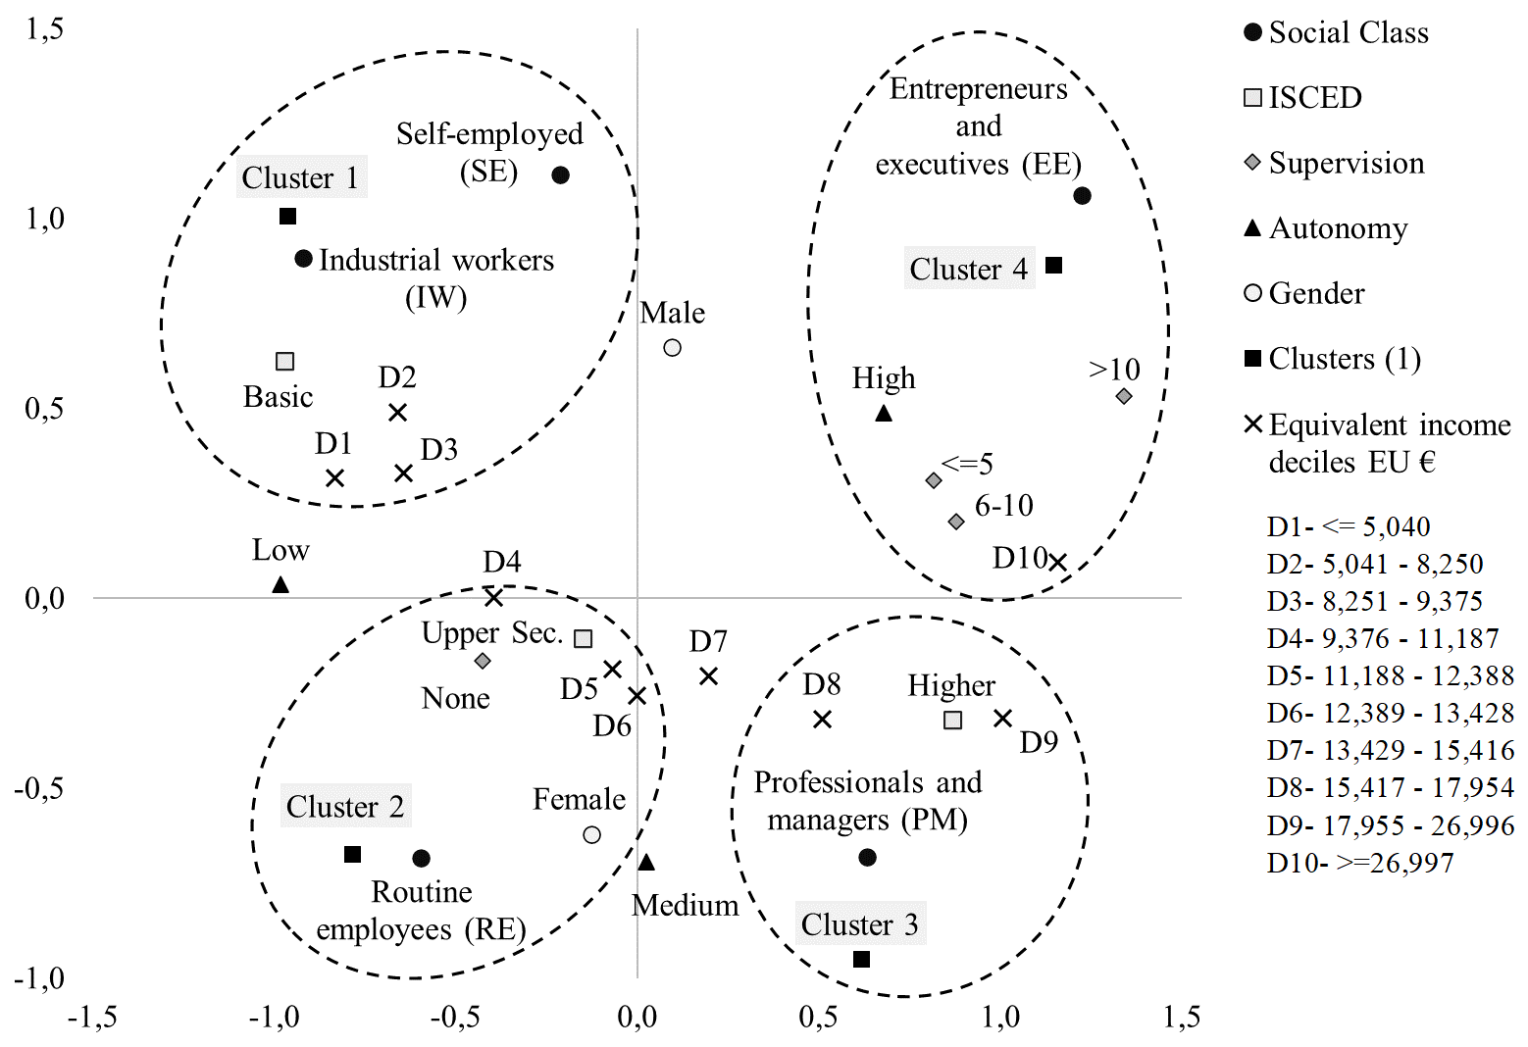
Results
Figure 1. The transnational social space of Europe
European social space of inequalities
Transnational analysis
Inequalities
Multiple Correspondence Analysis
+
Clusters analysis
4 clusters of Europeans, according social inequalities
Object: individual
Transnacional analysis

Slide 6
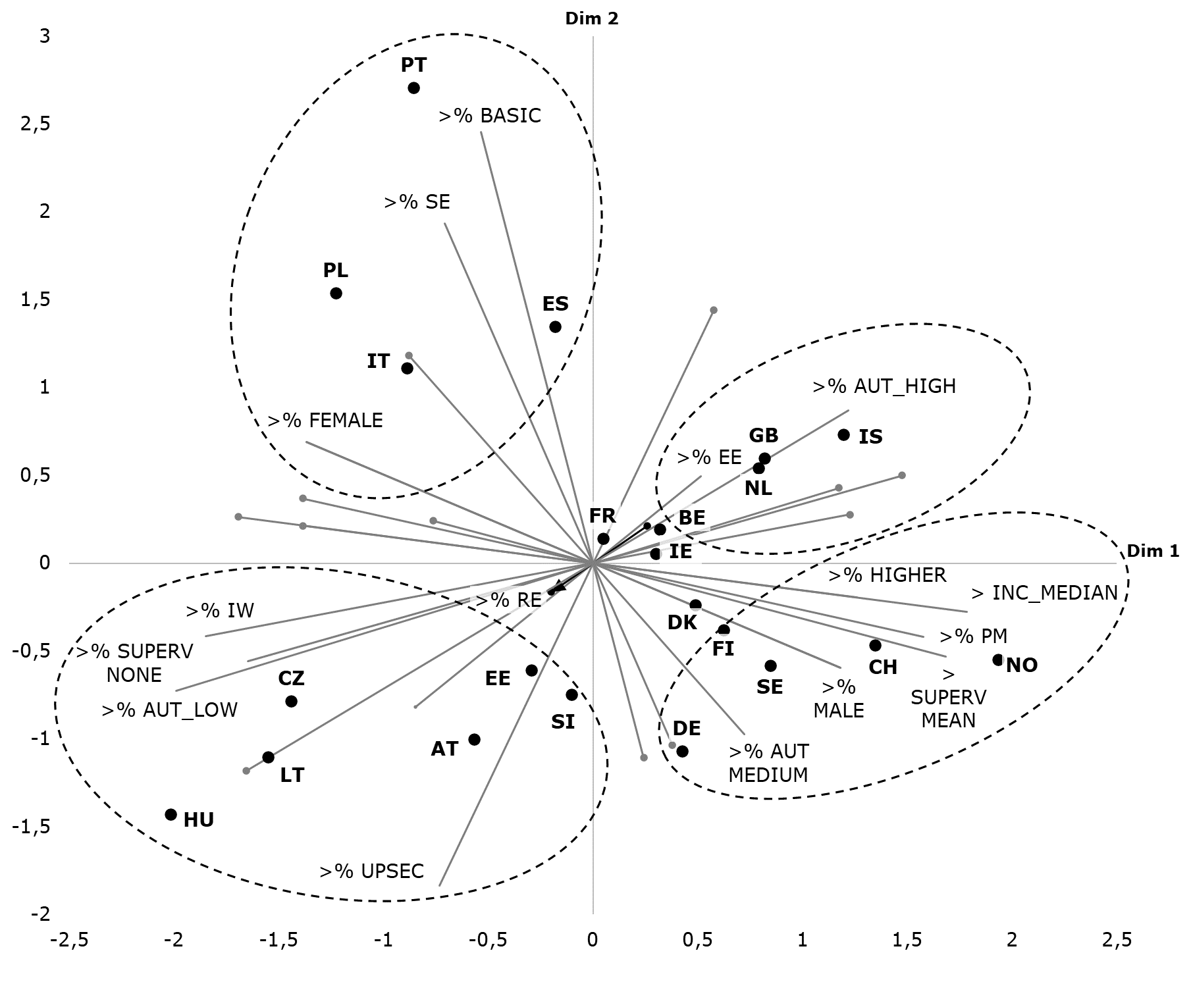
Figure 2. Inequality configurations in Europe
Results
Comparisons between countries
Inequalities
For each country the inequality variables were construct:
% of presence of each category
Income: median
Association between inequality indicators (and value direction).
The supplementary projection of the countries makes it possible to identify similarities and differences between them, regarding social inequalities.
Object: country

Slide 7
Results
Figure 3. Well-being profiles of European countries
Well-being
With country values for each well-being dimension, after clusters analysis it is possible to identify 5 clusters of countries.
Well-being global indicator by cluster, assuming that all dimensions are equally important.
Object:
1º individual – construction of well-being
dimensions
2º country – well-being profiles

Slide 8
Conclusions
The European social space is currently very unequal.
The analysis developed confirms the existence of multidimensional intersections between social inequalities and well-being.
The place-based analysis conducted in Portugal (using a mix-method approach)
  - Allowed to identified five national clusters of inequalities - constructed with some of the main indicators that are also significant at the transnational and national levels.
  – Then the analysis of the well-being conditions in these territories mobilised 74 place-based indicators, produced by Statistics Portugal and the regions, also confirms the multidimensional intersections between social inequalities and well-being.

Slide 9
Thank you
Conference on New Techniques
& Technologies for Official Statistics
(NTTS 2021 – 9-11 March)
Rosário Mauritti (rosario.mauritti@iscte-iul.pt)
Maria do Carmo Botelho (maria.botelho@iscte-iul.pt)
Nuno Nunes (nuno.nunes@iscte-iul.pt)
Sara Franco da Silva (Sara_Franco_Silva@iscte-iul.pt)
Luis Cabrita (luiscab200@hotmail.com)
Daniela Craveiro (daniela.craveiro@iscte-iul.pt)

