Slide 1
The path to integrate Deep Learning into Official Statistics
A review of uncertainty estimation techniques for deep learning
Krzysztof Cybulski¹², Marco Puts¹, Tim De Jong¹, Christof Seiler², Siamak Mehrkanoon²
1. Centraal Bureau voor de Statistiek (Statistics Netherlands)
2. Maastricht University

Slide 2
Deep learning for official statistics
Deep learning is a method which uses massive, complex models to solve tasks difficult to implement by hand, like in computer vision.
Deep neural networks require a lot of data to train, and they generally perform better and better as more data is provided; they tend to overfit, not underfit.
As such, deep learning allows us to leverage large quantities of data, which are more and more common in official statistics.

Slide 3
Deep learning for official statistics
Some possible use cases:
Road traffic classification from roadside cameras.
Predicting whether individuals will move within some timeframe.
Counting objects in aerial photographs, e.g. buildings to track urbanization.
Imputation; inferring missing values.

Slide 4
Deep learning is problematic
Common deep learning models only provide point estimates, without giving uncertainty information. We don't know how much we can trust their predictions.
For example, classifier softmax outputs are nonnegative and sum up to one, but if a model assigns a score of 95% to an input to a specific class, it does not actually mean there is a 95% probability that the input belongs to this class.
In fact, modern neural networks are really bad at this; they’re generally quite miscalibrated.

Slide 5
What can we do about it?
Various methods to deal with deep neural network uncertainties have been proposed.
I will talk about:
Uncertainty quantification
Selective abstention
Classifier calibration
Conformal prediction

Slide 6
Uncertainty quantification

Slide 7
Uncertainty quantification
Uncertainty quantification refers to methods to produce “confidence” values for model predictions.
These are not necessarily probabilities, but they can be.

Slide 8
Uses of uncertainty quantification
By quantifying uncertainty, we can:
Choose to abstain from using an uncertain model prediction, and forward it to experts for manual inspection.
Detect which inputs confuse our models, and thus gain insights in what we need to improve. This can be used for an active learning pipeline, where we focus on training our models on especially difficult instances.
See PhD thesis of Yonatan Geifman (2019) for in depth review.

Slide 9
Uncertainty quantification methods
One branch of work comes from a Bayesian perspective, by trying to model uncertainties over parameters. Gal and Ghahramani (2016) found that stochastic regularization techniques like dropout approximate variational inference in Bayesian neural networks.
Hence, by using dropout repeatedly, we can sample multiple predictions from the predictive distribution given one input. Variance of these predictions is then a measure of uncertainty.
See Yarin Gal's PhD thesis (2016) for a deeper dive into Bayesian deep learning.
Gal, Y., & Ghahramani, Z. (2016). Dropout as a Bayesian Approximation: Representing Model Uncertainty in Deep Learning. ICML 2016

Slide 10
Uncertainty quantification methods
Lakshminarayanan et al. (2017) instead simply trained multiple models to produce ensembles of DNNs, and hence obtained samples from a predictive distribution. They found that five models were sufficient for good uncertainties from the variance.
An interesting side finding is that models trained on bootstrapped data do not perform so well. Nixon et al. (2020) evaluated ensembles trained on such data and discovered that these models perform worse than ensembles simply trained on the entire dataset.

Slide 11
Uncertainty quantification methods
Lakshminarayanan, B., Pritzel, A., & Blundell, C. (2017). Simple and Scalable Predictive Uncertainty Estimation using Deep Ensembles. NIPS 2017
Jeremy Nixon, Balaji Lakshminarayanan, Dustin Tran, (2020) Why Are Bootstrapped Deep Ensembles Not Better? In I Can't Believe It's Not Better! Workshop at NeurIPS 2020 (ICBINB@NeurIPS 2020)

Slide 12
Types of uncertainties
Kendall and Gal (2017) divide DNN uncertainties into:
aleatoric (inherent in data)
epistemic (coming from the model)
Of these, aleatoric uncertainties cannot be improved upon without changing the data; for instance, dice rolls remain random, no matter how good our model is.
Epistemic uncertainties, on the other hand, can be improved with better models.
Kendall, A., & Gal, Y. (2017). What Uncertainties Do We Need in Bayesian Deep Learning for Computer Vision? NIPS 2017

Slide 13
Issues with uncertainty quantification methods
Deep ensembles and MC-Dropout are costly to use, since the deep ensembles require multiple models to be trained and both methods need multiple predictions to be computed.
To avoid this, some recent work is focused on obtaining uncertainty estimates from single predictions. An example of work in this direction is Gast and Roth (2018), who output parametric probability distributions of possible output values for each input.
Unfortunately, it is too early to say which of these methods are reliable.
Gast, J., & Roth, S. (2018). Lightweight Probabilistic Deep Networks. 2018 IEEE/CVF Conference on Computer Vision and Pattern Recognition.

Slide 14
Read more about uncertainty quantification
A very extensive review preprint was published recently. (Abdar et al., 2021)
Abdar, M., Pourpanah, F., Hussain, S., Rezazadegan, D., Liu, L., Ghavamzadeh, M., Fieguth, P., Cao, X., Khosravi, A., Acharya, U. R., Makarenkov, V., & Nahavandi, S. (2021). A Review of Uncertainty Quantification in Deep Learning: Techniques, Applications and Challenges. ArXiv:2011.06225 [Cs]. http://arxiv.org/abs/2011.06225

Slide 15
Selective abstention

Slide 16
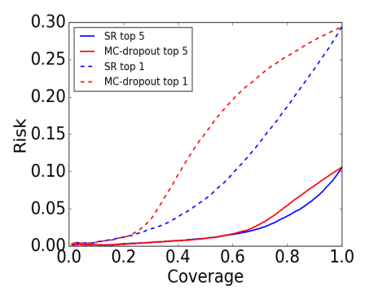
Selective abstention
Selective abstention is the methodology of abstaining from predictions if we suspect them to be wrong.
Usually, it is performed by defining a confidence function on inputs and setting a threshold below which they are not classified.
All uncertainty estimation methods mentioned before can be used for confidence functions.
A coverage-risk plot from (Geifman and El-Yaniv, 2017)
SR – maximum softmax response

Slide 17
Selective abstention
Geifman and El-Yaniv (2017) provide the Selection with Guaranteed Risk (SGR) algorithm that, given a confidence function, provides a confidence threshold which obtains a desired risk with guaranteed performance, under assumption of i.i.d.
Geifman, Y., & El-Yaniv, R. (2017). Selective Classification for Deep Neural Networks. NIPS 2017

Slide 18
Baselines for selective abstention
If you would like to try your own confidence function for selective abstention, see Hendrycks and Gimpel (2017) for a baseline to compare against. They evaluated performance of maximum softmax response (SR) as a confidence function on multiple tasks.
Also, be sure to check Shafaei et al. (2019) for a rigorous procedure in evaluating out-of-distribution detectors.
A more recent, well performing method is ODIN (Liang et al., 2018), which uses softmax values of perturbed inputs.
Hendrycks, D., & Gimpel, K. (2017). A Baseline for Detecting Misclassified and Out-of-Distribution Examples in Neural Networks. ICLR 2017
Shafaei, A., Little, J. J., & Schmidt, M. (2019). A Less Biased Evaluation of Out-of-distribution Sample Detectors. in BMVC 2019.
Liang, S., Li, Y., & Srikant, R. (2018). Enhancing The Reliability of Out-of-distribution Image Detection in Neural Networks. ICLR 2018

Slide 19
Classifier calibration

Slide 20
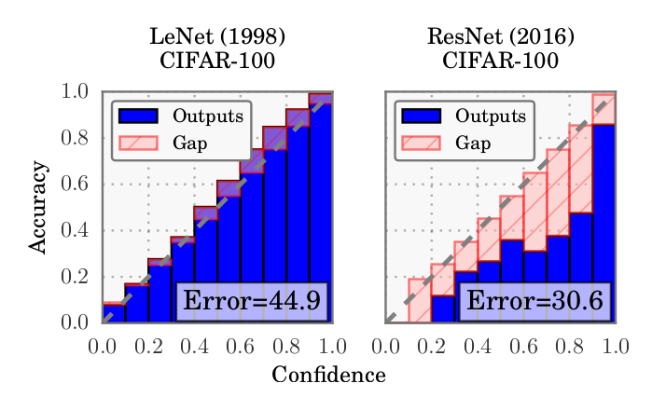
Classifier calibration
As mentioned before, modern deep neural classifiers are often miscalibrated (Guo et al., 2017).
Reliability diagrams from Guo et al. (2017) illustrating P(y is correct label for x | μ_{y}(x))
of two models. We can see that ResNet, a modern computer vision architecture, is a lot more miscalibrated than the older LeNet.
Guo, C., Pleiss, G., Sun, Y., & Weinberger, K. Q. (2017). On Calibration of Modern Neural Networks. Proceedings of the 34th International Conference on Machine Learning - Volume 70.

Slide 21
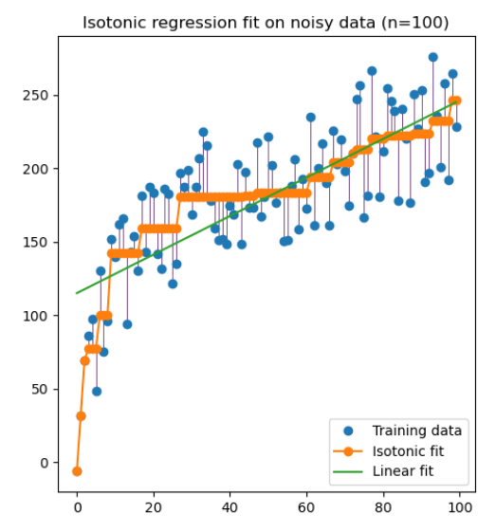
Calibration methods
To calibrate a model, it is necessary to keep a subset of data on which it was not trained. Then, based on this subset, a calibration function is constructed which maps model predictions μ(x) to true probabilities P(y is correct label for x | μ_{y}(x)).
Common calibration methods include isotonic regression and Platt scaling. In Platt scaling, predicted outputs are used as inputs for logistic regression.
Illustration of isotonic regression from scikit-learn documentation

Slide 22
Multi-class calibration
Guo et al. (2017) focuses on whether the predicted class output is calibrated correctly. Vaicenavicius et al. (2019) expand upon it by providing a framework to check if all of the predictions in the output vector are calibrated.
Vaicenavicius, J., Widmann, D., Andersson, C., Lindsten, F., Roll, J. & Schön, T.. (2019). Evaluating model calibration in classification. In PMLR 89:3459-3467

Slide 23
Conformal prediction

Slide 24
Conformal prediction
An issue with aforementioned calibration methods is that they do not provide correctness guarantees.
An alternative methodology which can provide guarantees for black box models in a finite number of samples is conformal prediction (Vovk, Gammerman and Shafer, 2005).
Conformal predictors output prediction sets with guaranteed coverage under the assumption of data exchangeability (i.e. all permutations are equally likely).
Vovk, V., Gammerman, A., & Shafer, G. (2005). Algorithmic Learning in a Random World. Springer-Verlag.

Slide 25
Conformal prediction basics
To construct a conformal predictor on top of a model, it is necessary to define a "nonconformity score“ s(x, y). This score measures how dissimilar a given example is to previously seen instances.
For example, a simple nonconformity score in regression can be the residuals; that is, absolute difference between the prediction and the label
s(x, y) = |μ(x) – y|

Slide 26
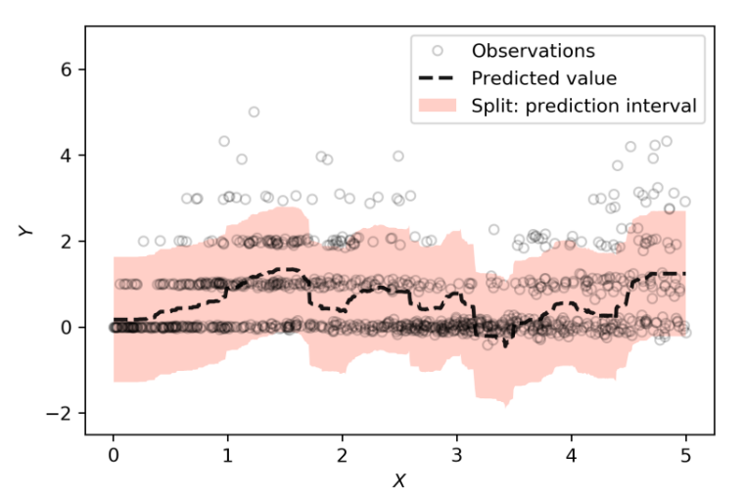
Conformal prediction basics
Given a usual, point-estimate model, we can compute nonconformity scores of instances from a hold-out calibration set.
Then, for a desired coverage level α, we compute a nonconformity score threshold q such that only (1 – α) of samples have a higher score.
Now, with this threshold, we set the predictive sets to be such that, for every input x, they contain all possible values of y around the model prediction μ(x) which would have a nonconformity score below q.
So, if we use residuals as a nonconformity score, the predictive sets are
Г(x) = [μ(x) – q, μ(x) + q]
Now, we know these sets will cover α of true predictor values. (Papadopoulos et al., 2002).
Example of predictive sets from Romano et al. (2019)
Papadopoulos, H., Proedrou, K., Vovk, V., & Gammerman, A. (2002). Inductive confidence machines for regression. In T. Elomaa, H. Mannila, & H. Toivonen (Eds.), Machine Learning: ECML 2002 (Vol. 2430, pp. 345–356).

Slide 27
Modern conformal prediction
One issue with conformal prediction using residuals as the nonconformity score is that the resulting intervals have constant length, even though some instances may be more difficult than others.
Furthermore, conformal prediction only guarantees marginal coverage, so it might be biased for subsets of the population.
Example of predictive sets from Romano et al. (2019)

Slide 28
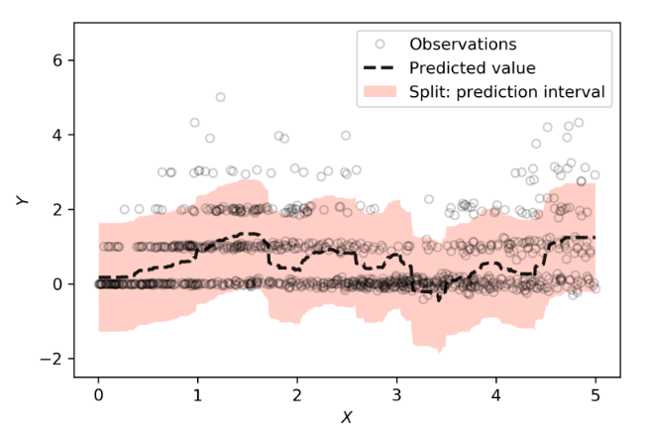
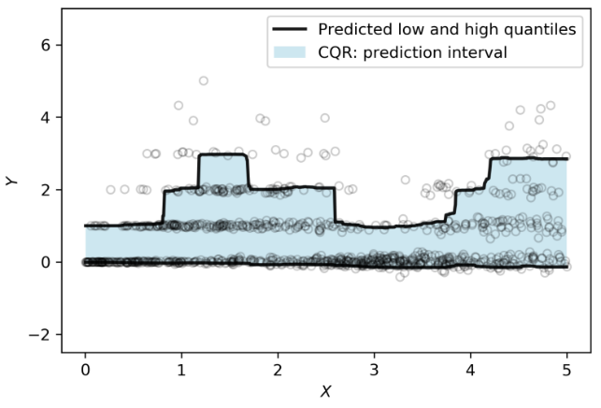
Modern conformal prediction
In an effort to counter this problem of needlessly wide intervals, Romano et al. (2019) propose Conformalized Quantile Regression (CQR).
By combining conformal prediction with quantile regression, they obtain predictive intervals with width conditional on the input features. However, CQR on its own still only provides marginal coverage.
In a more recent paper, Romano et al. (2020) propose a methodology for obtaining conditional coverage as well.
Comparison of mean + residual and CQR conformal prediction from Romano et al. (2019)

Slide 29
Modern conformal prediction
Romano, Y., Patterson, E., & Candes, E. (2019). Conformalized Quantile Regression. In Advances in Neural Information Processing Systems 32
Romano, Y., Barber, R. F., Sabatti, C., & Candès, E. (2020). With Malice Toward None: Assessing Uncertainty via Equalized Coverage. Harvard Data Science Review

Slide 30
Modern conformal prediction
For a more thorough look at recent developments in conformal prediction, I recommend a talk by Emmanuel Candes at the Bernoulli-IMS One World Symposium 2020.
https://www.youtube.com/watch?v=61tpigfLHso

