Slide 1


New Techniques and Technologies for Statistics (NTTS) Conference 2021
Smart data for multinational enterprises (MNEs)
Contract N° SC000050- ESTAT 2018.0086-2018.0182
overall duration: 6 April 2020 – 6 February 2021

Slide 2
New Techniques and Technologies for Statistics (NTTS) Conference 2021
Agenda
Introduction
Project‘s aim and scope
Advantages and Disadvantages of open data sources
Methods used
Results
Way forward

Slide 3
Introduction (I)
The big picture behind smart data for MNEs
  Traditionally, NSIs responsible for Business Register for statistical purposes
  EuroGroup Register (EGR) – facilitates the cooperation in the ESS for producing statistics on globalisation related business activties
  MNEs located outside the EU and active in the common market
  retrieving information about MNEs and enterprise groups operating in EU and EFTA countries
  Enrichment of the EGR
Why is it important for Eurostat?
  future developments within the Trusted Smart Statistics framework and the Web Intelligence Hub (WIH)

Slide 4
Introduction (I)
Smart statistics:
future extended role of official statistics in a world impregnated with smart technologies.
  real-time, automated, interactive technologies
  optimize the physical operation of appliances and consumer devices
  smart technology embedded in smart systems that would transform "data" to "information".
Trusted Smart statistics:
  a service provided by smart systems, embedding auditable and transparent data life-cycles, ensuring the validity and accuracy of the outputs, respecting data subjects' privacy and protecting confidentiality.

Slide 5
Project’s objectives and aims (I)
Scope and assess relevant data sources for producing information on MNE.
Tools to process, scrape/take raw data and extract the information required for analysis
Transformation of data
Deliver MNE relevant information that can be further exploited.
Developments within the Trusted Smart Statistics framework and the Web Intelligence Hub, for enhancing and extending the availability of information on MNE

Slide 6
Project’s objectives and aims (II)
1 Scoping
List of the data sources, a detailed description of the data sources and the data, a detailed report on the conditions and difficulties to use the data sources in a sustainable way, their potential and their limitations.
Data retrieval
Retrieved data and fully documented free and open source software routines, suitable to retrieve and keep up to date all the data from the sources identified while performing Task 1.
Pre-processing
Fully documented free and open source software routines, written in R, suitable to transform raw data into tabular data containing information about enterprise groups operating in the EU and EFTA countries. Information about enterprises and enterprise groups stamped with extraction reference date and source.
Transformation
Operational and interactive dashboard sto run in the most popular web browsers, display aggregate statistics extracted from the tabular data containing enterprise information, Functional documentation of the application, to be displayed as web pages.
Documentation
Abstract and scientific paper in publishable format, presentation. Documentation of statistical programs, source code in R on the Github repository of Eurostat

Slide 7
Advantages and disadvantages of open sources
(+) Reduced costs
(+) timeliness of information
(+) Smart Data could be updated on the spot
(+) infra-annual information and trends
(-) quality of information to be validated
(-) financial information not available

Slide 8
Overview and Assessment of Sources

Slide 9
Methods used
data collection via the use of APIs and web scraping
programs scripts - download the datasets are written in the R and Python
smaller bits of codes scripts
final formatted overview in the form of an “interactive dashboard”, are written in R
program scripts map variables and information obtained against current EGR
List of 199 companies provided by Eurostat and EGR variables

Slide 10
Results – Data retrieval (I)
organisation of the collection process was planned in a consistent way using the list of 199 MNEs
Issues on:
  Activity status: missing LEI would indicate a non-active status of the company. This information would need validation;
  Unclear names: the supplied list of names of the MNEs did not corresponded exactly with the names found through in the open data sources
  Companies and parent companies: Parent company could not be identified for some of the provided MNEs
  Companies not publicly listed
Information on pdf files/annual report unstructured

Slide 11
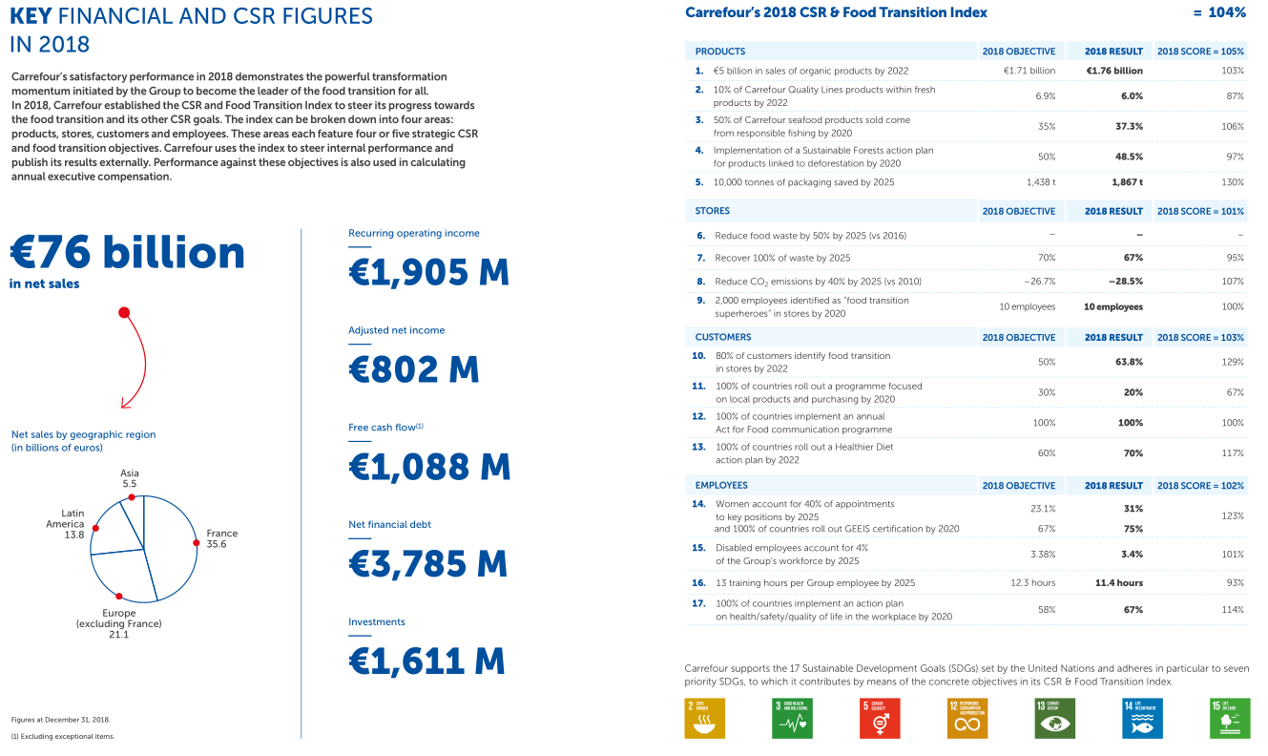
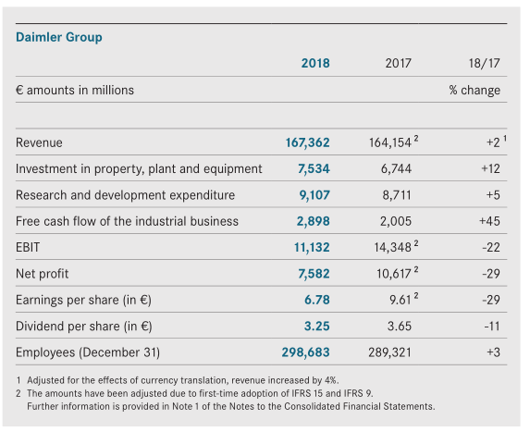
Results – Data retrieval (II)

Slide 12
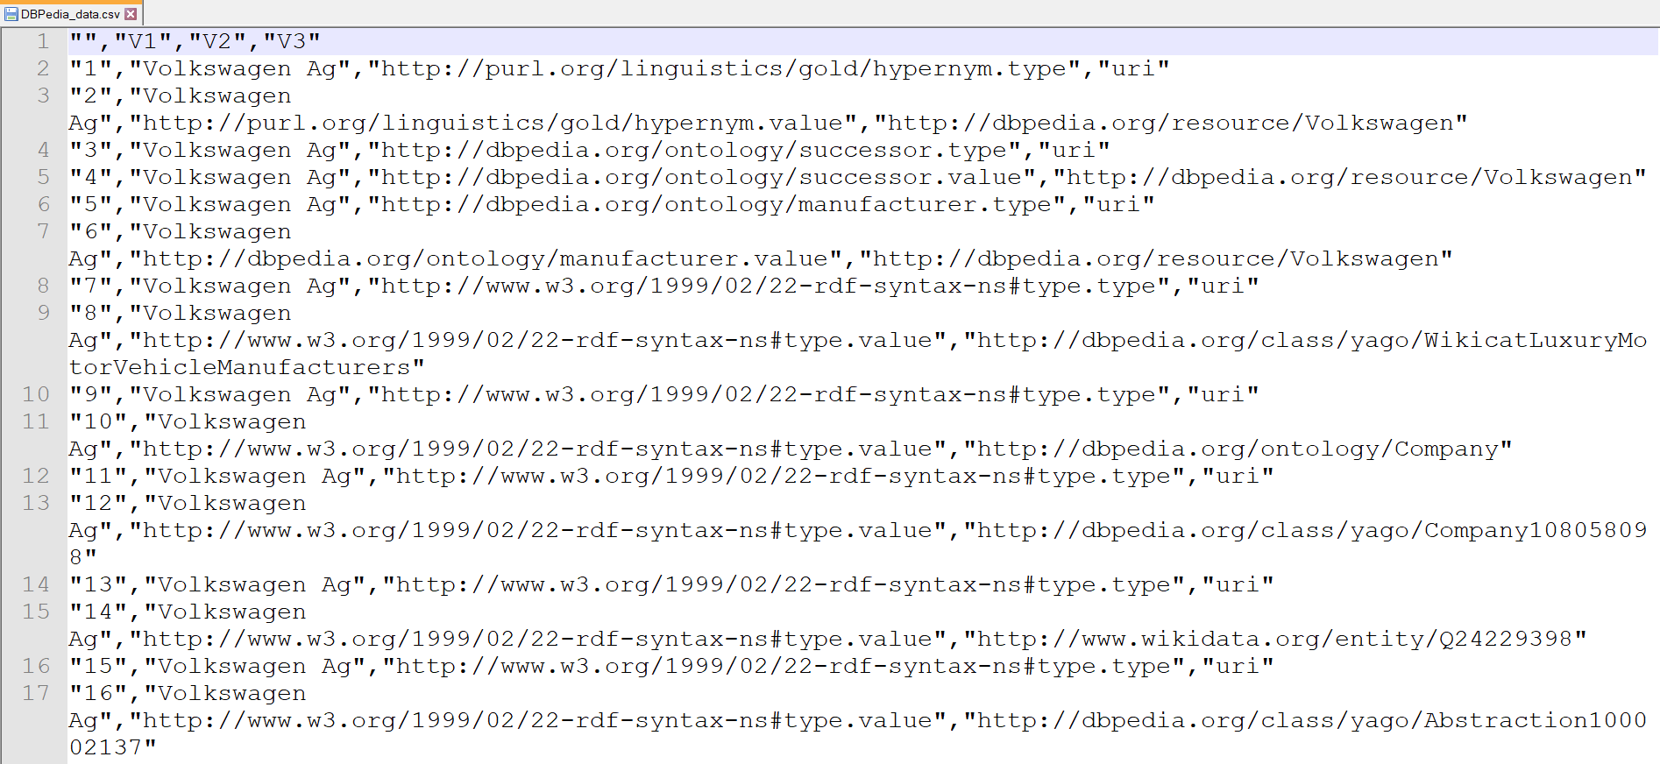
Results – Data retrieval (III)

Slide 13
Results – Data pre-processing (I)
R Codes which use the retrieved data and transform it to a more “structured” pooled format.
User input needed in the initial stage to identify useful variables.
Data from different sources organised in “Output” files

Slide 14
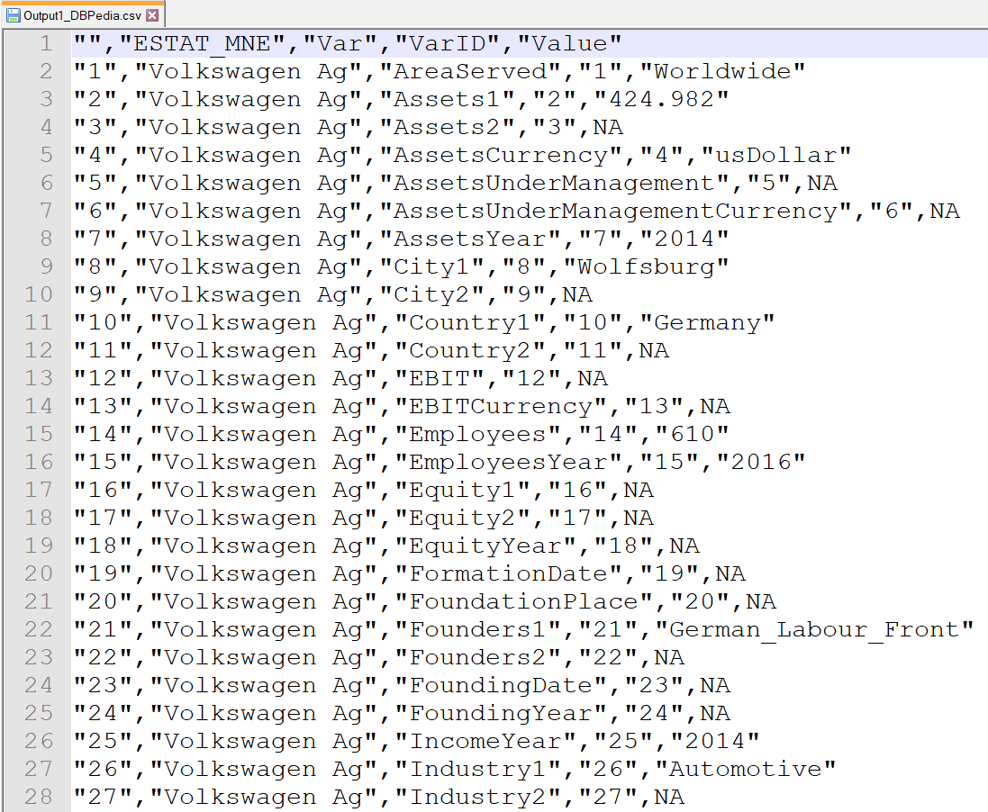
Results – Data pre-processing (II)

Slide 15
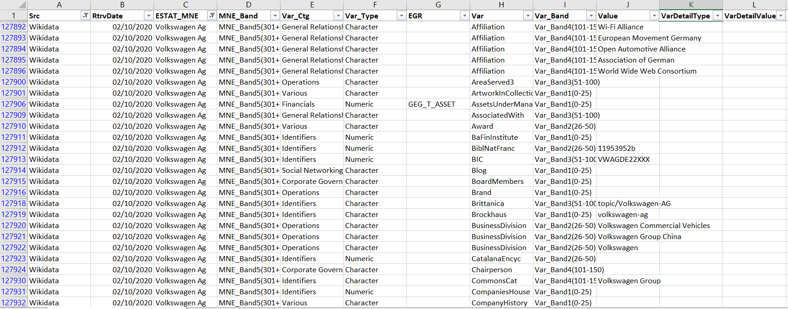
Results – Data transformation
For EGR Comparison

Slide 16
Results– Output (I)

Slide 17
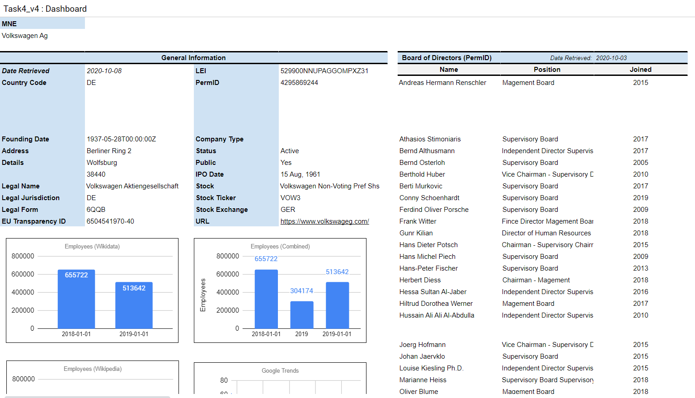
Results – Data visualization

Slide 18
Conclusions
large number of sources and retrieved data from those that offer free APIs and allow web scraping
Sources e.g. Reuters Financial, Yahoo Finance etc for financial data upon agreement of collaboration
data sources might be used, to some extent, as a source to update the EuroGroup Register
any web scraping activity/code script or APIs will be accurate as long as the original data source keeps the format of the webpage/data environment or API process unchanged
Concerning the EGR economic variables (turnover, assets) and employment, the most extensive data source are the annual reports
Assessment of the quality of the results is still needed

