Slide 1
An inventory of innovative tools and sources for smart Time Use & Household Budget Survey
Eniel.Ninka@ext.ec.europa.eu
Eurostat Unit F4
NTTS 2021 Conference
Notes:
Hello!
My aim today is to introduce you to the Inventory of innovative tools and sources for the Household Budget Survey and the Time Use Survey.

Slide 2
Background
Since 2018
Completely redesigned in 2020
Eurostat* and two Task Forces** maintain it
Info about innovative smart tools and sources being developed or used in the data collection for HBS or TUS
* Eurostat Unit F4 – Income and living conditions; Quality of life
** Task Forces on Innovative tools and sources for HBS/TUS respectively
Notes:
The inventory exists since 2018. Information about new tools is added and updated on a regular basis.
Eurostat actively maintains it in collaboration with two Task Forces.
The purpose of the Inventory is to inform National Statistical Institutions about existing, innovative, smart solutions to collect data, as well as about projects in development.
The Inventory contains a wealth of information about tools that are being developed or used in collecting survey data.
In addition, the Inventory contains information on sources of data being investigated, or planned for adoption by National Statistical Institutions in a number of European countries.

Slide 3
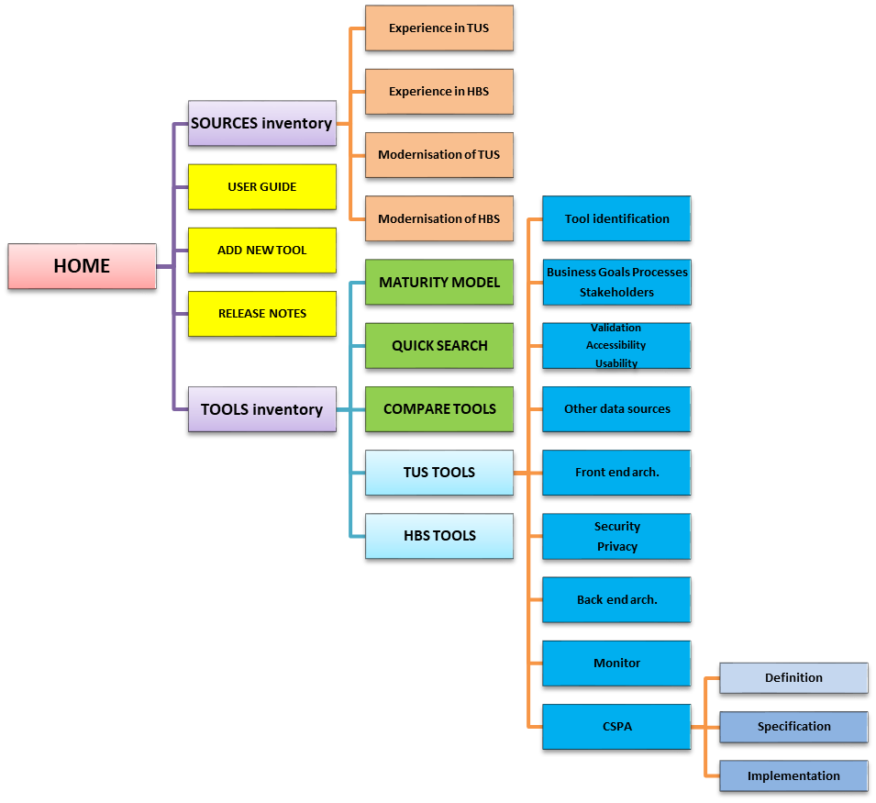
Structure
Notes:
The Inventory is structured in two main blocs: one for the tools and one for the sources.
Tools are divided according to the survey they are used for.
However, the information on tools is the same for both surveys. It has been grouped into eight main categories, following a logical order: from non-technical to technical.
In July 2020 a completely redesigned version of the Inventory was released.
The new version contains new features and enhanced user and content management.
Moreover, its usability has been improved with a user-friendly design in mind.

Slide 4
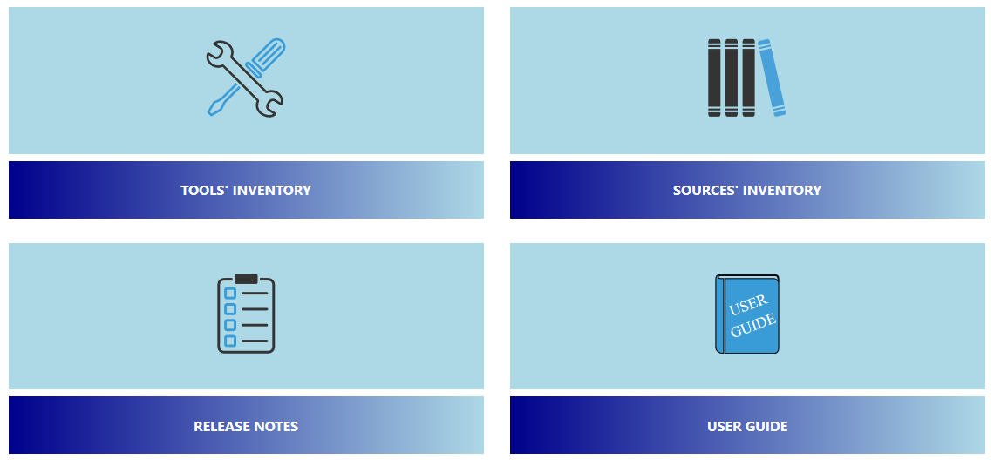
Main page
Notes:
This is the Main Page of the new Inventory.
Users can navigate it using a tree menu, or the clickable buttons.
A user guide explains the use of its features. A glossary explains the terminology.

Slide 5
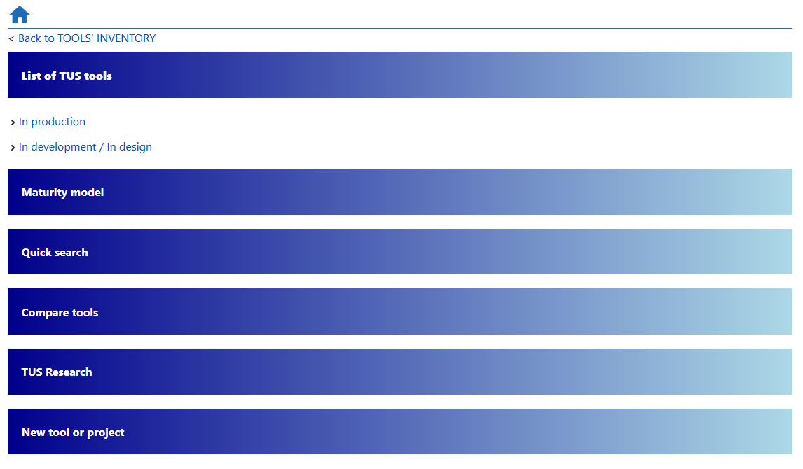
TUS Tools Menu page
Notes:
Users can:
rank tools according to their maturity,
perform a quick search based on a given set of functionalities, or
compare two or more tools.

Slide 6
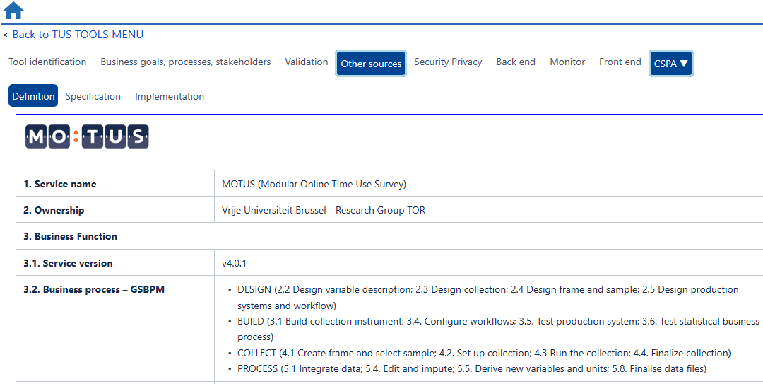
A tool’s page
Notes:
The content about tools is displayed in individual pages: one for each listed tool.
Within a page, information is shown in distinct tabs.

Slide 7
Features and content
26 tools listed
18 tools in production or pilot phase
TUS*: 11
HBS*: 7
Sources
*HBS = Household Budget Survey
*TUS = Time Use Survey
User Guide
Glossary
Release notes
CSPA* compliant descriptions of tools
*Common Statistical Production Architecture
Quick search
Compare tools
Maturity Model (experimental)
TUS/HBS research documents (forthcoming)
Notes:
Currently the inventory contains information on 26 innovative tools.
A number of tools have already been used in large-scale surveys or in smaller-scale pilots.
To achieve a minimum of standardization, we adopt the recommendations of the Common Statistical Production Architecture in tools’ description.
CSPA compliant descriptions are currently available at the definition level.

Slide 8
How to access the inventory?
The Inventory is hosted in a wiki page within the European Commission's external wiki platform. Follow the steps to gain access.
1. Obtain your EU Login (if you do not have it) https://webgate.ec.europa.eu/cas
2. Login in to the wiki https://webgate.ec.europa.eu/fpfis/wikis/display/ISTLCS/
3. Contact us
ESTAT-F4-INNOVATIVE-TOOLS@ec.europa.eu
Notes:
The Inventory is hosted in a wiki page within European Commission's external wiki platform.
Follow the steps to gain access.

Slide 9
Thank you
© European Union 2020
Unless otherwise noted the reuse of this presentation is authorised under the CC BY 4.0 license. For any use or reproduction of elements that are not owned by the EU, permission may need to be sought directly from the respective right holders.
Notes:
Thanks for watching!

