Slide 1
Official Statistics From Satellite Data – The example of Artificial Light Emissions in Ireland
A Presentation to the NTTS
Tim Linehan, (tim.linehan@cso.ie) Methodology Division
Central Statistics Office, Ireland March 2021

Slide 2
Introduction

Slide 3
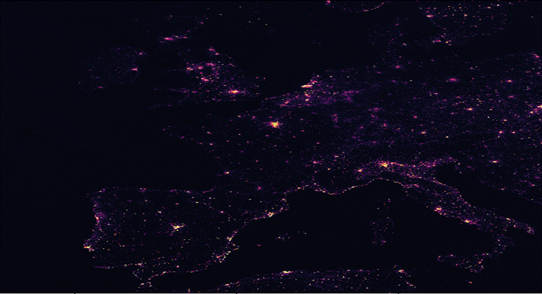

Slide 4
Introduction
The CSO and Satellite Imagery
CSO has a major focus on secondary and “big” data sources
Eurostat/UN drive for satellite statistics
In early 2019, CSO Satellite Imagery Group was set up – around 15 members from different areas of the office
A mixture of experienced practitioners and those with an interest in producing official statistics from satellite imagery
Objective: Can official statistics be produced from satellite imagery?

Slide 5
Artificial Light Statistics

Slide 6
Why Artificial Light Emissions?
Subject of considerable public interest
2009 UK Government report – impact of artificial light on:
Animal behaviour
Human sleep and health
Energy waste
Carbon emissions
France passed legislation in 2013 to deal with issue.

Slide 7
Why Artificial Light Emissions?
Subject of considerable public interest
EU set up the 2016 STARS4ALL Program
US NOAA research linking artificial light emissions to air pollution
Extensive academic research linking artificial light emissions to negative human and animal health outcomes
Ideal for producing statistics from satellite imagery
Well-documented approach

Slide 8
How light statistics are produced
The data collection and analysis process
NASA VIIRS-DNB satellite data downloaded
Light emissions statistics from 2012 onwards
Data has been pre-processed for quality
VIIRS-DNB is an instrument on the Suomi-NPP satellite
The satellite data on light emissions is geocoded.
CSO overlays the light emissions data with OSI maps
Statistics are produced

Slide 9
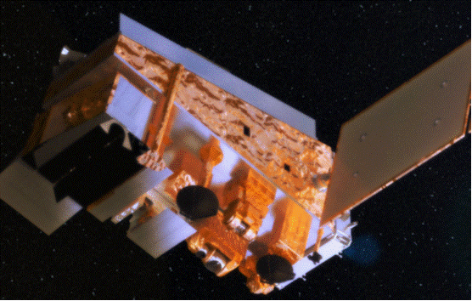
NASA Suomi-NPP Satellite

Slide 10
The data source
VIIRS-DNB dataset has the following attributes
Monthly dataset from US NOAA
1. Latitude and longitude of measurements
1km x 1km grid resolution.
2. The average monthly composite cloud-free radiance figure (measures light).
The unit is nanoWatt per square centimetre per square radian (nW/cm²/sr). A typical value for a rural area may be less than 5, while a city centre may have values well above 50.
3. The number of cloud free days in each month.

Slide 11
Data collection quality assurance
VIIRS-DNB dataset has built in quality assurance
Light emission statistics work best when no clouds in sky
Single biggest issue in satellite statistics
VIIRS-DNB light dataset uses cloud-free days only
Some months are missing but guarantees quality measurements
Editing/imputation not used as if data missing for month then not enough cloud free (valid) measurements

Slide 12
Derivation of output
CSO derives output from the dataset in following steps:
So we have monthly cloud free data
The satellite imagery is then overlayed with OSI boundary files (counties etc) in R “raster” package
Summary light emission statistics are then generated in R
R mapping tools were then used – the “sp” tool in particular
R advantage is open source – can be run on a desktop PC
No commercial/specialist software used – there is also option of running it on CSO Data Hub

Slide 13
Validation of output
Numerous steps in validating output - successful
The source dataset is validated on ongoing basis by NASA/NOAA
Output validation – dataset used by many academic researchers for artificial light emissions
Benchmarking – estimated emissions were compared with known urban and rural areas to see if plausible
Kerry and Mayo “Deep Sky” reserves for low emission areas
Pembroke docks for high emission areas
International comparisons – London, Paris
Feedback on report also obtained from Gavin Smith of the EPA

Slide 14
Results

Slide 15
Output datasets produced
Geographical area | Complete datasets availability¹
Ireland | January-March, September, October-December 2015-2019
Counties of Ireland | January-March, September, October-December 2015-2019
Local Electoral Areas of Ireland | January-March, September, October-December 2015-2019
Urban Settlements of Ireland | January 2015, 2016, 2017, 2018, 2019
Electoral Divisions of Ireland | January-March, September, October-December 2015-2019

Slide 16
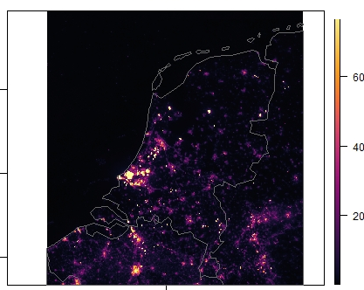
International example - Netherlands

Slide 17
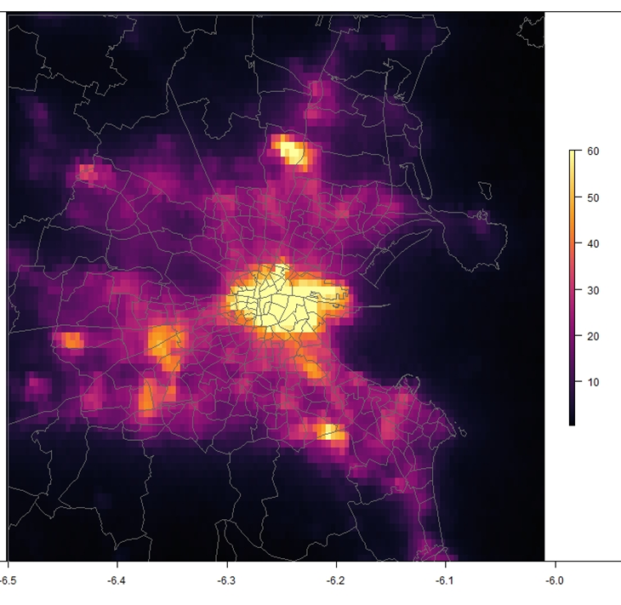
Light emissions overlay on electoral map

Slide 18
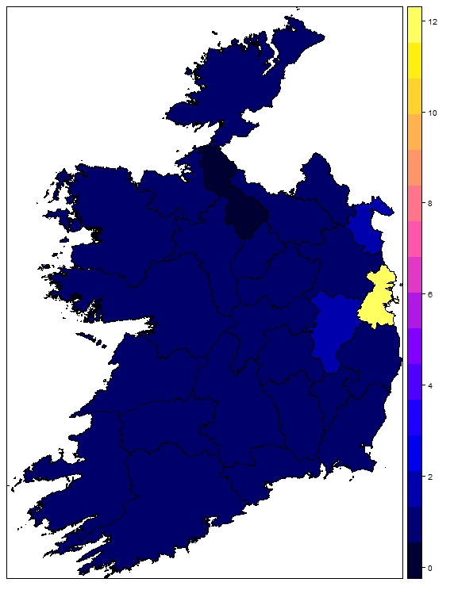
Light emissions by County

Slide 19
County level statistics
Counties with high and low levels of emissions
Table 2: Light emissions (nW/cm²/sr) by county
County | January 2015 light emissions | January 2019 light emissions | Change in emissions
DUBLIN | 14.678 | 11.531 | -27.30%
LOUTH | 2.275 | 1.695 | -34.20%
KILDARE | 2.079 | 1.494 | -39.20%
KERRY | 0.766 | 0.576 | -33.00%
MAYO | 0.79 | 0.545 | -45.00%
LEITRIM | 0.772 | 0.516 | -49.60%

Slide 20
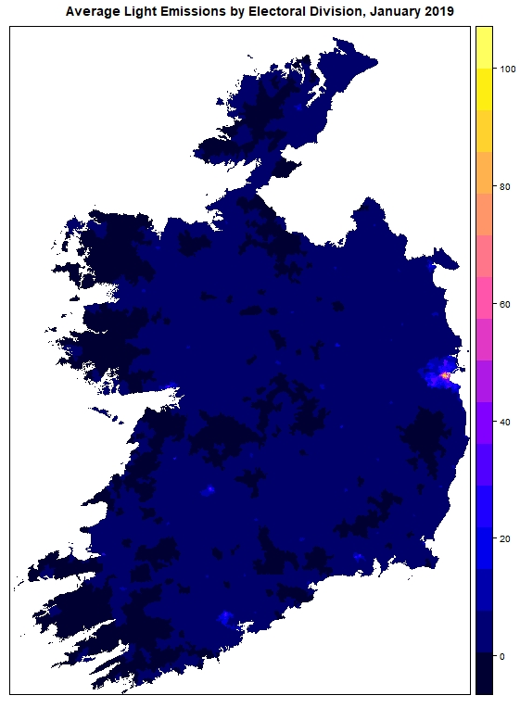
Light emissions by Electoral Division

Slide 21
Electoral Division level statistics
Top 5 electoral divisions for artificial light emissions
ED | Electoral Division | COUNTY | January 2015 | January 2019
268115 | PEMBROKE WEST A | DUBLIN | 195.582 | 156.42
268111 | PEMBROKE EAST B | DUBLIN | 133.821 | 122.251
268141 | ROYAL EXCHANGE B | DUBLIN | 152.25 | 103.88
268116 | PEMBROKE WEST B | DUBLIN | 90.747 | 100.383
268140 | ROYAL EXCHANGE A | DUBLIN | 138.228 | 98.657

Slide 22
Artificial light emissions by settlements

Slide 23
Conclusions
The following conclusions are drawn
High quality statistics can be produced from satellite imagery for artificial light emissions.
This exercise does not involve significant resources
It required one statistician and one desktop PC
Open source data and software was used
Ensuring high quality source data and rigorous output validation processes is very important

Slide 24
Acknowledgements
The author wishes to thank:
NOAA's National Geophysical Data Center
The Environmental Protection Agency – Gavin Smith
The members of the CSO Remote Sensing and Satellite Imagery Group – in particular Marco Grimaldi, Paul Alexander, Sam Scriven and Sinead Bracken
Paul M Crowley, John Dunne, Ciaran Dooly, Elaine O’Mahoney, Richard Murphy and Helen Cahill CSO.
Alistair McKinstry, ICHEC.

Slide 25
Thank You Any Questions?

