Slide 1
Continuous integration and sharing code in Official Statistics: an example with the ‘lissyrtools’ package
Josep Espasa Reig
Data Scientist at LIS – Cross-National Data Center in Luxembourg

Slide 2
This presentation
What is LIS?
‘lissyrtools’ and sharing code
CI and TDD

Slide 3
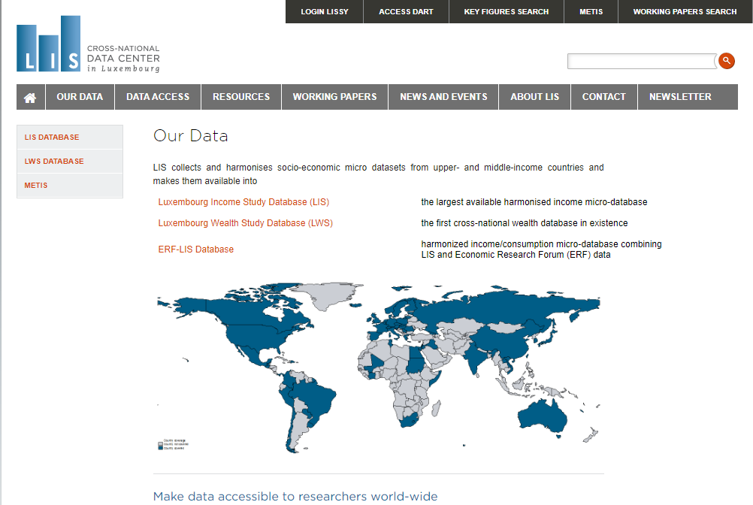
What is LIS and what do we do?

Slide 4
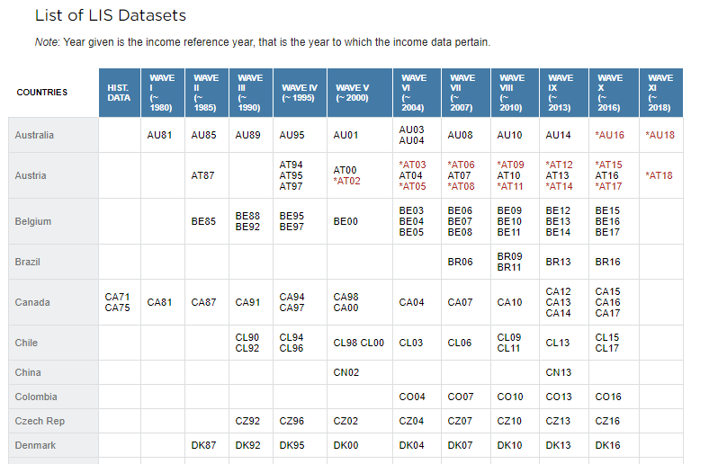
What is LIS and what do we do?

Slide 5
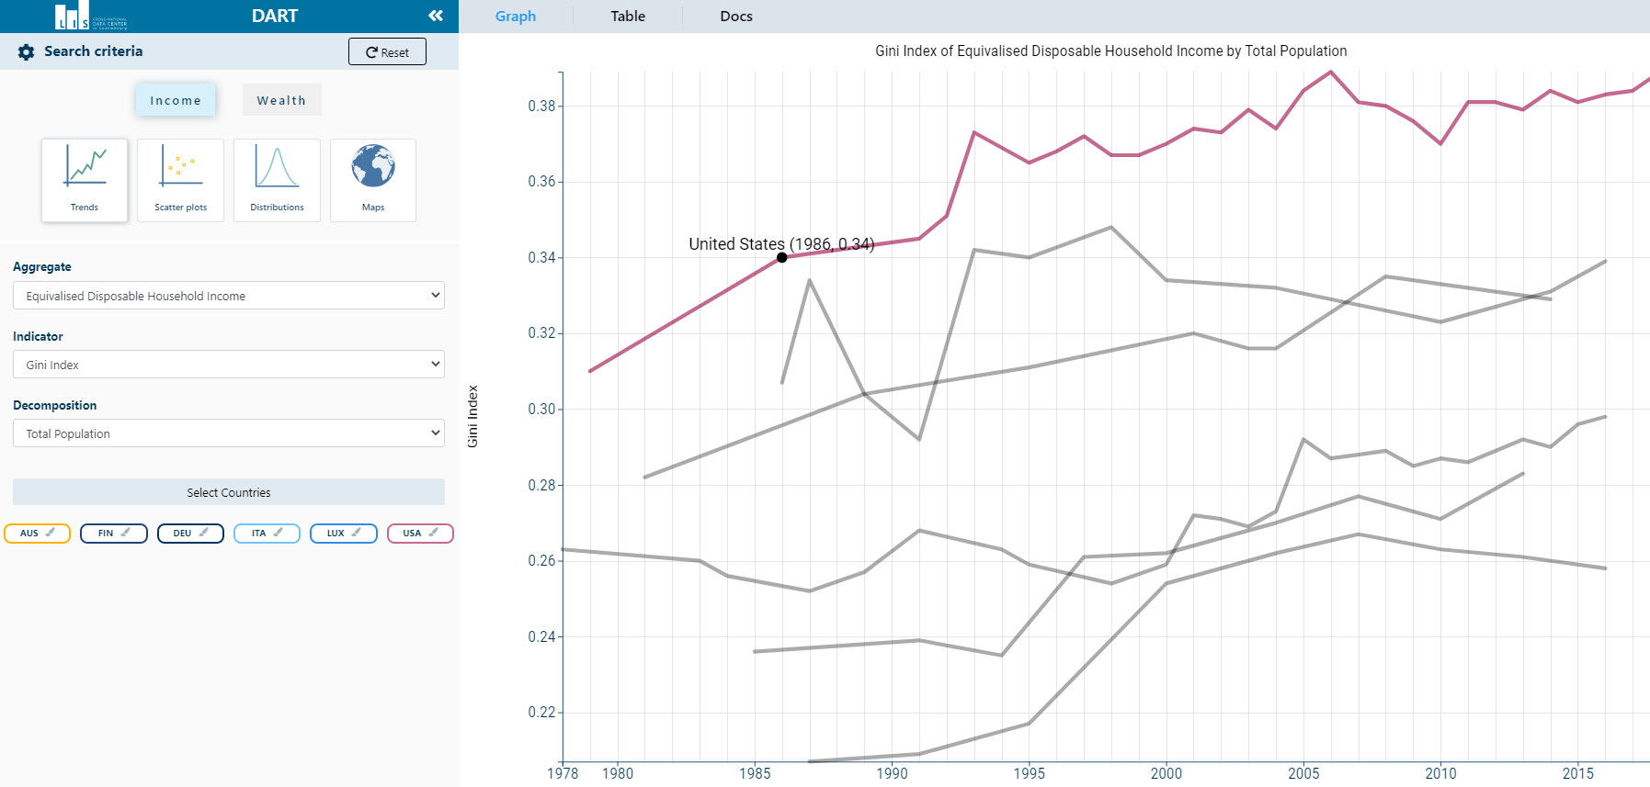
What is LIS and what do we do?
https://dart.lisdatacenter.org/

Slide 6
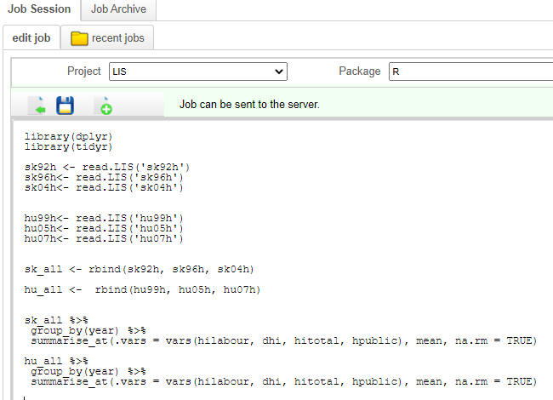
LISSY – our external interface

Slide 7
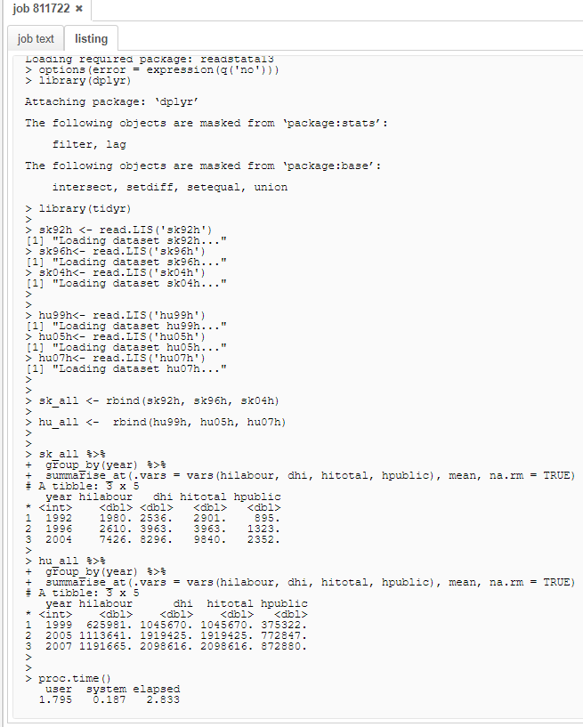
LISSY – our external interface

Slide 8
The problem
Our data often requires:
deflator adjustments (CPI or PPP)
equivalizing by household size
applying the right weights
using net or gross variables or
employing the correct unit of analysis

Slide 9
Code example
Read person and household-level files for multiple countries;
Merge files for both levels;
Produce data transformations such as:
recoding negative values to zeroes
equalize by household size
trim outliers with top and bottom coding
adjust by PPP
Data would be ready for any computation

Slide 10
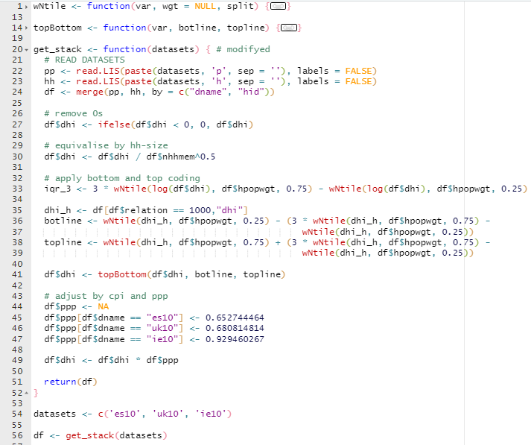
Read and manage data – typical user code

Slide 11
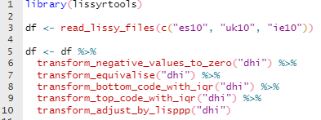
Read and manage data – our code

Slide 12
Current situation
Challenging data processes
We produce lots of code in our day to day (e.g. DART computations)

Slide 13
Current situation
Challenging data processes
We produce lots of code in our day to day (e.g. DART computations)
Clearly inefficient!

Slide 14
Current situation
Challenging data processes
We produce lots of code in our day to day (e.g. DART computations)
Clearly inefficient!
Solution: sharing code

Slide 15
Sharing code in R
R packages
Code
Data
Documentation
Tests

Slide 16
The ‘lissyrtools’ package
3 main types of functions:
Read and merge

Slide 17
‘lissyrtools’ - Read and merge

Slide 18
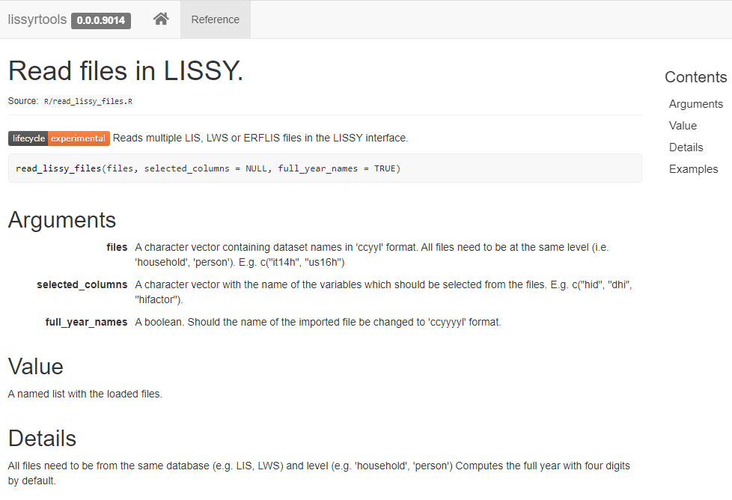
‘lissyrtools’ - Read and merge

Slide 19
The ‘lissyrtools’ package
3 main types of functions:
Read and merge
Transformations

Slide 20
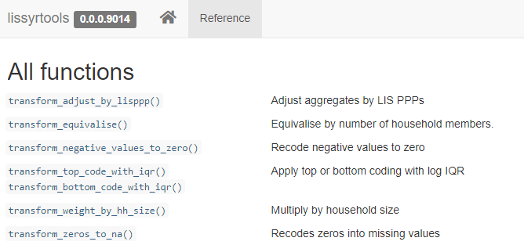
‘lissyrtools’ - transformations

Slide 21
‘lissyrtools’ - transformations

Slide 22
The ‘lissyrtools’ package
3 main types of functions:
Read and merge
Transformations
Computations and plots

Slide 23
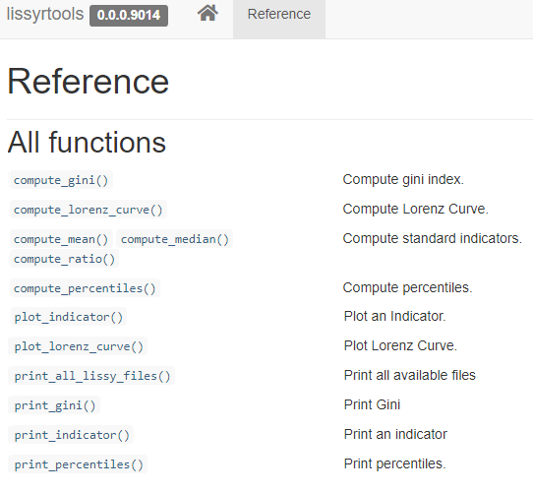
‘lissyrtools’ - computations

Slide 24
Continuous Integration (CI) and Test Driven Development (TDD):
Why is this important?

Slide 25
Continuous Integration (CI) and Test Driven Development (TDD):
Why is this important?
Software has a hidden cost:
Code needs maintenance and so is a liability
Source: Swagerman, D, V. (2020) The hidden costs of software inventory. Available from https://www.linkedin.com/pulse/hidden-costs-software-inventory-dirk-jan-swagerman/

Slide 26
Continuous Integration (CI) and Test Driven Development (TDD):
Why is this important?
Software has a hidden cost:
Code needs maintenance and so is a liability
Developing more code = more maintenance costs
Long term, productivity of software teams moves to 0
Source: Swagerman, D, V. (2020) The hidden costs of software inventory. Available from https://www.linkedin.com/pulse/hidden-costs-software-inventory-dirk-jan-swagerman/

Slide 27
Continuous Integration (CI) and Test Driven Development (TDD):
Why is this important?
Software has a hidden cost:
Code needs maintenance and so is a liability
Developing more code = more maintenance costs
Long term, productivity of software teams moves to 0
CI and TDD can increase code quality and thus reduce this cost
Source: Swagerman, D, V. (2020) The hidden costs of software inventory. Available from https://www.linkedin.com/pulse/hidden-costs-software-inventory-dirk-jan-swagerman/

Slide 28
CI and TDD:
Continuous Integration (CI) and Test Driven Development (TDD):
save time on manual testing
make developers think about the requirements the functions should meet
help improve the quality of shared code

Slide 29
TDD - Automated tests
Informal tests
Reproducible scripts

Slide 30
Advantages of automated tests
Fewer bugs
Better code structure
More robust code
Source: Wickham, H. (2015) R Packages: Organize, Test, Document, and Share Your Code. Available from: https://r-pkgs.org/tests.htm

Slide 31
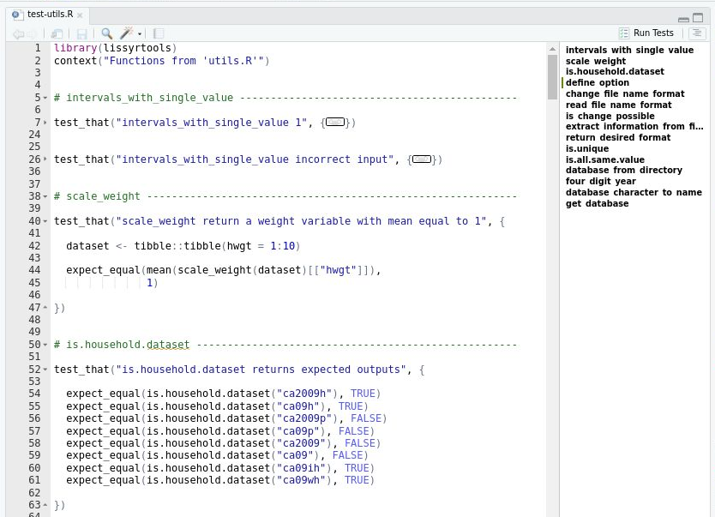
Automated tests in R – testthat package

Slide 32
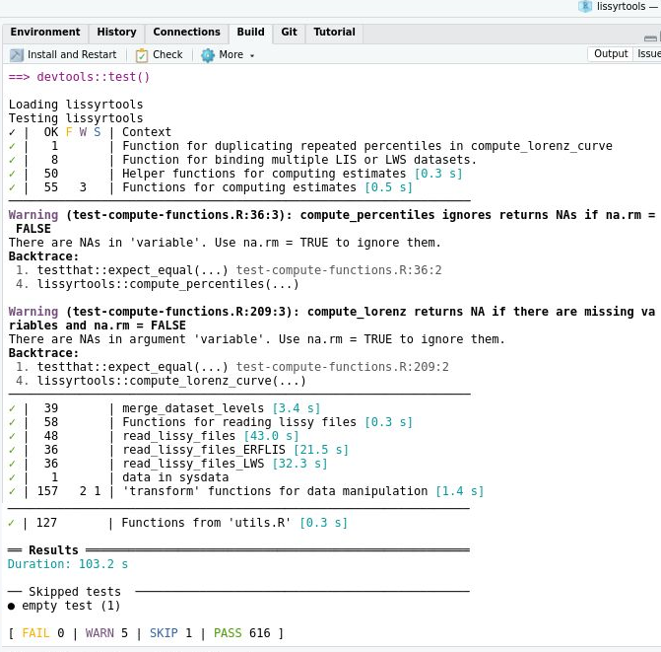
Automated tests in R – testthat package

Slide 33
Test Driven Development (TDD)
Forcing developers to create unit tests for new functions before actually writing them

Slide 34
Continuous Integration (CI)
integrating changes into a single repository

Slide 35
Continuous Integration (CI)
integrating changes into a single repository
modifications implemented gradually

Slide 36
Continuous Integration (CI)
integrating changes into a single repository
modifications implemented gradually
minor alteration -> unit tests are run

Slide 37
CI tools
Warning: expect to spend some time troubleshooting!

Slide 38
CI tools
Warning: expect to spend some time troubleshooting!
Services:
Travis CI
GitHub Actions
Sources:
rOpenSci (2021) rOpenSci Packages: Development, Maintenance, and Peer Review. Available from https://devguide.ropensci.org/
Silge, J. (2016) A Beginner's Guide to Travis-CI for R. Available from https://juliasilge.com/blog/beginners-guide-to-travis/

Slide 39
Thank you for your attention!
espasareig (add) lisdatacenter (dot) org

Slide 40
Bibliography
LIS Cross-national Data Center (2020) Data Access Research Tool. Available from https://dart.lisdatacenter.org/
LIS Cross-national Data Center (2020) lissyrtools R Package repository. Available from https://github.com/JosepER/lissyrtools https
rOpenSci (2021) rOpenSci Packages: Development, Maintenance, and Peer Review. Available from https://devguide.ropensci.org/https://r-pkgs.org/tests.htm
Silge, J. (2016) A Beginner's Guide to Travis-CI for R. Available from https://juliasilge.com/blog/beginners-guide-to-travis/
Swagerman, D, V. (2017) The Gardeners Dilemma. Available from https://www.linkedin.com/pulse/gardeners-dilemma-dirk-jan-swagerman/
Swagerman, D, V. (2020) The hidden costs of software inventory. Available from https://www.linkedin.com/pulse/hidden-costs-software-inventory-dirk-jan-swagermanht
Wickham, H. (2015) R Packages: Organize, Test, Document, and Share Your Code. Available from: https://r-pkgs.org/tests.html

