Slide 1
DIGICOM – an unprecedented collaboration on the dissemination and communication of European statistics
Ewa Czumaj (Statistics Poland) Henriette de Jong-de Heer (Statistics Netherlands) Adolfo Galvez Moraleda (National Statistics Institute (INE), Spain) Susanne Hagenkort-Rieger (Federal Statistical Office (DESTATIS), Germany) José Pinto Martins (Statistics Portugal) Eoin McCuirc (Central Statistics Office, Ireland) Guillaume Mordant (National Institute of Statistics and Economic Studies (Insee), France) Giulia Mottura (Istat, Italy) Hannele Orjala (Statistics Finland) Thomas Schulz (Swiss Federal Statistical Office) Beatrix Tomaschek (Statistics Austria) Maurizio Vichi (Sapienza University of Rome)
Martin Karlberg (Eurostat)

Slide 2
DIGICOM business case
Digital communication, User analytics and Innovative products
Objectives
Delivering (and capacity-building) within two ESS Vision 2020 key areas:
Identifying user needs and cooperation with stakeholders
Dissemination and communication on European statistics
Deliverables: 55 deliverables to be achieved in 4 Work Packages (WPs)
WP1: User Analysis
WP2: Innovative and shareable products and tools
WP3: Open Data Dissemination
WP4: Communication and promotion
Execution phase: 2016-2019

Slide 3
Key features of DIGICOM
Collaborative:
Involvement of at least 100 colleagues – and more than ¾ of all ESS members
ESS Task Force working on the Business Case
Steering Group overseeing the project
Work package teams overseeing each technical strand of the project
Collaboration (coordinated by Eurostat and INE Spain) during each (academic) year of the European Statistics Competition
Sharing
of concepts, platforms and technical solutions (European Statistics Competition, e-learning…)
Voluntary localisation (digital publications, games…) by NSIs
Agile:
Experimentation
Changes, downsizing, expansion
NSI = National Statistical Institute

Slide 4
Main DIGICOM outcomes
Enlarged ESS product portfolio
co-developed digital publications
public use files
experimental statistics
Strategies
outreach to data journalists
linked open data
public use files
Guidelines and recommendations
user research/personas/analytics
usability
social media
visualisation
LOD requirements and portals
Links to final report & all deliverables available online at:
https://ec.europa.eu/eurostat/cros/DIGICOM
Statistical literacy products
games
e-learning material
educational videos
Studies
branding and communication
user profiling
linked open data (LOD)
Outreach activities:
European Statistics Competition
social media platforms
Power from Statistics
multiplier communities
(Twitter & LinkedIn: #DIGICOMadventCalendar
Tools and prototypes
user personas
visualisation tools
Linked Open Statistical Data hub
ESS-wide inventories
user analysis
open data dissemination
communication and promotion
visualisation

Slide 5
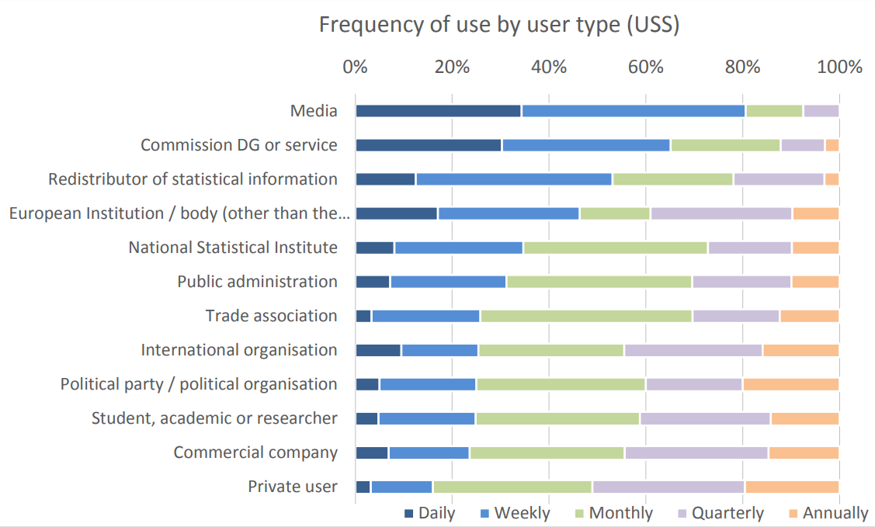
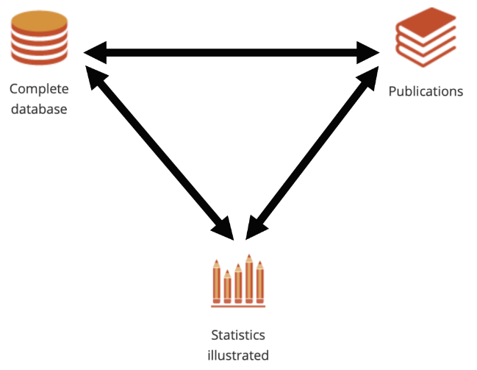
WP1: user analysis
User analysis
Who are using European statistics?
Usability guidelines
For websites (and other online tools) that are used for the dissemination of official statistics.

Slide 6
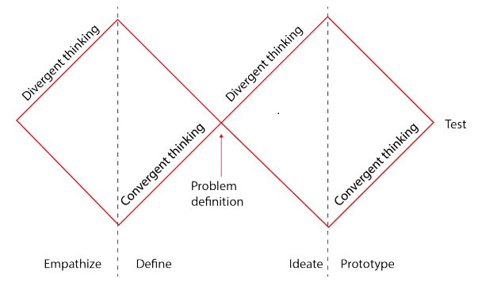
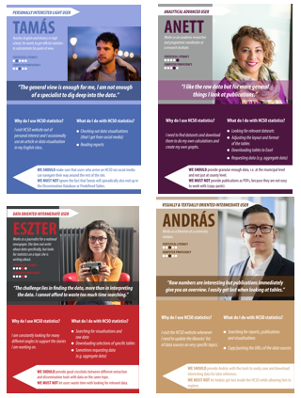
User personas (WP1)
Guidelines
How to apply the human-centric design for
user analytics
user research
personas
User personas
Personas of users of European statistics…
…adapted for the Hungarian Central Statistical Office:

Slide 7
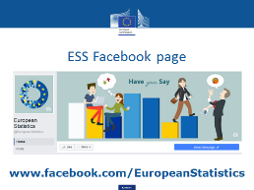
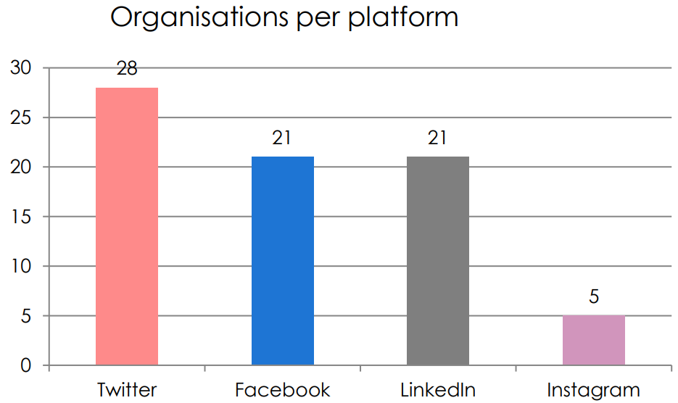
Social media (WP1)
Social media platforms Piloting of platform
– for potential users:
– for advanced users:
Social media guidelines
State of play & good practices

Slide 8
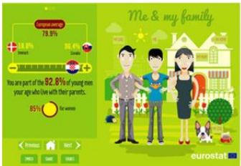
WP2: Innovative & shareable products & tools
ESS digital publication
Translation by NSIs
Simultaneous publication in 24 languages on 18 October 2017
Unprecedented impact
Shareable infographics
… and guidelines on sharing
Visualisation
workshops

Slide 9
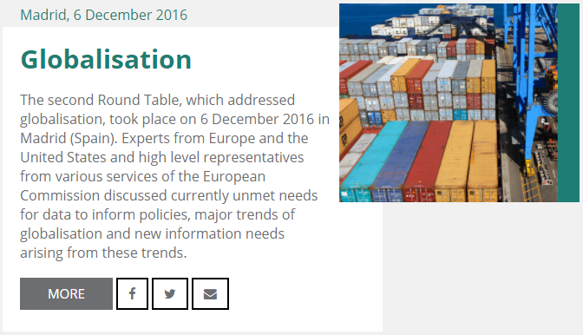
(WP2)
5 thematic roundtables

Slide 10
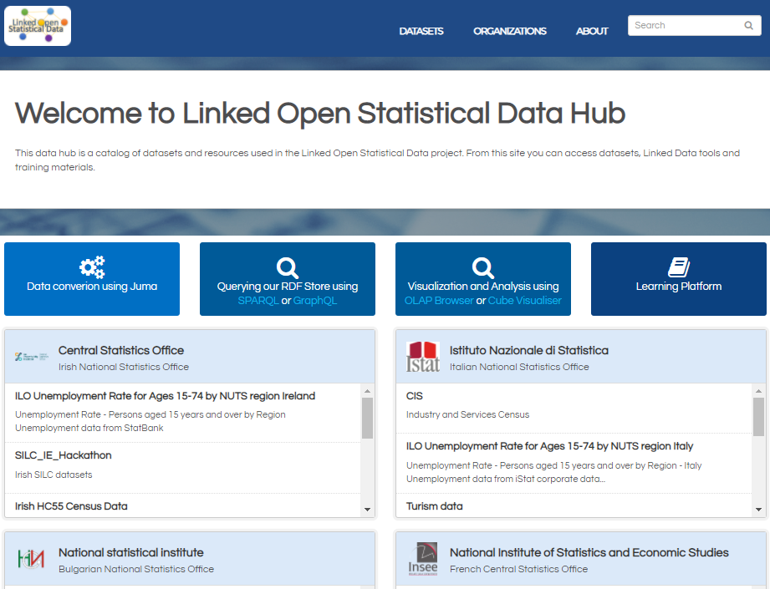
WP3: open data dissemination
Public Use files
Linked Open Statistical Data Hub

Slide 11
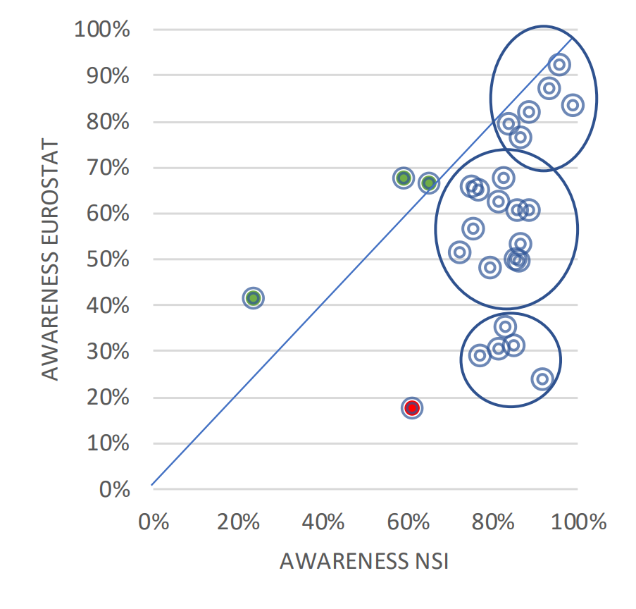
WP4: Communication and promotion
Branding study
Possible communication strategies
Eurostat, an expert for experts Focus on expert target audiences
Eurostat, the knowledge disseminator Outreach to multipliers (G to M to C)
Eurostat, a democratic guide Focus on general public (G to C)

Slide 12
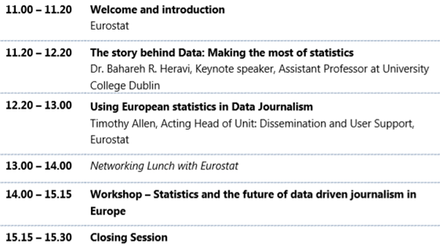
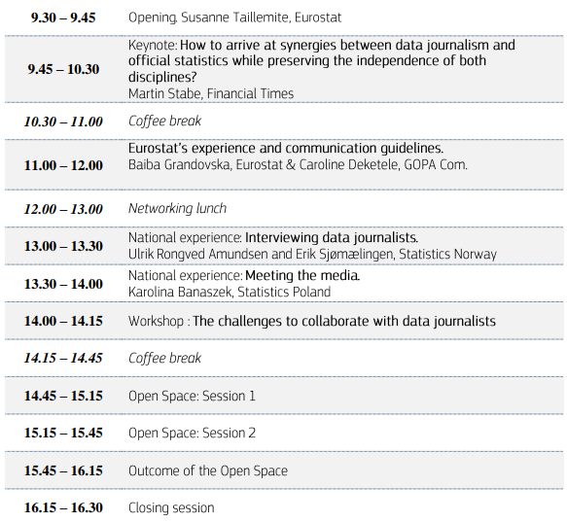
Outreach to multipliers (WP4)
Data Journalists
Workshop with Data Journalists to gather their needs
Workshop on Data Journalism with ESS colleagues
Data journalist outreach strategy
Statistics in support of Data Journalism
ESS event on Data Journalism

Slide 13
Outreach to multipliers (WP4)
Non-governmental organisations (NGOs)
Categorised inventory of NGOs active in fields related to ageing
Targeted communication
concerning relevant topics, e.g. on the digital ‘Ageing Europe’ publication

Slide 14
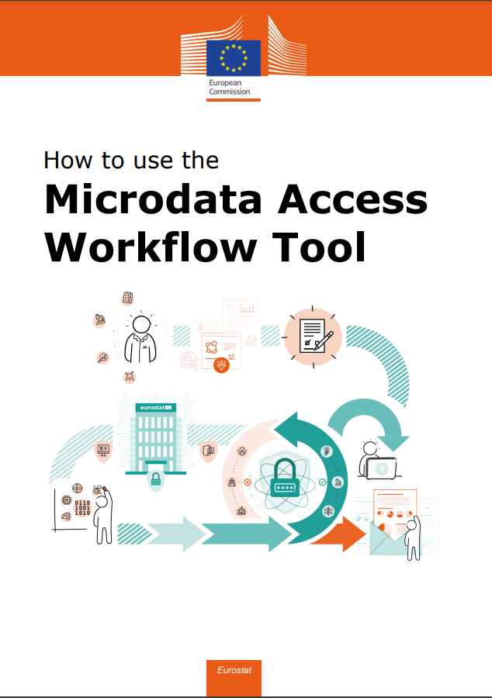
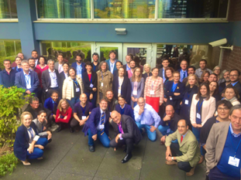
Outreach to multipliers (WP4)
Researchers
European statistics in support of researchers
#ESiSoR
Microdata access toolkit

Slide 15
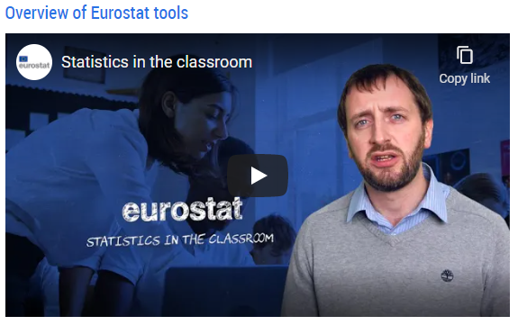
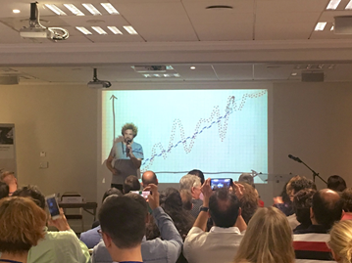
Outreach to multipliers (WP4)
Teachers
European statistics for the classroom
#ESftC
Statistics in the classroom
For teachers: A video guiding to Eurostat didactic resources
For students: Videos + exercises on:
energy statistics
labour market statistics
price statistics
SDGs

Slide 16
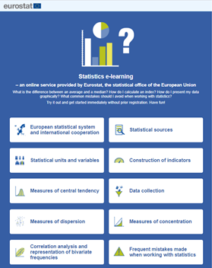
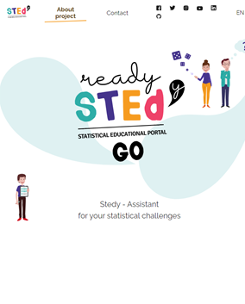
Statistical literacy (WP4): e-learning
Development under DIGICOM statistical literacy grants
Statistics Online
Based on DESTATIS platform
Translated (and adapted to European statistics) by Eurostat

Slide 17
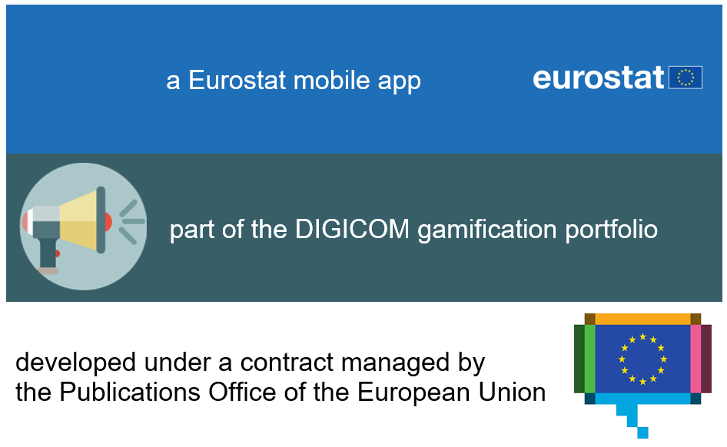
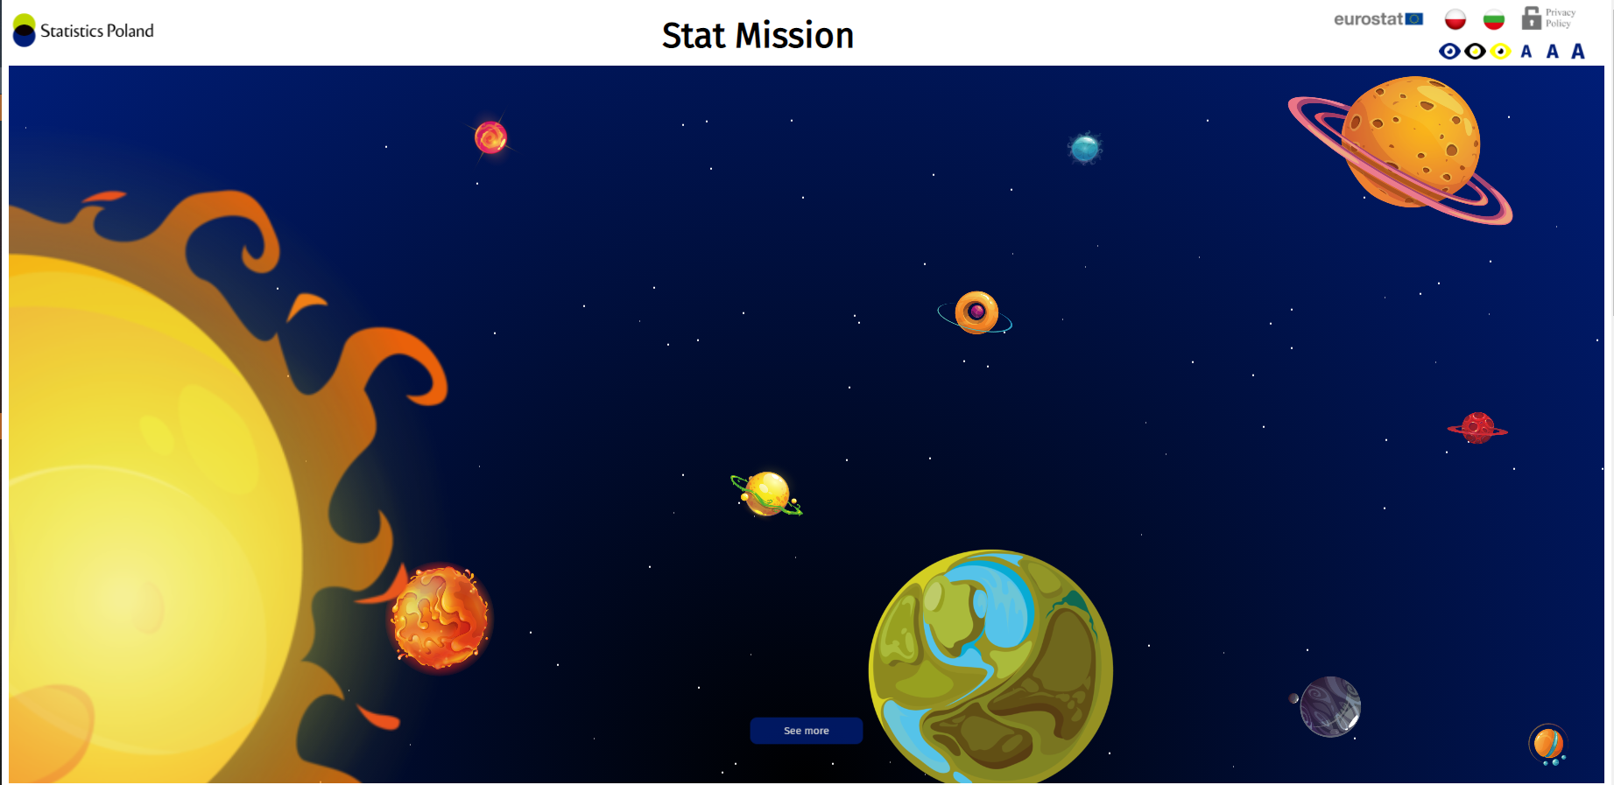
Statistical literacy (WP4): games
Development under DIGICOM statistical literacy grants
Development by an NSI
Translation by another NSI
ViROS – Virtual Reality for Official Statistics
Originally available in 5 languages
Translated voluntarily by NSIs – now available in 13 languages

Slide 18
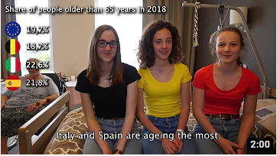
Statistical literacy (WP4): ESC
European Statistics Competition
Multiple outcomes
Outreach (to pupils)
Eurostat → NSIs → teachers → pupils
Statistical literacy (of pupils)
Promotional videos (by pupils)

Slide 19
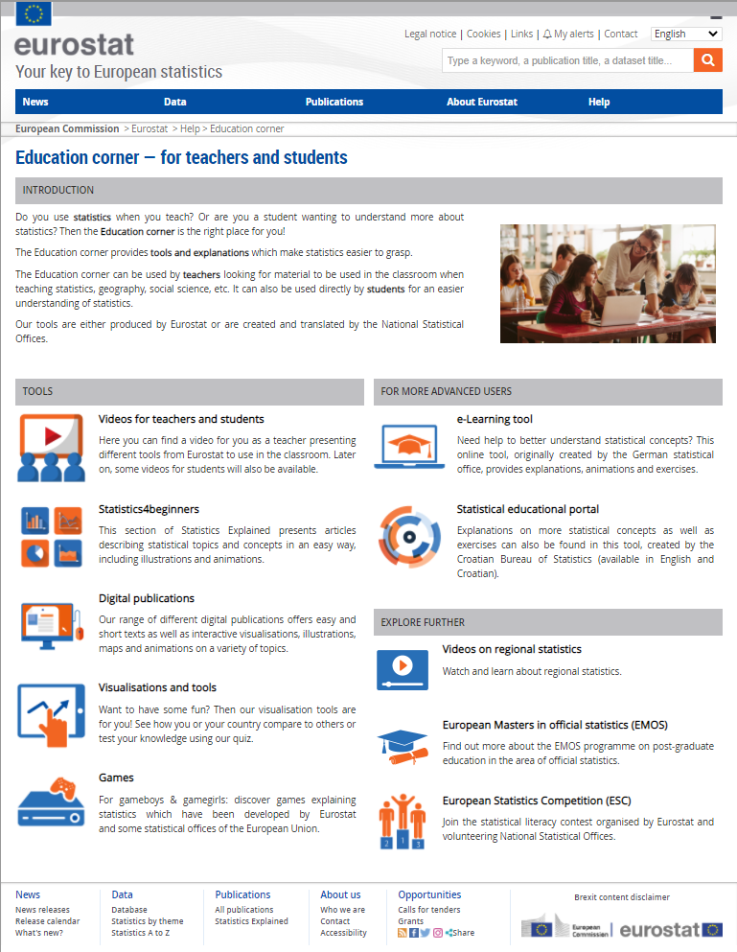
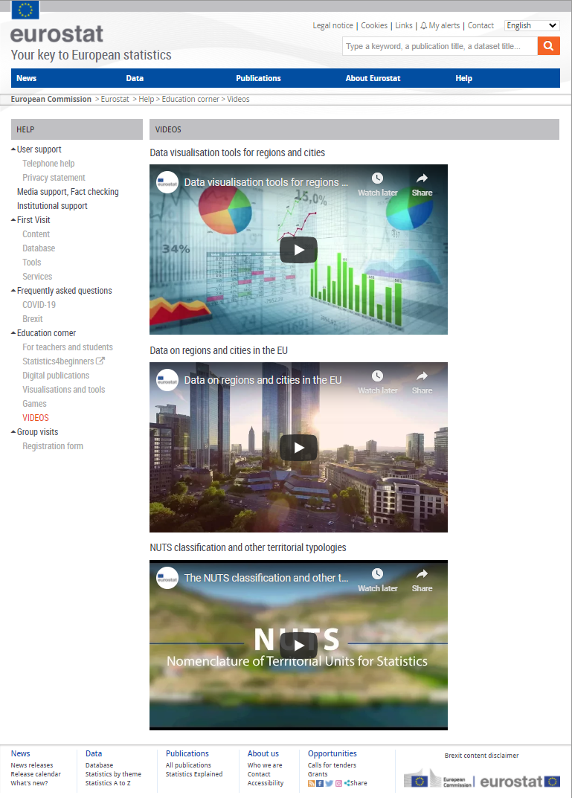
Statistical literacy (WP4)
Didactic videos on regional statistics
Developed for a Massive Open Online Course (MOOC) of the European Committee of the Regions
Eurostat education corner
One-stop shop for Eurostat & ESS statistical literacy resources
DIGICOM results under many headings

Slide 20
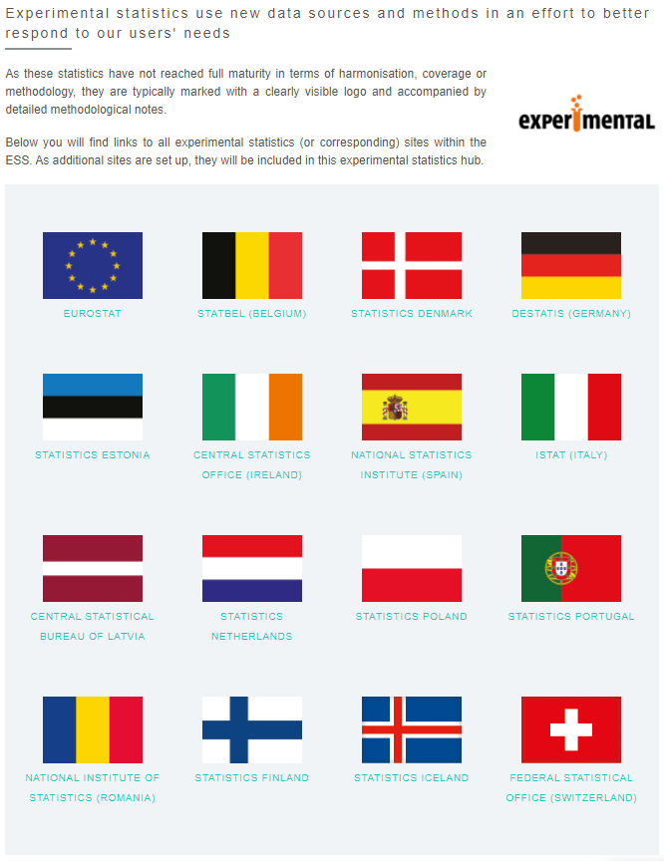
Experimentation (WP4)
European Big Data Hackathon
1st edition at NTTS 2017
Policy question: How would you support the design of policies for reducing mismatch between jobs and skills at regional level in the EU through the use of data?
ESS statistics hub
Urgent innovation – COVID-19 response
Recently set up national experimental statistics sites
Recently launched experimental statistics products

Slide 21
Beyond DIGICOM
Statistical literacy tools
Processes
games (including Virtual Reality)
e-learning
videos
European Statistics Competition
Public use files
Experimental statistics
Sharing of digital publications
User and usability testing
Guidelines & recommendations
For the official statistics community
For multipliers (teachers & researchers)
21

Slide 22
Lessons learned from DIGICOM
Sharing is worthwhile – but challenging
Networking – worth the investment
intellectual property right issues
adaptation issues (linguistic, technical, procedural)
risk for “donor overload”
risk for “recipient dependency”
⇒ cost (risk) / benefit assessment
dissemination and communication
new colleagues to reach out to
must be nurtured
Multiplier effect
ESC > 10 000 pupils (every year)
ESC: videos that “money can’t buy”
22

Slide 23
What’s in it for you and your organisation?
Experimental statistics
Promote statistical literacy
Check out experimental statistics
Propose experimental statistics
Give your feedback
Use guidelines
Use tools
Use personas
Use the education corner
Use the promotional videos
Make sure your country plays an active role in the European Statistics Competition
Collaborative & experimental approach in your project
– try new stuff & dare to fail!
Make use of resources
Get inspired by the approach

