Slide 1
Classifying transaction and web scraped data
NTTS 2021
Ingolf Boettcher
Statistics Austria

Slide 2
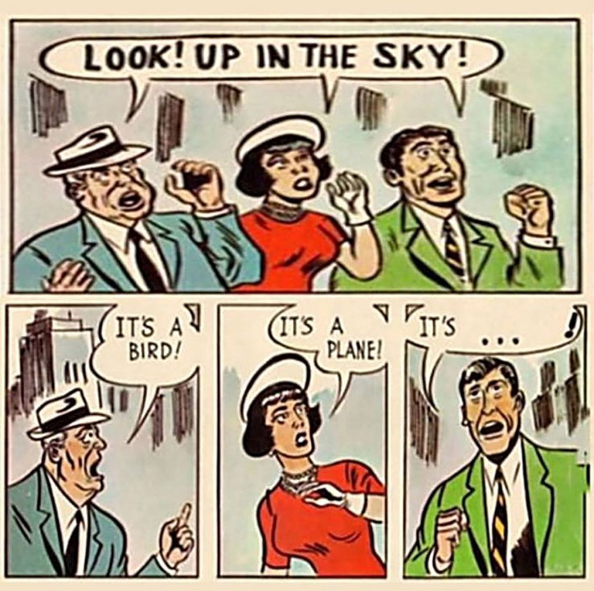
The challenge of product-classification
But what if there are a lot of objects to classify?
https://flightradar.live/, retrieved 21.09.2020
https://cdn.kstarlive.com/image/1593412020668-0.jpg

Slide 3
The challenge of product-classification
DATA STRUCTURE Retailer N
ITEM Number
GTIN Number
Promotion Code
Brand
Description
Content Quantity
Product Group 1
Product Group 2
Produkct Group 3
But what if data comes in different structures?
DATA STRUCTURE Retailer D
ITEM Number
GTIN Number
Promotion Code
Brand
Description
Content Quantity
Product Group 1
Product Group 2
Produkct Group 3
DATA STRUCTURE – Retailer G
ITEM Number
Description
Content Quantity
Product Group 1
Product Group 2
Promotion Info
DATA STRUCTURE Retailer J
ITEM Number
GTIN Number
Promotion Code
Brand
Description
Content Quantity
Product Group 1
Product Group 2
Produkct Group 3
DATA STRUCTURE – Retailer XYZ
ITEM Number
Description
Content Quantity
Product Group 1
Product Group 2
Promotion Info
DATA STRUCTURE Retailer ABC
ITEM Number
GTIN Number
Promotion Code
Brand
Description
Content Quantity
Product Group 1
Product Group 2
Produkct Group 3
DATA STRUCTURE – Retailer O
ITEM Number
Description
Content Quantity
Product Group 1
Product Group 2
Promotion Info
DATA STRUCTURE – Retailer XYZ
ITEM Number
Description
Content Quantity
Product Group 1
Product Group 2
Promotion Info
DATA STRUCTURE Retailer ABC
ITEM Number
GTIN Number
Promotion Code
Brand
Description
Content Quantity
Product Group 1
Product Group 2
Produkct Group 3
DATA STRUCTURE – Retailer A
ITEM Number
Description
Content Quantity
Product Group 1
Product Group 2
Promotion Info
DATA STRUCTURE – Retailer XYZ
ITEM Number
Description
Content Quantity
Product Group 1
Product Group 2
Promotion Info
DATA STRUCTURE Retailer ABC
ITEM Number
GTIN Number
Promotion Code
Brand
Description
Content Quantity
Product Group 1
Product Group 2
Produkct Group 3
DATA STRUCTURE – Retailer E
ITEM Number
Description
Content Quantity
Product Group 1
Product Group 2
Promotion Info
DATA STRUCTURE – Retailer XYZ
ITEM Number
Description
Content Quantity
Product Group 1
Product Group 2
Promotion Info
DATA STRUCTURE Retailer ABC
ITEM Number
GTIN Number
Promotion Code
Brand
Description
Content Quantity
Product Group 1
Product Group 2
Produkct Group 3
DATA STRUCTURE – Retailer M
ITEM Number
Description
Content Quantity
Product Group 1
Product Group 2
Promotion Info
DATA STRUCTURE – Retailer XYZ
ITEM Number
Description
Content Quantity
Product Group 1
Product Group 2
Promotion Info
DATA STRUCTURE Retailer ABC
ITEM Number
GTIN Number
Promotion Code
Brand
Description
Content Quantity
Product Group 1
Product Group 2
Produkct Group 3
DATA STRUCTURE – Retailer XYZ
ITEM Number
Description
Content Quantity
Product Group 1
Product Group 2
Promotion Info
DATA STRUCTURE Retailer L
ITEM Number
GTIN Number
Promotion Code
Brand
Description
Content Quantity
Product Group 1
Product Group 2
Produkct Group 3
DATA STRUCTURE Retailer ABC
ITEM Number
GTIN Number
Promotion Code
Brand
Description
Content Quantity
Product Group 1
Product Group 2
Produkct Group 3
DATA STRUCTURE Retailer H
ITEM Number
GTIN Number
Promotion Code
Brand
Description
Content Quantity
Product Group 1
Product Group 2
Produkct Group 3
DATA STRUCTURE – Retailer C
ITEM Number
Description
Content Quantity
Product Group 1
Product Group 2
Promotion Info
DATA STRUCTURE Retailer P
ITEM Number
GTIN Number
Promotion Code
Brand
Description
Content Quantity
Product Group 1
Product Group 2
Produkct Group 3
DATA STRUCTURE – Retailer I
ITEM Number
Description
Content Quantity
Product Group 1
Product Group 2
Promotion Info
DATA STRUCTURE – Retailer XYZ
ITEM Number
Description
Content Quantity
Product Group 1
Product Group 2
Promotion Info
DATA STRUCTURE Retailer B
ITEM Number
GTIN Number
Promotion Code
Brand
Description
Content Quantity
Product Group 1
Product Group 2
Produkct Group 3
DATA STRUCTURE Retailer ABC
ITEM Number
GTIN Number
Promotion Code
Brand
Description
Content Quantity
Product Group 1
Product Group 2
Produkct Group 3
DATA STRUCTURE – Retailer XYZ
ITEM Number
Description
Content Quantity
Product Group 1
Product Group 2
Promotion Info
DATA STRUCTURE Retailer F
ITEM Number
GTIN Number
Promotion Code
Brand
Description
Content Quantity
Product Group 1
Product Group 2
Produkct Group 3
DATA STRUCTURE Retailer ABC
ITEM Number
GTIN Number
Promotion Code
Brand
Description
Content Quantity
Product Group 1
Product Group 2
Produkct Group 3
DATA STRUCTURE – Retailer XYZ
ITEM Number
Description
Content Quantity
Product Group 1
Product Group 2
Promotion Info
DATA STRUCTURE Retailer ABC
ITEM Number
GTIN Number
Promotion Code
Brand
Description
Content Quantity
Product Group 1
Product Group 2
Produkct Group 3
DATA STRUCTURE – Retailer XYZ
ITEM Number
Description
Content Quantity
Product Group 1
Product Group 2
Promotion Info
DATA STRUCTURE Retailer ABC
ITEM Number
GTIN Number
Promotion Code
Brand
Description
Content Quantity
Product Group 1
Product Group 2
Product Group 3
DATA STRUCTURE – Retailer K
ITEM Number
Description
Content Quantity
Product Group 1
Product Group 2
Promotion Info

Slide 4
The challenge of product-classification
But what if there are different right answers?
Young Woman
Old Woman

Slide 5
The challenge of classification
Some products are easy to classify… even for machines!
01.1.6.1 Fresh or chilled fruit

Slide 6
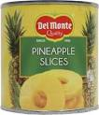
The challenge of classification
Some products are hard to
classify… even for humans!
01.1.6.4 Preserved fruit & fruit-based products
preserved fruit and fruit-based products,
dietary preparations and culinary ingredients
based exclusively on fruit, canned or tinned fruit
or
01.1.8.2 Jams, marmalades and honey
jams, marmalades, compotes, jellies, fruit purées, and pastes, natural and artificial honey, maple syrup, molasses and parts of plants preserved in sugar
https://pics.me.me/its-a-bird-s-it-30th-its-both-its-a-plane-42003647.png

Slide 7
The challenge of classification
Some products are hard to
classify… because of your (users) needs!
Milk
UHT
Pasteurized
Raw
Skimmed
Whole
Semi-skimmed
Specific low fat
organic
raw milk
Lactose free

Slide 8
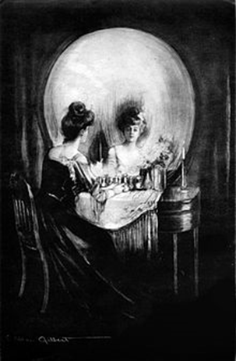
A multi-method approach
Find the ones that are hard to classify/misclassified often
Report them for human verification
But how?
Disagreement vs. consensus of different human judges seams to be an indication.
Does it work for different ML-models too?
http://2.bp.blogspot.com/_9RCN1r0EalU/TS2kuJryrmI/AAAAAAAAAEs/Jpat0WrJECs/s1600/scary+optical+illusions6.jpg

Slide 9
Current classification process
Current ECOICOP Database
Precondition: Significant one-off effort of manual classifying
of tens/hundreds of thousands of products
Current Article Master Tables
1. Article Number Match (SAS)
2. GTIN and Article Name Matching (Preprocessing, Similarity check - SAS)
New Article(number)
No Match (Real New Article)
3. ML-Process, ECOICOP Classification (R)
Match
Consensus Result
Result without Consensus
Updated ECOICOP Database I.
Articles for Manual Coding
Updated ECOICOP Database II.
4. Selection of Article with significant Revenue (SAS)

Slide 10
ML-Approaches
Naive Bayes (NB; library(e1071))
Support Vector Machine (SVM; library(e1071))
Random Forrest (RF; library(ranger))
Gradient Boosted Trees/XGBoost (XGB; library(xgboost))
Linear Discriminant Analyses (LDA; SAS)

Slide 11
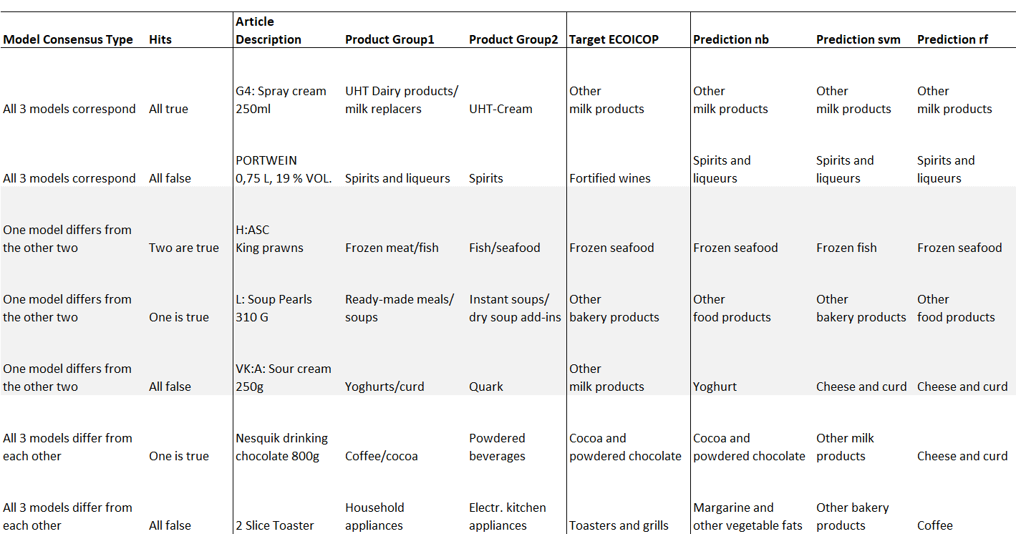
Results Consensus vs. Disagreement Examples
Products of a discount supermarket chain - 50% test-/train-split (4.388 products in test)
✓
✓
✓
N =
3.926
X
X
X
N =
192
✓
X
✓
N =
151
X
✓
X
N =
65
Selected for manual classification
X
X
X
N =
29
✓
X
X
N =
19
X
X
X
N =
6
Σ = 270

Slide 12
Range of classification methods
-manual classification (possibly with suggestions based on past classifications) - (semi) supervised classification - probabilistic classification - machine learning methods - word embeddings

Slide 13
Classifying transaction and web scraped data
NTTS 2021
Ingolf Boettcher
Adam Tardos
Manuel Koller
Statistics Austria
ingolf.boettcher@statistik.gv.at
adam.tardos@statistik.gv.at
manuel.koller@statistik.gv.at

