Slide 1
Using administrative data and machine learning to address nonresponse bias in establishment surveys
Evidence from the IAB-Job Vacancy Survey
Benjamin Küfner (Presenter)
Joseph W. Sakshaug
Stefan Zins
Notes:
- Ph. D student at the Institute for Employment Research in Germany
- Joint work on nonresponse bias and nonresponse bias adjustments
- In particular, we analyze the IAB-Job Vacancy Survey and investigate how administrative data and machine learnig help us to analze and address nonresponse bias

Slide 2
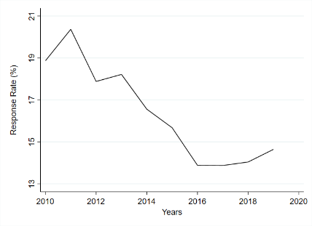
INtRoduction
IAB-Job Vacancy Survey is facing a decreasing response rate during
the last decade
Risk of nonresponse bias
Administrative data is getting more and more available for establishment surveys (e.g. Bavdaž et al. 2020)
More establishment-level information on respondents and nonrespondents to analyze survey participation and nonresponse bias
Growing and promising literature on machine learning in nonresponse prediction (e.g. Earp et al. 2018, Kern et al. 2019) and nonresponse adjustment (e.g. Buskirk & Kolenikov 2015, Lohr et al. 2015)
Improvements of nonresponse adjustment weights due to data-driven approaches possible
Research Objectives:
Investigation of nonresponse bias based on administrative data
Evaluation of administrative data for nonresponse adjustments
Evaluation of machine-learning methods for nonresponse adjustments
Notes:
Response Rate.
The IAB Job Vacancy Survey is facing decreasing response rate
Starting from about 20 percent in 2010, decreased to around 14 percent in recent years
Strong decrease in the first half of the decade, stabilizing in the second half of the decade
However, this comparably low response rate implies a risk of nonresponse bias
Administrative data:
We see that administrative data on establishment level gets more and more available.
Can be used to improve and validate establishment surveys
Administrative data for respondents and nonrespondents, which helps us to analyze survey participation
Machine-Learning:
More and more studys documenting potential of machine learning in nonresponse prediction and nonresponse adjustment
So there is a big potential to improve establishment surveys
Research Objectives:
Bring all points together
Use administrative data to asses nonresponse bias
Exploit the administrative data to improve the nonresponse adjustment procedure
More variables increased number of potential variables, machine-learning approaches to detect high-level dependencies

Slide 3
Data
IAB Job Vacancy Survey (Bossler et al. 2020)
Annual and voluntary establishment survey conducted in the fourth quarter each year
Analyzing vacancies, job flows and recruiting processes
Full sample consists of up to 110,000 establishments
Stratified sample (region, industry, establishment size)
Establishment History Panel (BHP) (Ganzer et al. 2020)
Administrative data for all establishments contributing to social security in Germany
Yearly aggregation of the administrative records (reference date: 30th of June)
Establishment characteristics: age, industry, establishment size etc.
Employee characteristics aggregated to establishment level: age, wage, sex, qualification etc.
Linkage
Unique establishment identifier
Due to data privacy regulations the linkage of the IAB-JVS to the BHP prior to 2010 is not possible
We can link about 95 % of all sampled establishments between 2010-2018
Different reference dates between sampling frame and BHP make 100% record linkage impossible
Notes:
Briefly introduce our data:

Slide 4
Methods for Nonresponse Bias Analysis
Comparing respondents and full sample with respect to administrative data
Formulas:
$NR Bias= {\hat{Y}}_{i,r}−{\hat{Y}}_{i,n}$ (1)
$Abs. NR Bias= \left|{\hat{Y}}_{i,r}−{\hat{Y}}_{i,n}\right|$ (2)
$Avg. abs. NR bias= \frac{\sum_{i=1}^{K}{\left|{\hat{Y}}_{i,r}−{\hat{Y}}_{i,n}\right|}}{K}$ (3)
Categorization of administrative data into equally sized categories
Inclusion probabilities are considered in the estimation
Notes:
So how do we measure nonresponse bias:
Gernerally, we compare target estimtates of respondents and the full sample.
To give equal weight over and underrepresentation we use the absolute bias, which is the absolute value of the NR bias.
To get an average bias measure across different target estimates we average all available estimates. Additionally, we compare two subset of variables. Establishment and employee characteristics.
For this reason we categorize all variables into equally sized categories
In all estimations, we take inclusion probabilities into account.

Slide 5
Nonresponse Bias
Reassuringly low level of nonresponse bias
No clear trend in nonresponse bias across years
Nonresponse bias with respect to establishment characteristics is higher than for employee characteristics.
Notes:
Let’s turn to the results. The solid line represents average absolute bias across all administrative bias estimates.
Generally speaking, the nonresponse bias is reassuringly low and on average below 2 percent. This is especially important as our response rate is below 20 percent.
In addition, we see no clear noresponse bias trend during our observation period. Although the response rate decreases, the average nonresponse bias estimates is below and above 1.5 percent.
If we look more on details, we see that establishment characteristics have higher nonresponse bias values than the employee characteristics.
Particular single bias estimates show severe biases, which are not shown here. Such examples are some industry groups and the indicator whether an establishment closes the year after the survey.

Slide 6
Methods for Nonresponse Adjustments
Comparing regression and machine learning modeling approaches to estimate response propensities
Regression
Logistic (with and without extended set of administrative Variables)
Lasso (including second term polynomials)
Ridge (including second term polynomials)
Generalized Additive Models (GAM)
Generalized Additive Model Selection (GAMSEL)
Machine-Learning:
Classification and Regression Trees (CART)
Conditional Inference Trees (C-Tree)
Model-based recursive portioning (MOB)
Random Forest
Extreme Gradient Boosting (XG-BOOST)
Bayesian Additive Regression Trees (BART)
Weighting strategy:
Response Propensity Weighting
Trimming weights at the 99th percentile
Multiplication of design weights (i.e. inclusion probabilities) with inverse of response propensity
Evaluate nonresponse adjustment methods on two bias measures:
Average absolute bias by leaving the variable out of the response propensity estimation, on which the bias is measured
New Hires
Notes:
Now we want to use this additional data to improve our nonresponse adjustment procedures:
Basically, we do response propensity weighting and use the admin data and differten modelling strategies to estimate response propensities.
First we estimate response propensities using an logististic regression (with and without an extended set of administrative variables as auxiliary data. This helps us to asses whether the additional data help to reduce nonresponse bias.
Afterwards we compare several ML-methods on the extended set of administrative data. We use regression approaches like Lasso, Ridge, Generalized Additive Models and Generalized Additive Model Selection.
And Machine-Learning methods: Here we use single Tree methods like Cart, C-Tree or MOB and ensemble tree methods like random Forest, XG-Boost and Bart.
As I said: we use response propensity weighting and we trim our weights at the 99th percentile and multiplicate them afterwards with the design weights to account for unequal inclusion probabilities.
We use two different measures two asses the efficacy of these nonresponse adjustment procedures:
We use the average absolute bias introduced in the proceeding slides. To avoid overfittig we exclude the variable out of the propensity estimation, on which the bias is measured
Secondly, we use the number of new hires as a second validation statistics. This variable is especially interesting because it could be seen as a proxy for vacancies, which is obviously the most important survey variable. The idea behind it is that, vacancies will led to hirings in the future. Additionally, it is not part of the set of auxiliary variables.

Slide 7
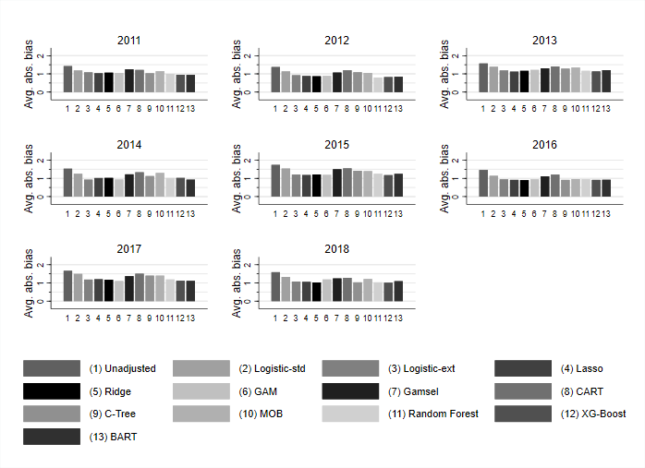
NonResponse Adjustment – Avg. Nonresponse Bias
Extended set of variables reduces nonresponse bias compared to the standard set of variables
Evaluation of ML-methods:
Ensemble tree methods work better than single tree-methods
Regression approaches (incl. logistic regression) perform similarly to ensemble tree methods
No clear winner across years
Notes:
This figure shows the average nonresponse bias separately for all years and weighting strategies. A lower values implies less nonresponse bias.
Bar 1 is the unadjusted nonresponse bias. To asses the impact of the extended set of administrative variables we have to compare bar 2 and bar 3. Throughout the years the extended set of variables reduces nonresponse bias more.
Comparing all used machine-learning methods. There is no clear winner across the years. It always depends on the year you are looking at. However, it is evident, that the ensemble tree methods work better than the single tree methods.
Also the regression approaches perform quite well and on a comparable level to ensemble tree methods This includes the standard logistic regression.

Slide 8
NonResponse Adjustment - New Hires
Similar conclusion:
Extended set of administrative data improves nonresponse adjustment procedure
Regression and ensemble tree methods work better than single tree methods
Notes:
This figures shows the performance with respect to new hires. The reference line shows the full sample estimate.
With all methods we underestimate the number of hirings. However the conclusion is similar to the average bias measure. The extended set of administrative variables helps to improve nonresponse bias with respect to the number of hirings.
We see that the ensemble tree methods and the regression approaches perform also in this application similar. In the year 2015 the standard logistic regression perform remarkably well.

Slide 9
Conclusion
Response rate decreased by about 6 percentage points between 2010 and 2019
Nonresponse Bias:
Nonresponse Bias is on average at a reassuringly low level
No clear trend of nonresponse bias during the observation period
Nonresponse adjustment:
Extended set of administrative data improves nonresponse adjustments
There is only limited evidence that ML-methods can help to reduce nonresponse bias compared to the standard approach
→ Selection of variables are more important then the used method
Notes:
To sum up:
The response rate of the IAB-Job vacancy survey decreased by about 6 percentage points between 2010 and 2019
The corresponding nonresponse bias is at a reassuringly low level
We don’t obersve a clear trend of nonresponse bias during the observation period
Nonresponse adjustments benefit from more administrative data as auxiliary variables
With repsect to machine-learning methods we see only limited evidence that these coud outperform more conventional regression approaches
-> We see this as evidence that the availability and selection of auxiliary variables is more important than the used mehtod

Slide 10
References
Bavdaž, M., Snijkers, G., Sakshaug, J. W., Brand, T., Haraldsen, G., Kurban, B., Saraiva, P. and Willimack, D. K. (2020) Business data collection methodology: Current state and future outlook. Statistical Journal of the IAOS,36, 1–16.
Bossler, M., Gürtzgen, N., Kubis, A., Küfner, B., & Lochner, B. (2020). The IAB Job Vacancy Survey: design and research potential. Journal for Labour Market Research, 54(1), 1-12.
Buskirk, T. D., & Kolenikov, S. (2015). Finding respondents in the forest: A comparison of logistic regression and random forest models for response propensity weighting and stratification. Survey Methods: Insights from the Field, 1-17.
Earp, M., Toth, D., Phipps, P., & Oslund, C. (2018). Assessing nonresponse in a longitudinal establishment survey using regression trees. Journal of Official Statistics, 34(2), 463-481.
Ganzer, A., Schmidtlein, L., Stegmaier, J., & Wolter, S. (2020). Establishment History Panel 1975-2018 (No. 202001_en). Institut für Arbeitsmarkt-und Berufsforschung (IAB), Nürnberg [Institute for Employment Research, Nuremberg, Germany].
Kern, C., Klausch, T., & Kreuter, F. (2019). Tree-based machine learning methods for survey research. In Survey Research Methods (Vol. 13, No. 1, pp. 73-93).
Lohr, S., Hsu, V. and Montaquila, J. (2015) Using classification and regression trees to model survey nonresponse. Paper presented at Joint Statistical Meetings, Seattle.
Notes:
These are my references

Slide 11
Thank you for your Attention!
Benjamin Küfner
benjamin.kuefner@iab.de
Notes:
Thank you for your attention.

