Slide 1
Distributional national accounts for household income and consumption Radoslav ISTATKOV (speaker) Friderike OEHLER Florian PALLARO EUROSTAT
Conference on New Techniques and Technologies for Statistics, 2021
NTTS2021

Slide 2
Background
Need for reinforced social indicators
in line with the EU reinforced macroeconomic governance
help assess social impacts of economic policies and economic impacts of social policies
Eurostat centralised exercise for compiling distributional national accounts for household income and consumption

Slide 3
Methodology: data sources
Input data
National accounts for sector Households
Adjusted for population not covered in social surveys (mainly institutional households)
EU-SILC (income) and HBS (consumption)
Reference year
Income – 2015
Consumption – as reported within HBS 2015 wave
Item breakdown
Income: 10 aggregate income items
Consumption: 12 main COICOP categories

Slide 4
Methodology: micro-macro gap allocation methods
M.1 Proportional allocation
Gap distributed proportionally over households
Micro data distribution is close to the "real" distribution
M.2 Pareto tail modelling
Top 10% households adjusted to conform to a Pareto distribution
Remaining gap allocated proportionally over all households
M.3 Ascending/descending gap shares by quintile
M3.1: gap shares 0%, 10%, 20%, 30%, 40% to Q1, Q2, Q3, Q4, Q5
M3.2: gap shares 40%, 30%, 20%, 10%, 0% to Q1, Q2, Q3, Q4, Q5
M.4 Combined approach
M.2: ‘property income (received)’, ‘mixed income’, ‘wealth taxes’
M.1: all other items

Slide 5
Results
Clustering households
Quintiles according to equivalised total disposable income
Modified OECD equivalence scale
Accounts for differences in the size and composition of households
Sensitivity analysis
Measuring the impact of method choice
Indicators
Gini coefficient, %
Q5/Q1 ratio

Slide 6
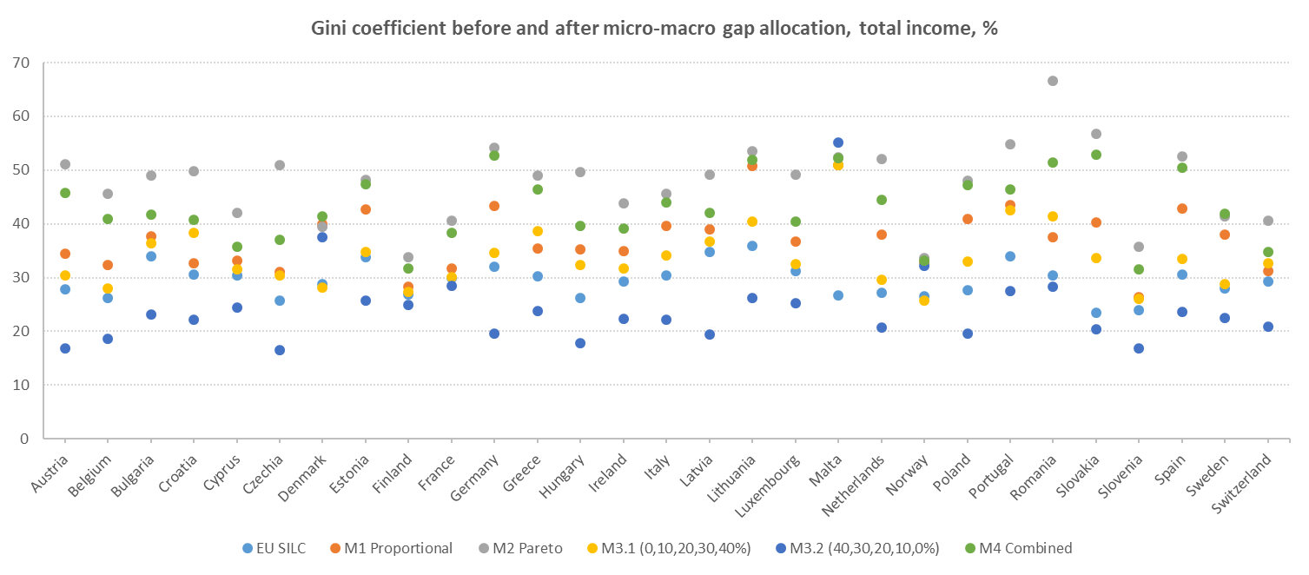
Conclusion: sensitivity indicators (disposable income)

Slide 7
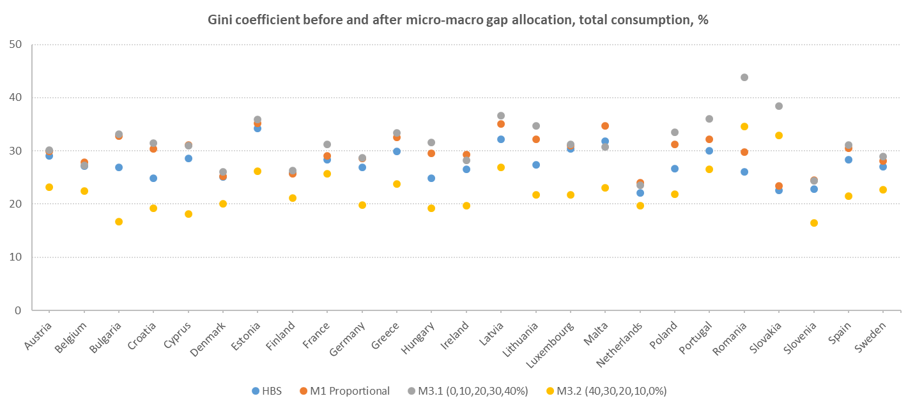
Conclusion: sensitivity indicators (consumption)

Slide 8
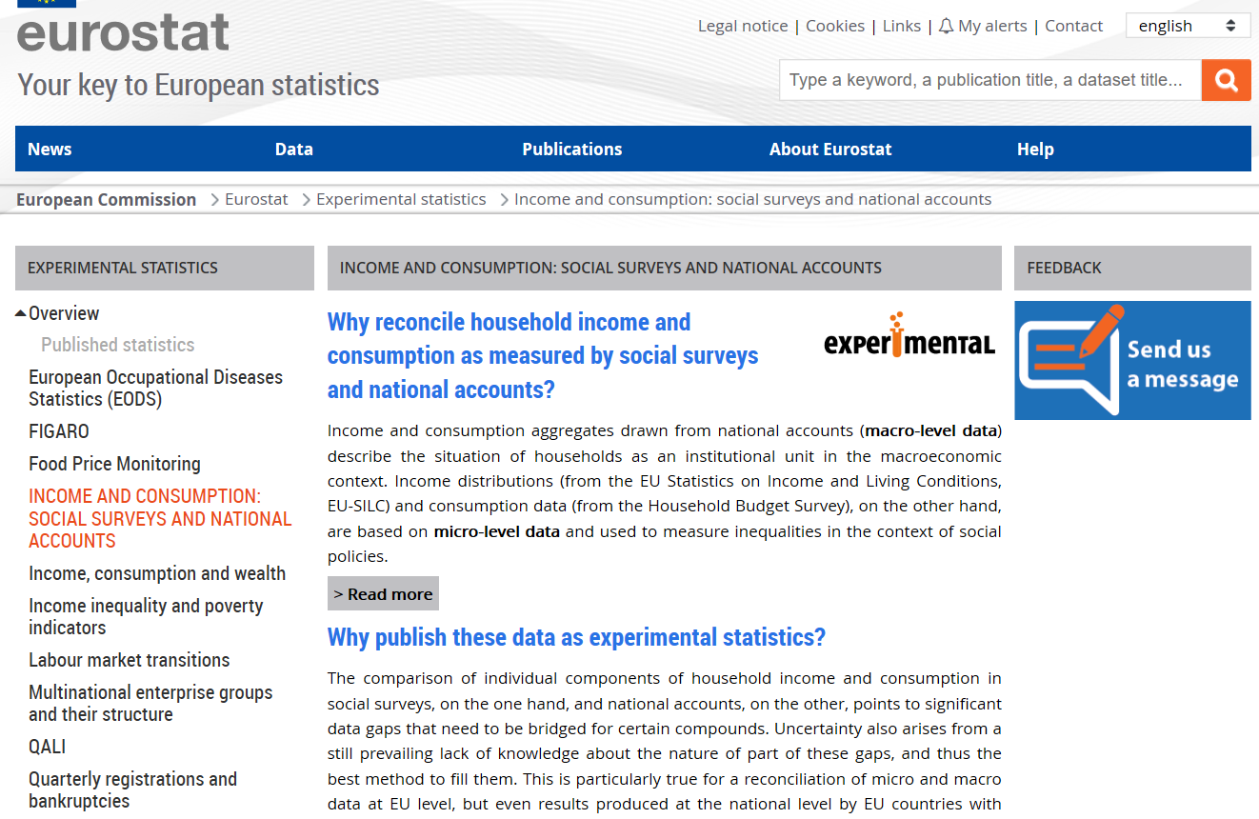
Thank you
Results published as experimental statistics
https://ec.europa.eu/eurostat/web/experimental-statistics/ic-social-surveys-and-national-accounts
E-mail:
ESTAT-ICW@ec.europa.eu

