Slide 1
Nonresponse in the Icelandic Labour Force Survey during Covid-19
Conference on new techniques and technologies for statistics 2021
Presented by
Arndís Vilhjálmsdóttir
Expert
Administration & cooperation
in conversation with
Anton Örn Karlsson
Head of Unit
Labour market, living conditions and demography

Slide 2
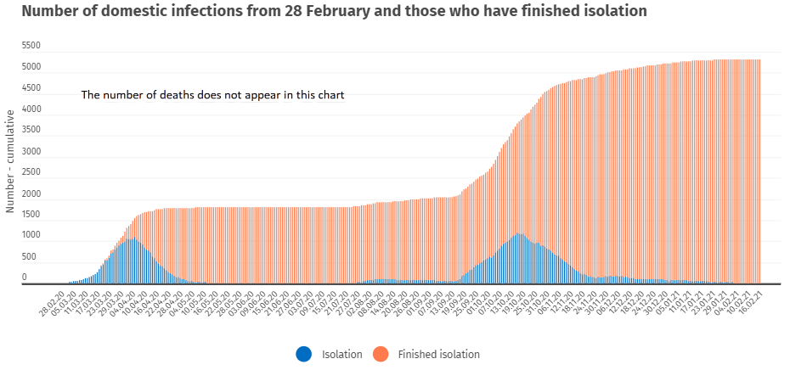
Covid-19 in Iceland
Ref: https://www.covid.is/data

Slide 3
The Icelandic Labour Force Survey (IS-LFS)
Strengths
Challenges
Computer assisted telephone survey („cheap“)
Sample from Registers Iceland Population registry
Auxilary data from registry
Registers Iceland
Educational registry
Directorate of Labour
Mismatch between unemployment numbers compared to Directorate of Labour
Bruttosample vs.nettosample
“Unstable“ population estimates
..because of recalculation of weights
Decreasing response rates
Largest decrease among all EU-LFSs since 2011

Slide 4
Nonresponse in the IS-LFS during Covid-19

Slide 5
Response rates in the IS-LFS by nationality

Slide 6
Response rates in the IS-LFS by age

Slide 7
Figure 4. Type of nonresposne by nationality

Slide 8
Type of nonresposne by age

